Slide 1

Make your Garden
Pop with Perennials
Program by the Alabama Cooperative Extension System and Alabama Master Gardener’s

Slide 2
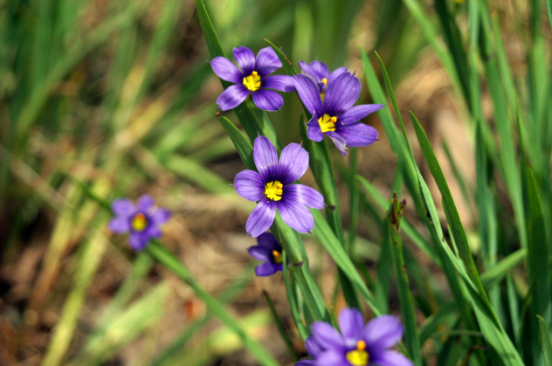
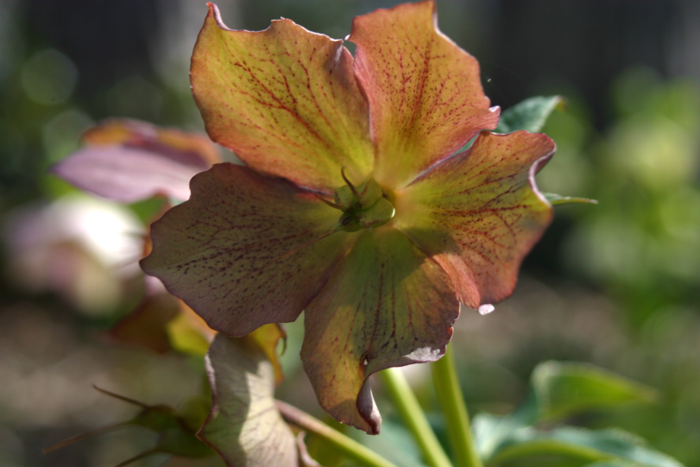
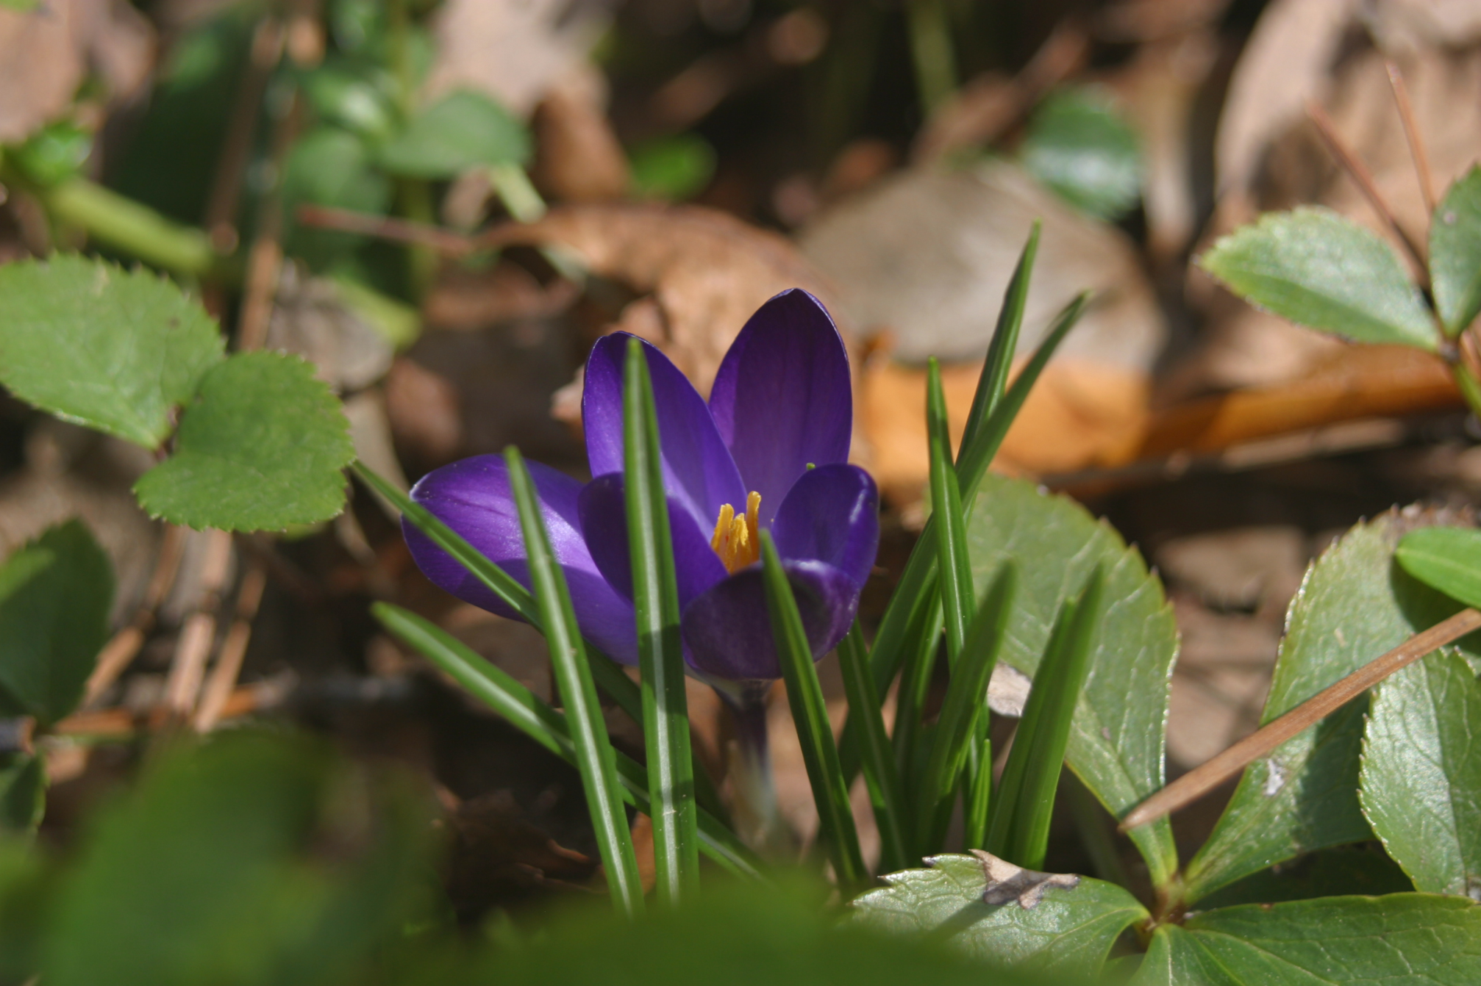
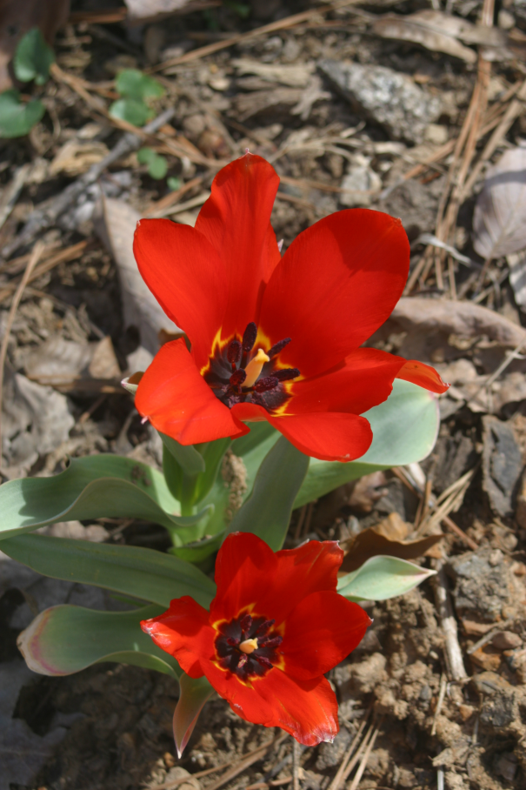
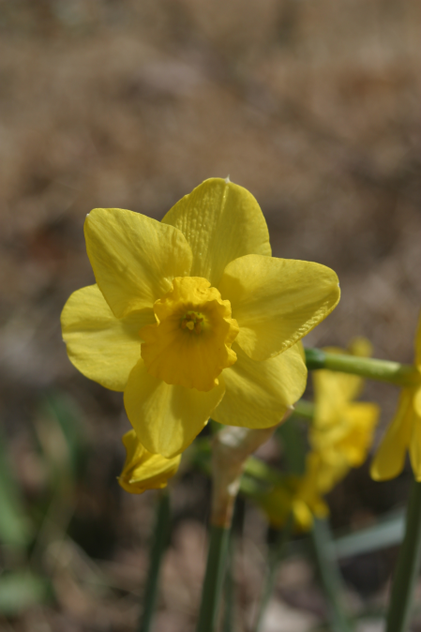
Make your Garden
Pop with Perennials
Notes:
When I was a child I hated the word garden. My daddy was a County Extension Chairman and owned a farm of several hundred acres. Like any good parent he believed children should help with the chores so I spent many hours on long, hot summer days working in the garden. However some of Daddy’s expertise did manage to rub off on me – possibly by osmosis!

Slide 3
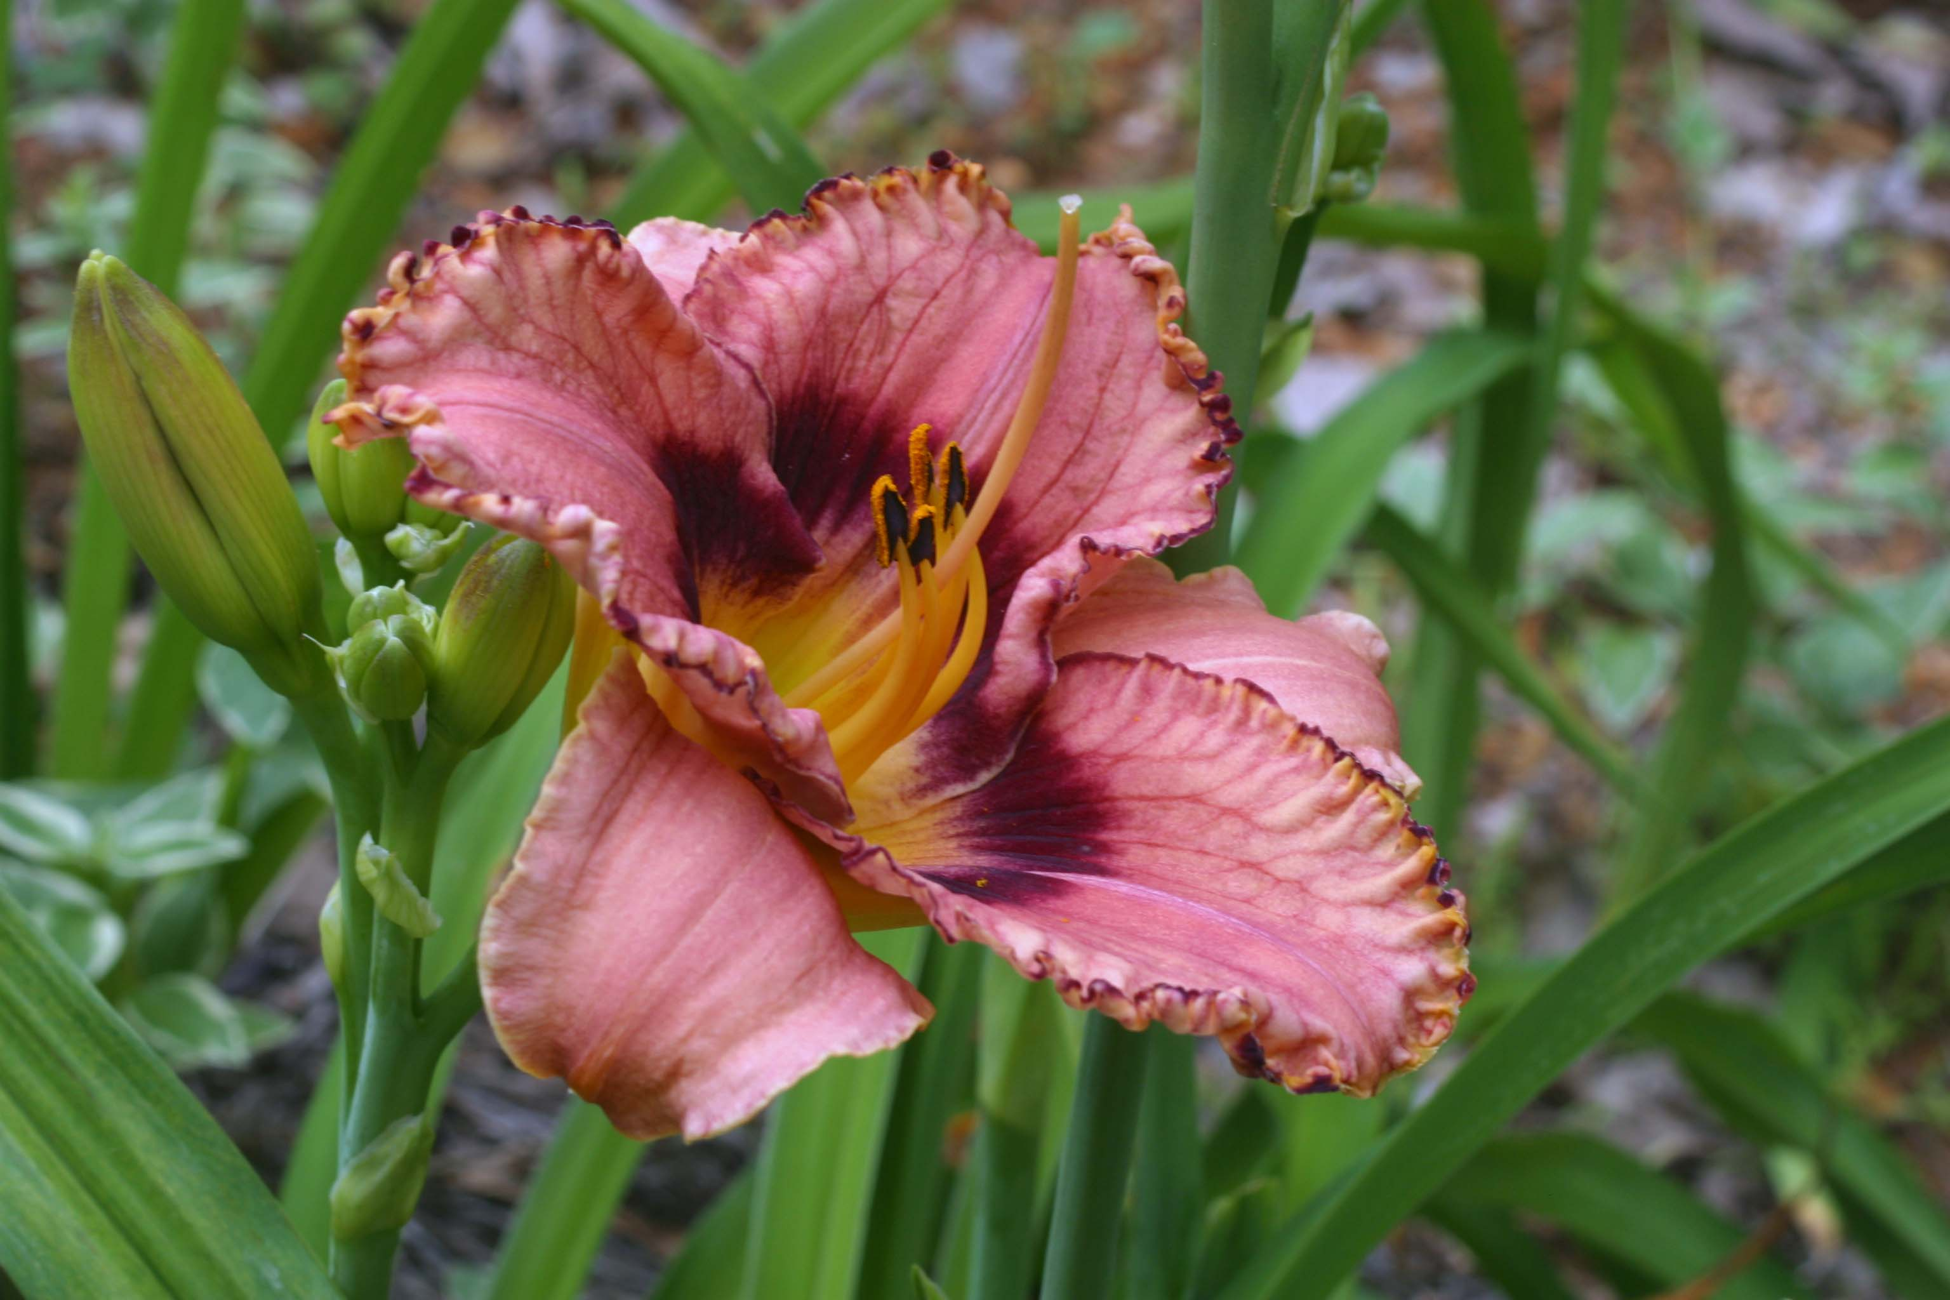
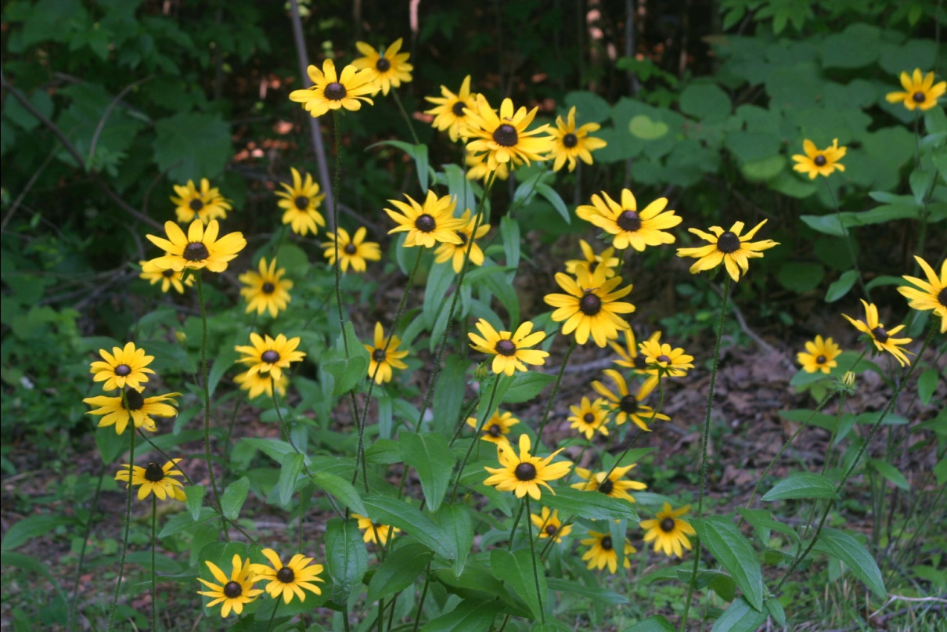
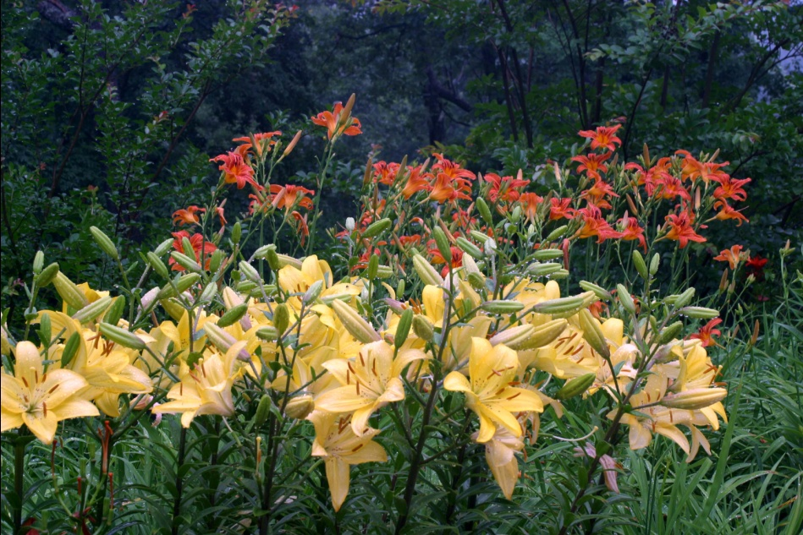
What Are Perennials?
A plant that had it not died immediately after planting would have lived for more than two years
Notes:
A perennial is any plant that survives a minimum of 2 years. They can vary in height from a couple of inches to over 6 feet. Perennials can thrive in any spot in the garden. Different varieties prefer sun, shade, dry soil, and wet feet so careful plant selection enables one to make all sections of the garden beautiful.

Slide 4
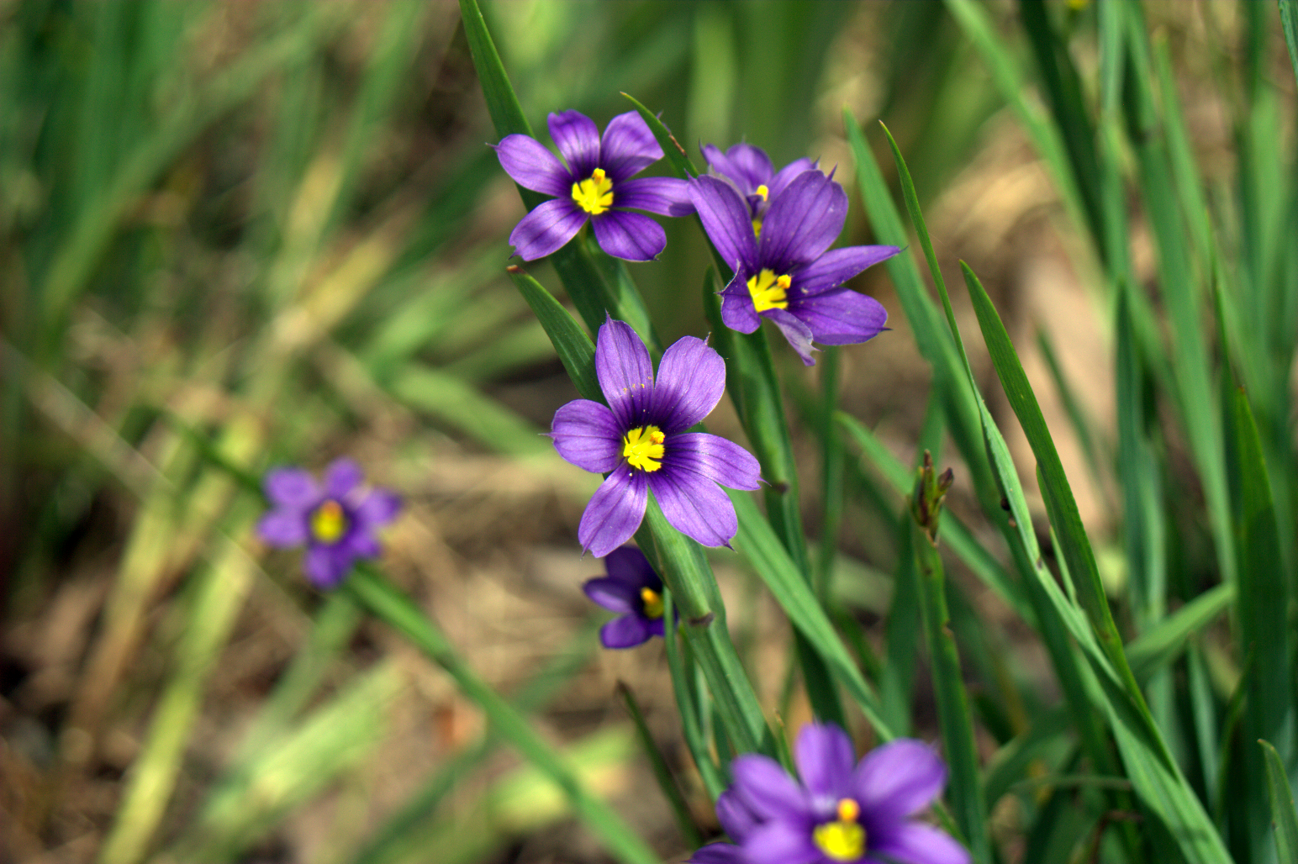
Why Perennials?
Notes:
I love Perennials! Why? Because I’m a lazy gardener! Perennials do not have to be replanted every year, but because they will remain in the same spot, proper bed preparation is essential.

Slide 5
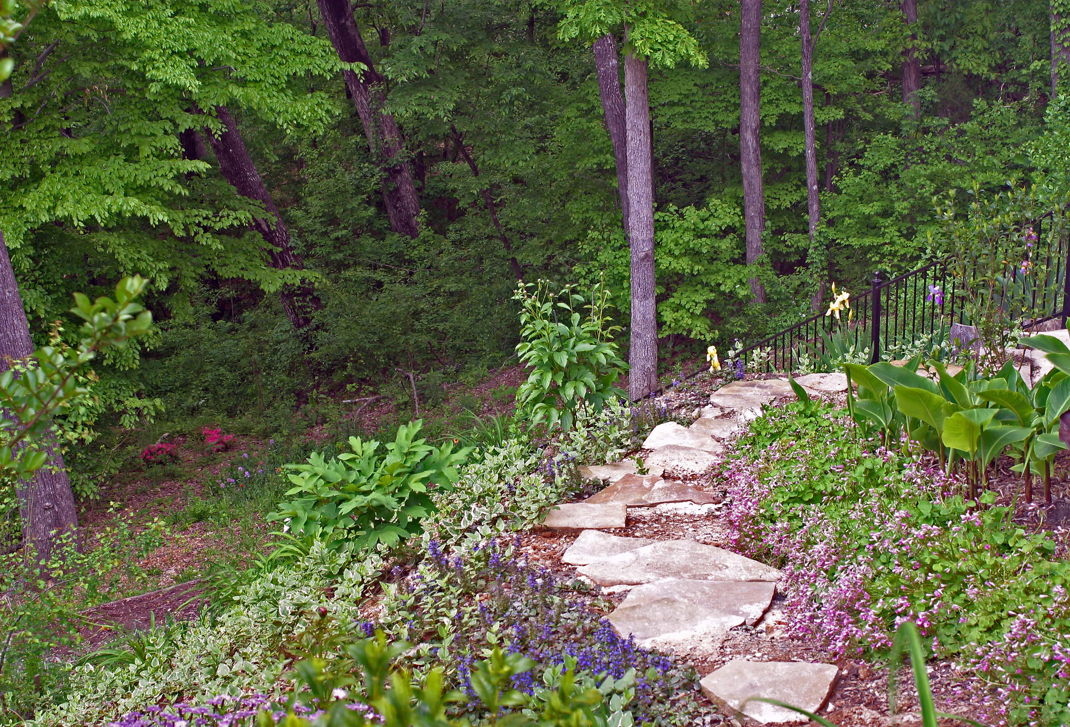
Bed Preparation
Remove all perennial weeds
Till the soil
Incorporate/fortify
Notes:
Incorporate/fortify - Add 3 to 4 inches organic matter to the bed to promote aeration and good drainage. Add both lime and fertilizer to the bed. Fertilizer should based on a soil test procured from the Extension Service. These tests only cost $7 and should be performed every 3 to 5 years because soil composition does change. Use 2 to 3 lbs. fertilizer per 100 sq. ft., 3 to 4 lbs. dolomitic lime per 100 sq. ft. Incorporate fertilizer, lime, and organic matter 8 to 12 inches deep.

Slide 6
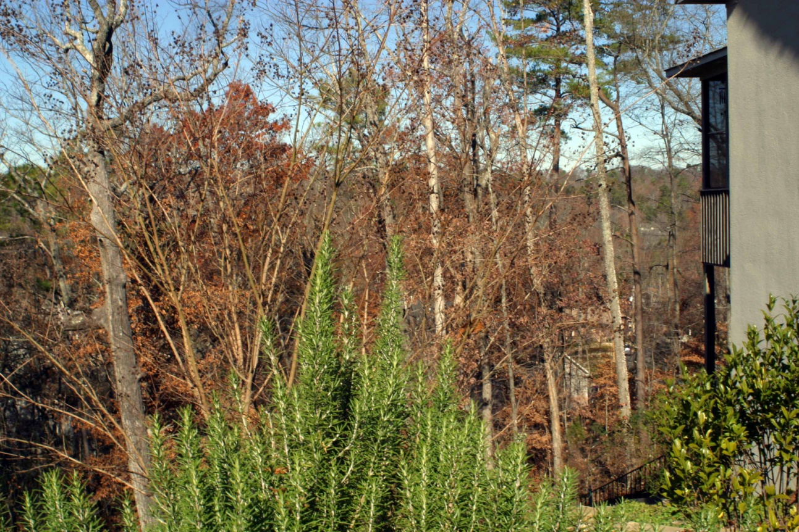
When to Plant
Fall
Early Spring
Notes:
The best time to plant perennials is in the fall because plants spend the winter developing their root system rather than expending energy on flowers and foliage. The next best time to plant is very early spring ASAP following the last frost. If this is done one must be much more conscientious about watering so the plants don’t dry out during our summer heat waves.

Slide 7
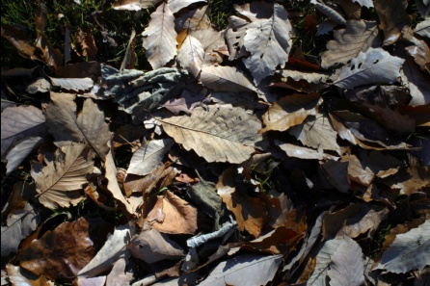
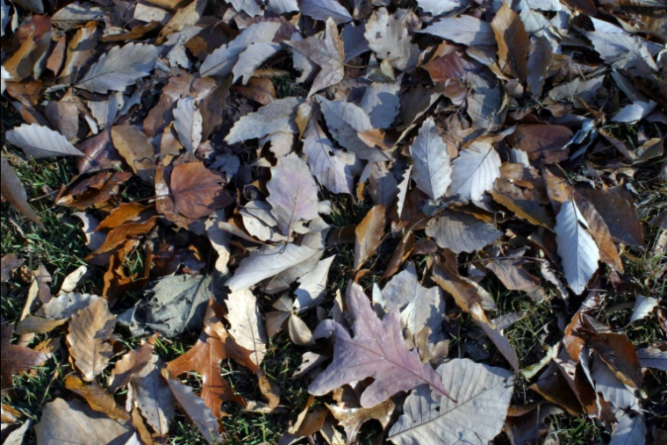

How to Plant
Determine spacing
Dig hole twice as wide as the root ball and only as deep as the root ball
Fill hole with water and observe drainage
Loosen roots
Plant crown at or slightly above ground level
Cover roots with soil
Notes:
Determine spacing – Check plant tag or gardening books for spacing between plants. A new, properly planted perennial bed will look sparse because the plants widen greatly as they age. Dig hole – hole needs to be twice as wide so it will be easy for plant roots to expand horizontally. Do not make hole deeper than the plant root ball! If hole is too deep, plant will tend to sink after a rain or watering. Fill hole with water. If the bed has been properly amended there should be no problem with drainage. Loosen roots – If plant is pot bound, loosen roots and spread in the bottom of the planting hole. Make sure the plant is at ground level or slightly above ground level. Firm soil lightly around the plant and water thoroughly at base.

Slide 8
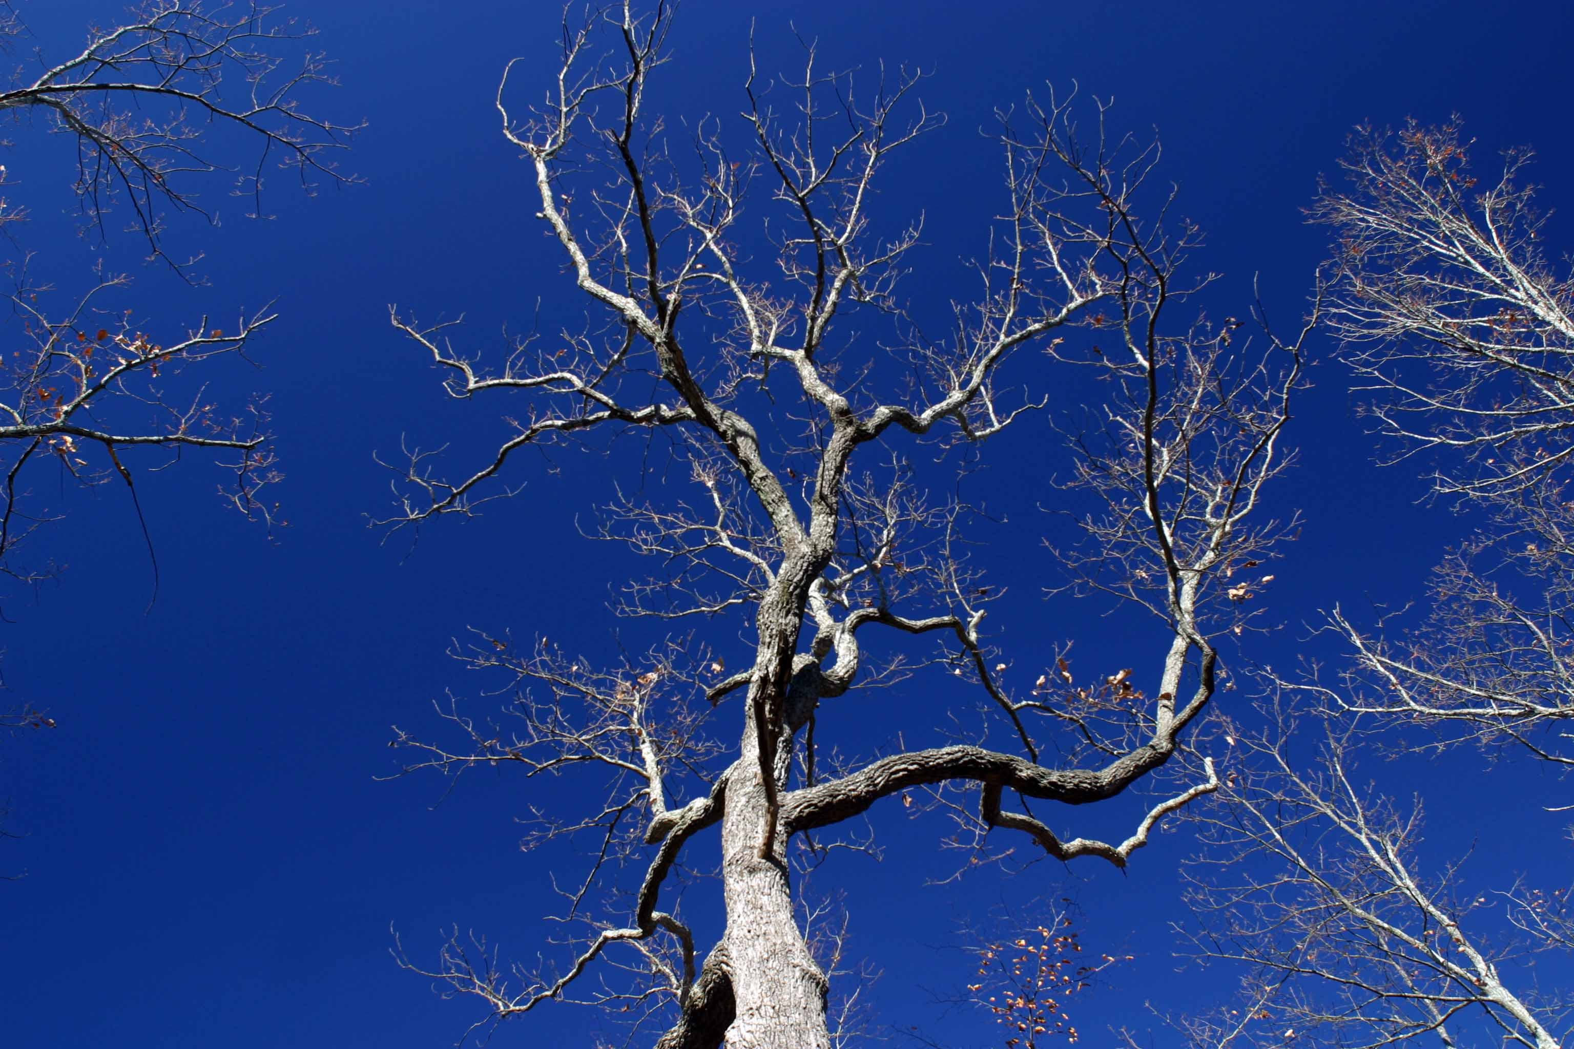
Maintenance Considerations
Weeding
Mulching
Staking
Deadheading
Feeding
Watering
Combating pests and weeds
Notes:
Once they are established, perennials are remarkably low maintenance. However no garden can be entirely maintenance free! These tasks need to be performed on a regular basis.
Weeding – Your plants will do better with less competition from undesirables for water and nutrients
Mulching – Keeps weeds to a minimum, retains moisture, nourishes plants as it disintegrates
Staking – Do it sooner rather than later
Deadheading – Promotes additional blooms and longer bloom time
Feeding – The more mulching done, less feeding needed. Nitrogen-rich (first number) fertilizer early in growing season helps build strong plant. Phosphate-rich (second number) at flowering time can improve the quality of bloom. Phosphorus is retained in the soil for a long time so be sure to have a soil test from the Extension Service performed before adding phosphorus. If there is already lots of phosphorus in the soil it doesn’t accomplish anything to add more.
Watering – 1 inch water per week, water deeply at base of plants rather than overhead watering.
There are too many pests and weeds to address in this talk. Be observant, pull weeds, and control pests before they become overpowering.
We will be covering plant pictures at a rapid clip. If you have questions about a particular plant, mark it on your handout and we will address questions after this talk is over.

Slide 9
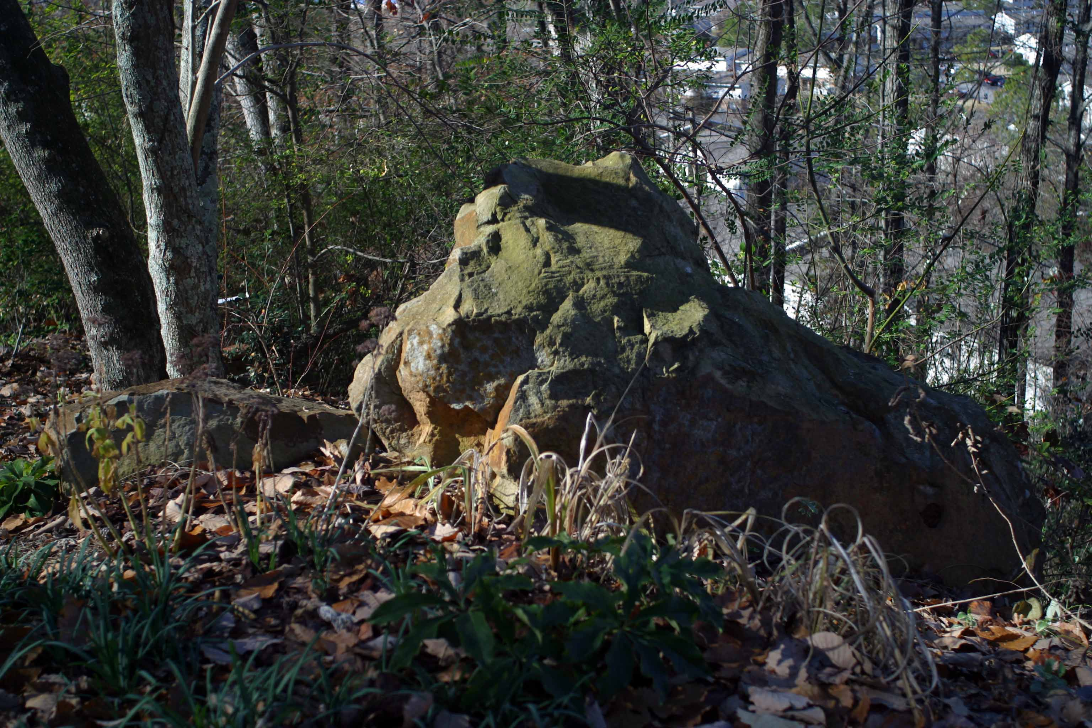
Year Round Interest
Notes:
All of the plants we are about to cover can thrive for many years. They can survive the drought and also wet conditions.

Slide 10
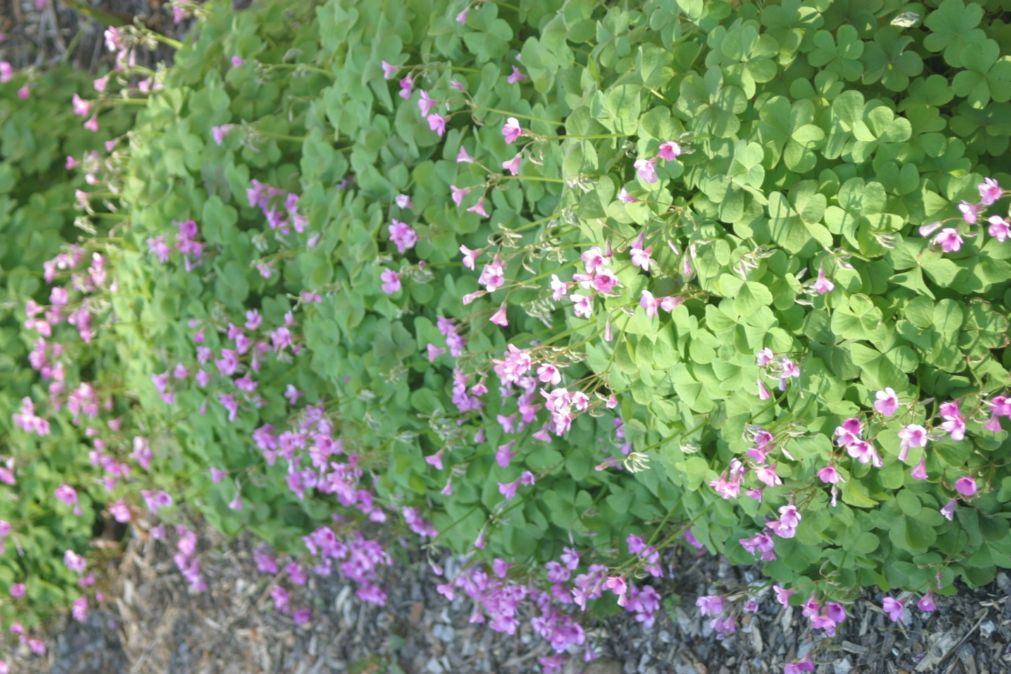
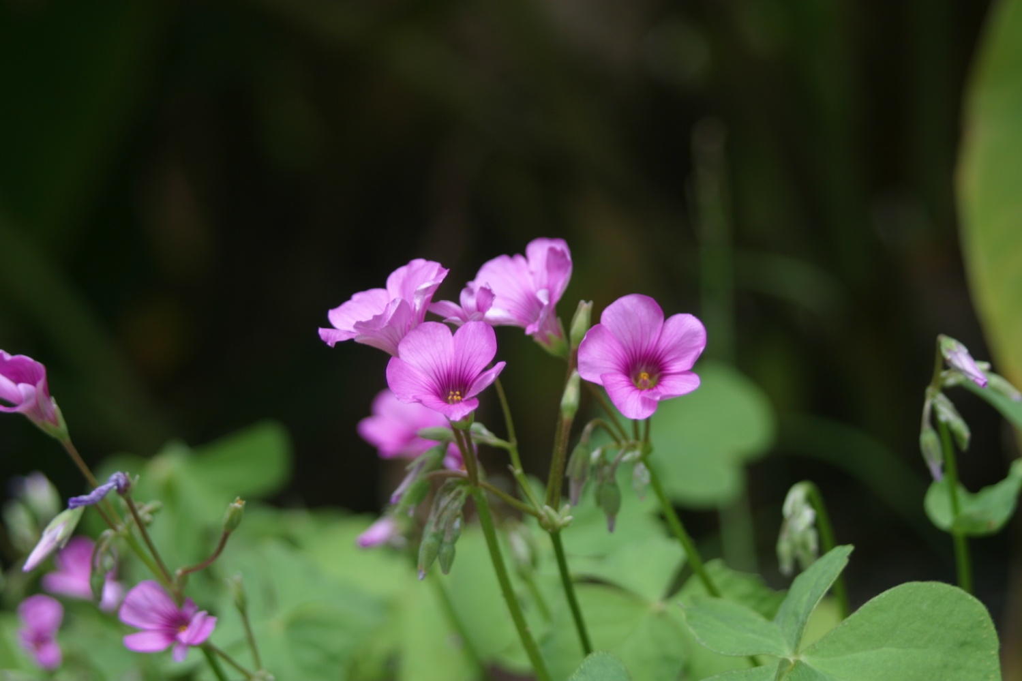
Oxalis
Wood Sorrel
Notes:
In our area Oxalis is an evergreen plant. It blooms from February or March until hard frost.

Slide 11
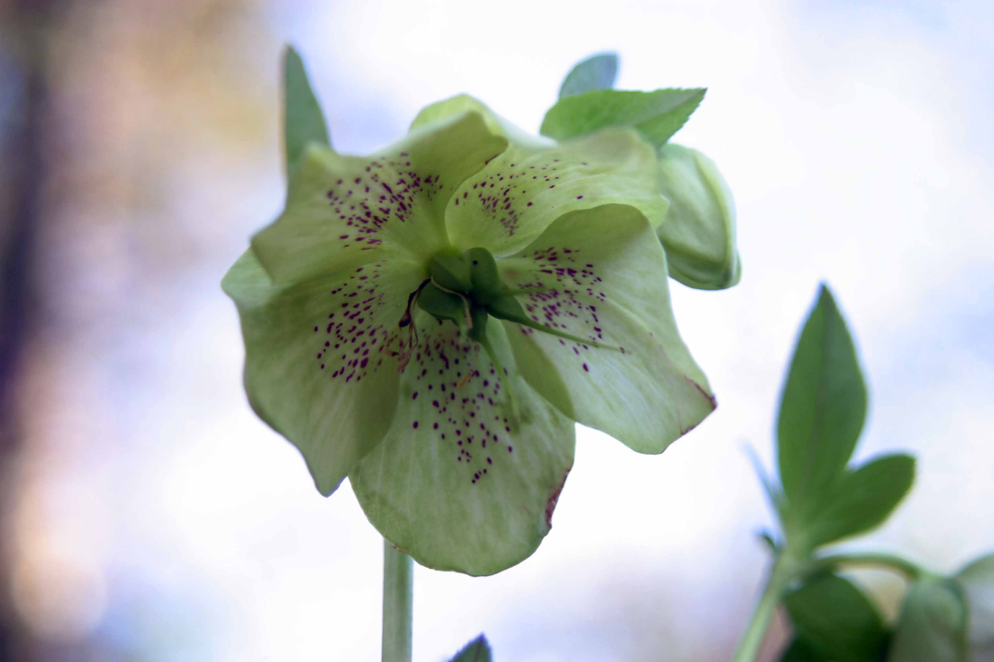
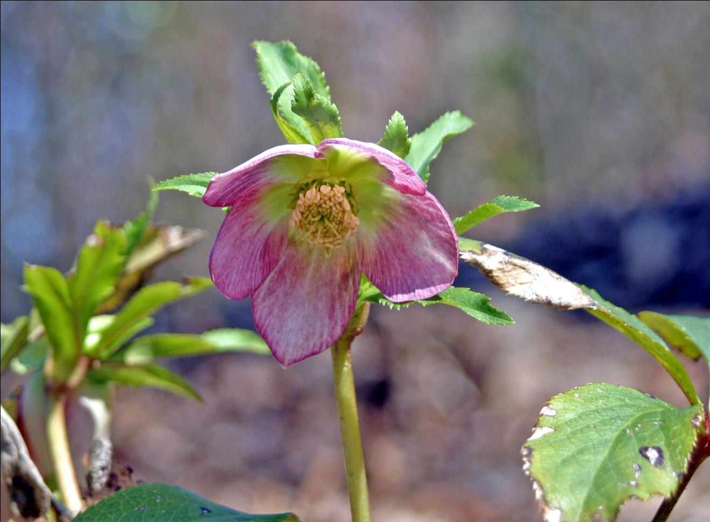
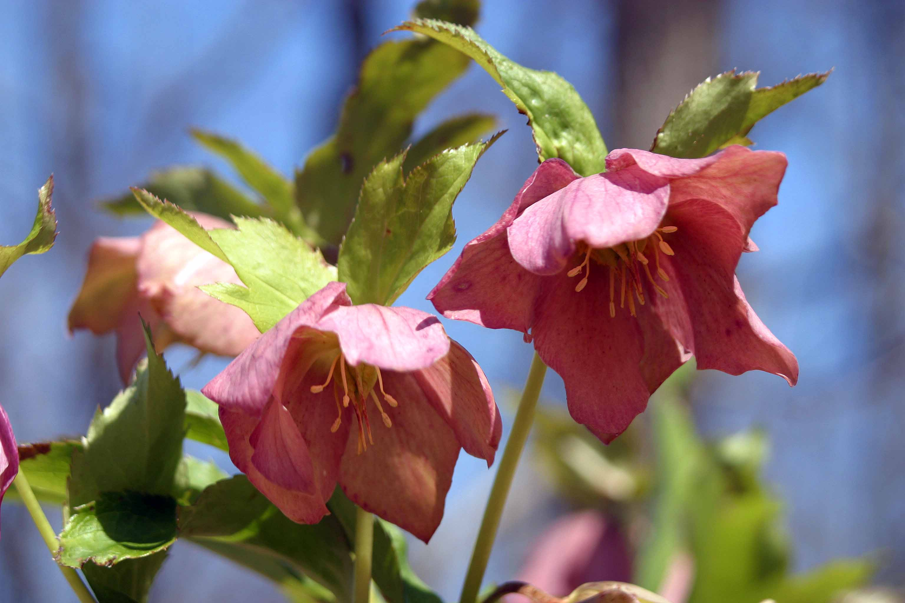
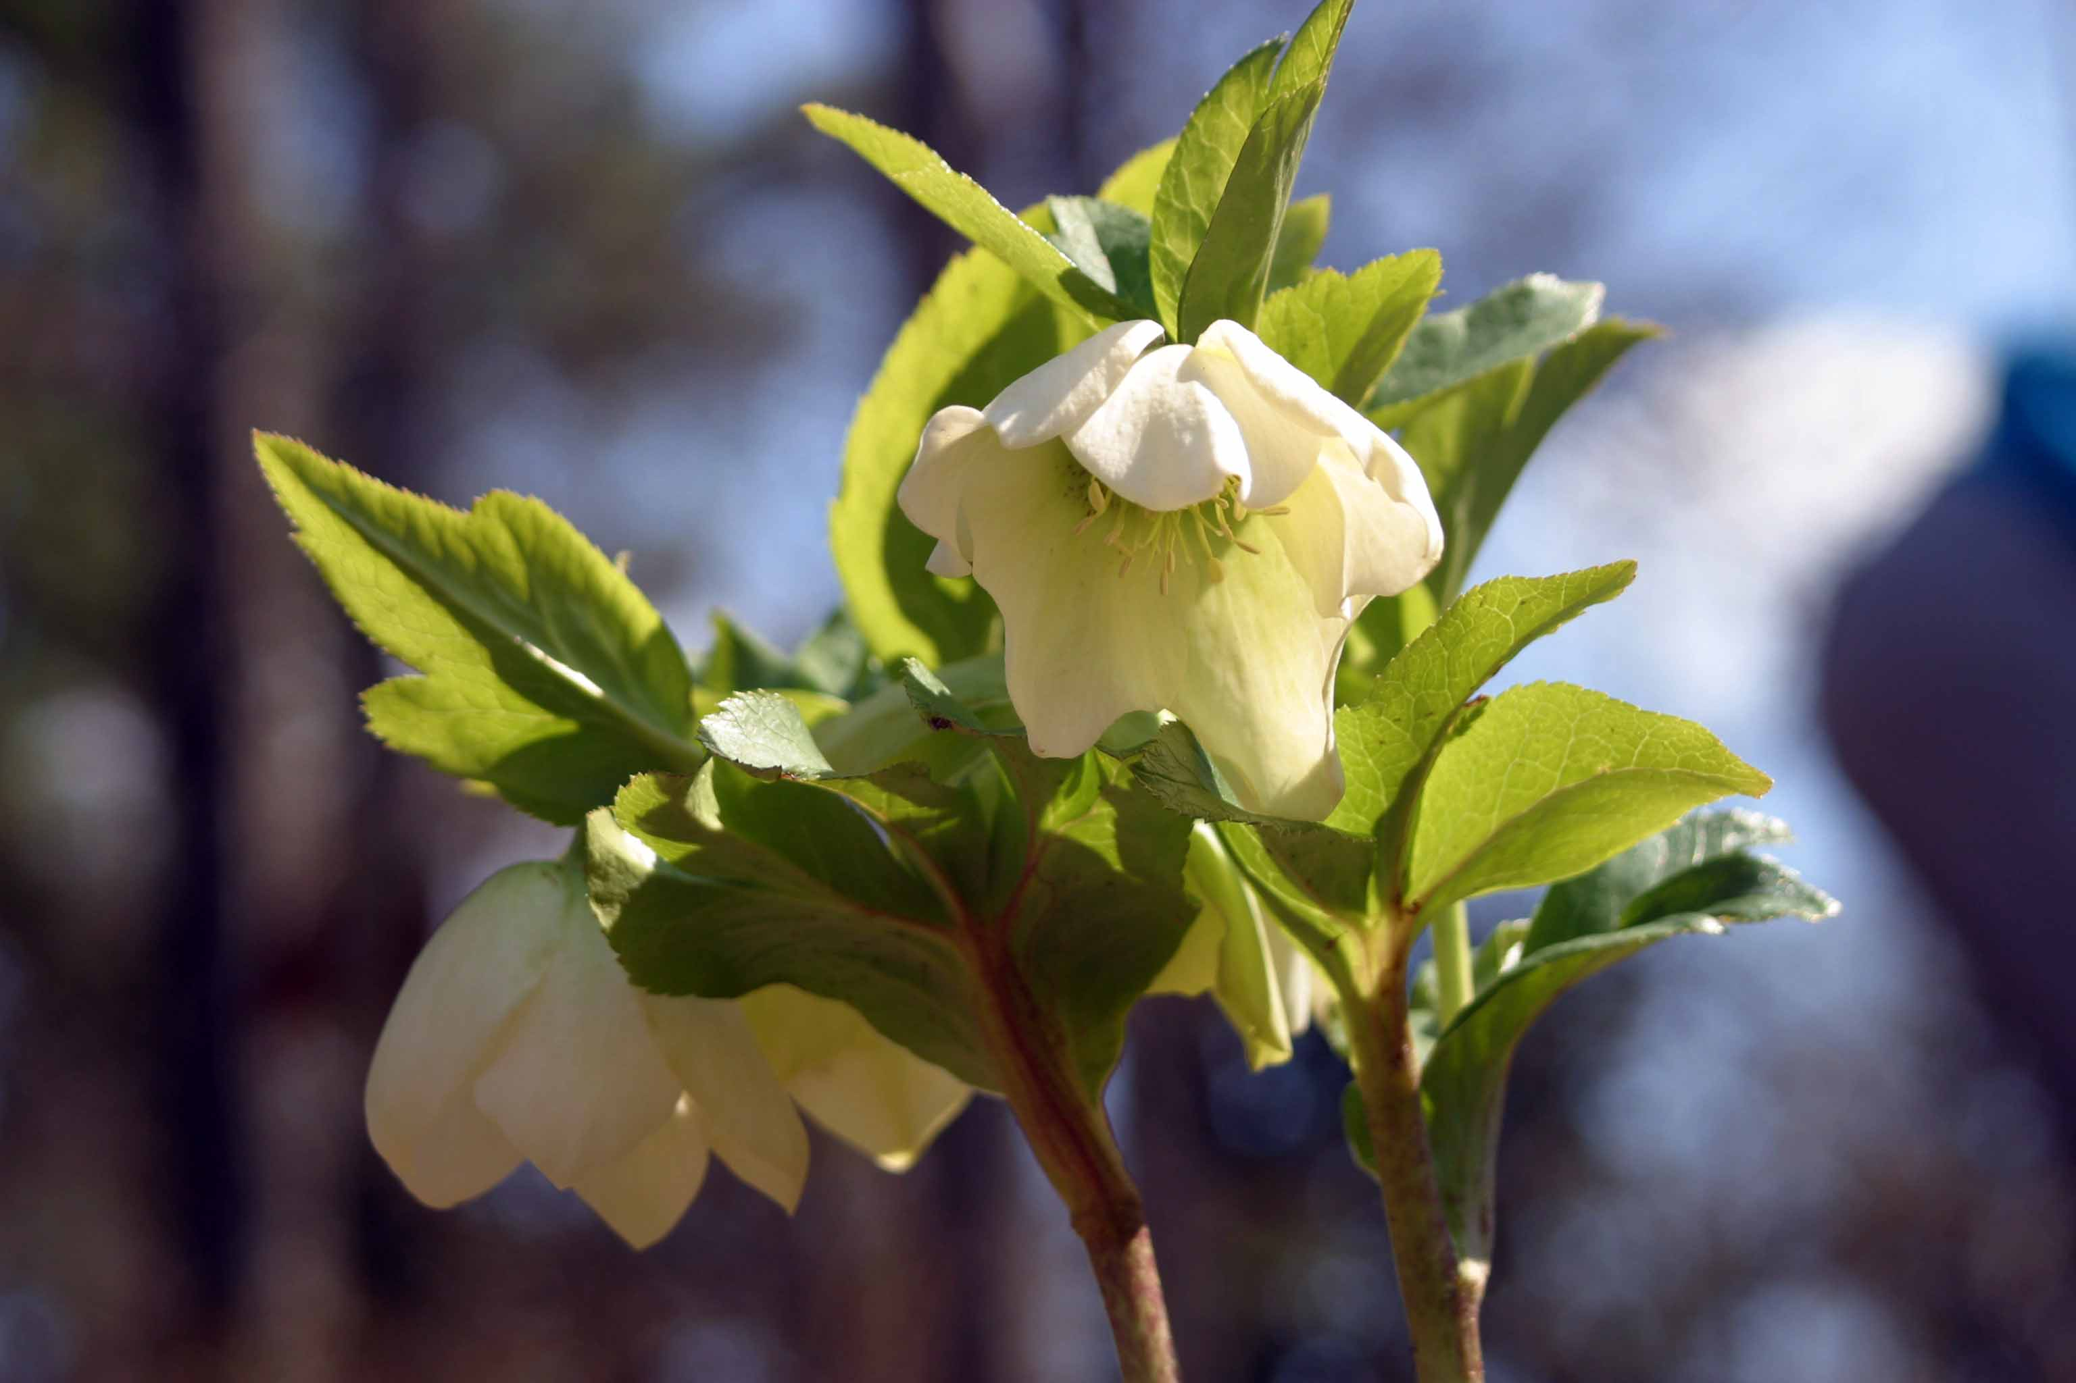
Helleborus
Christmas and Lenten Rose
Notes:
Helleborus is an evergreen plant. It should be planted in the shade under deciduous trees. Christmas rose starts blooming in December with Lenten rose starting to bloom in January with blooms continuing until April.

Slide 12
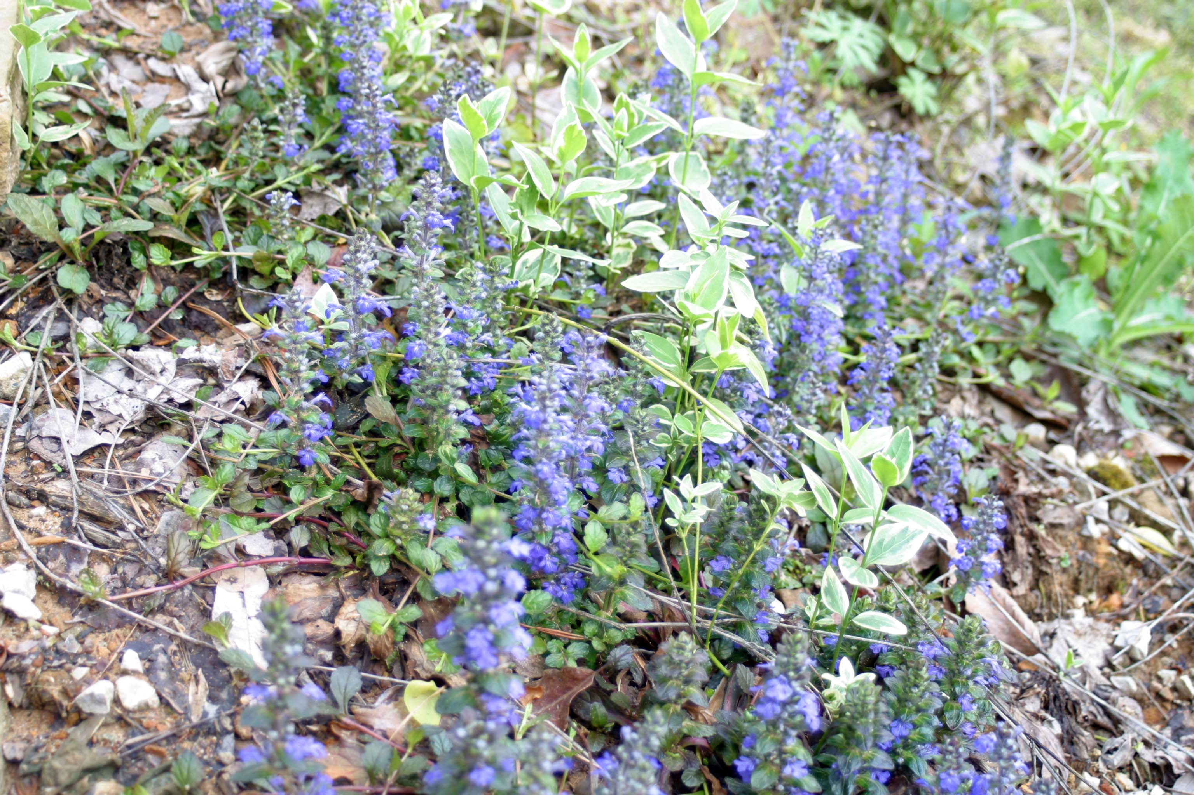
Ajuga
Bugleweed
Notes:
Ajuga is an evergreen plant with blue spikes of flowers in early spring. It normally grows in half shade although we have some thriving in full sun. It makes an excellent ground cover.

Slide 13
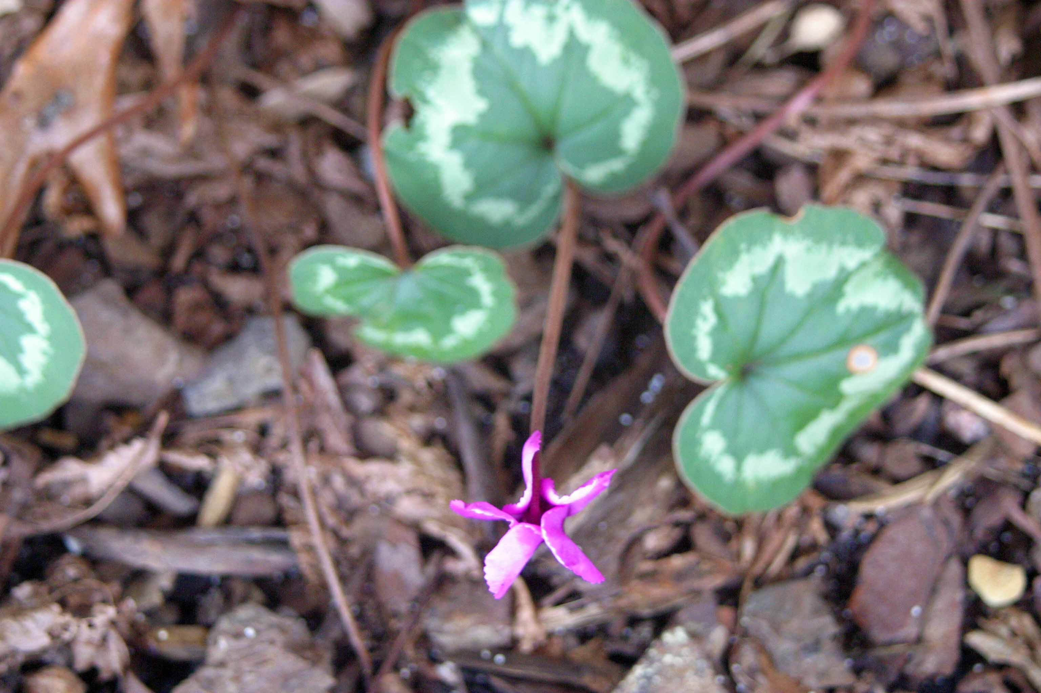
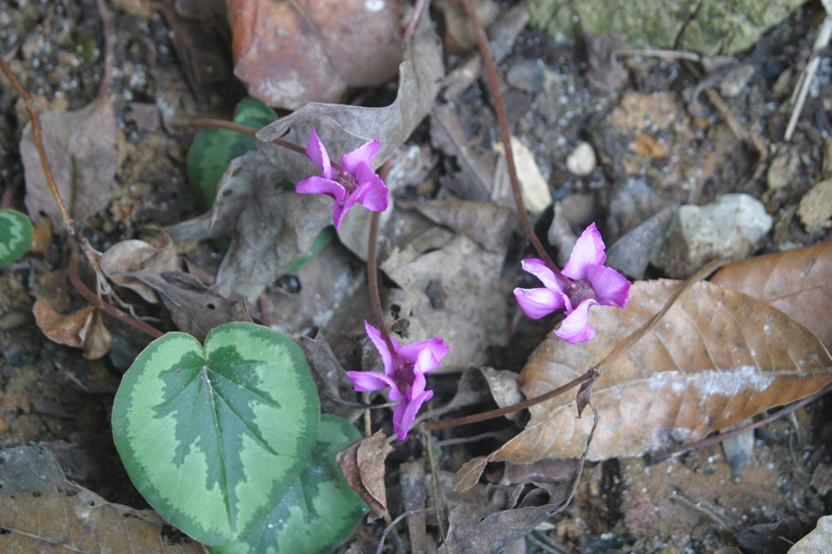
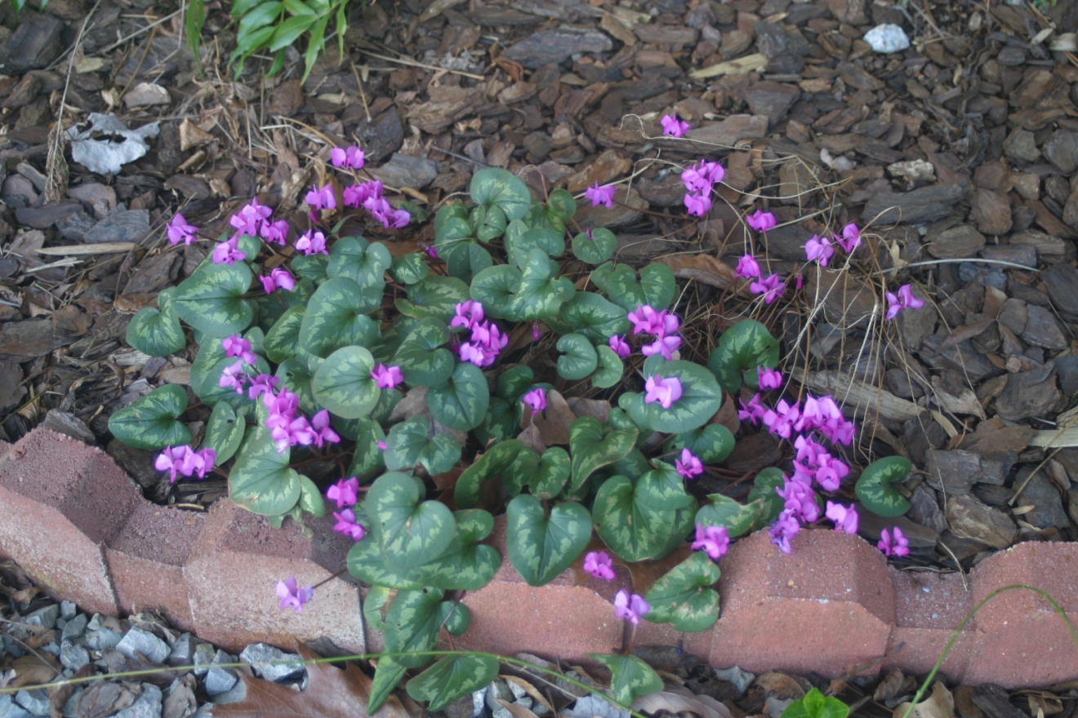
Cyclamen
Notes:
Cyclamen provides garden interest in fall, winter, and spring. It grows in half shade.

Slide 14
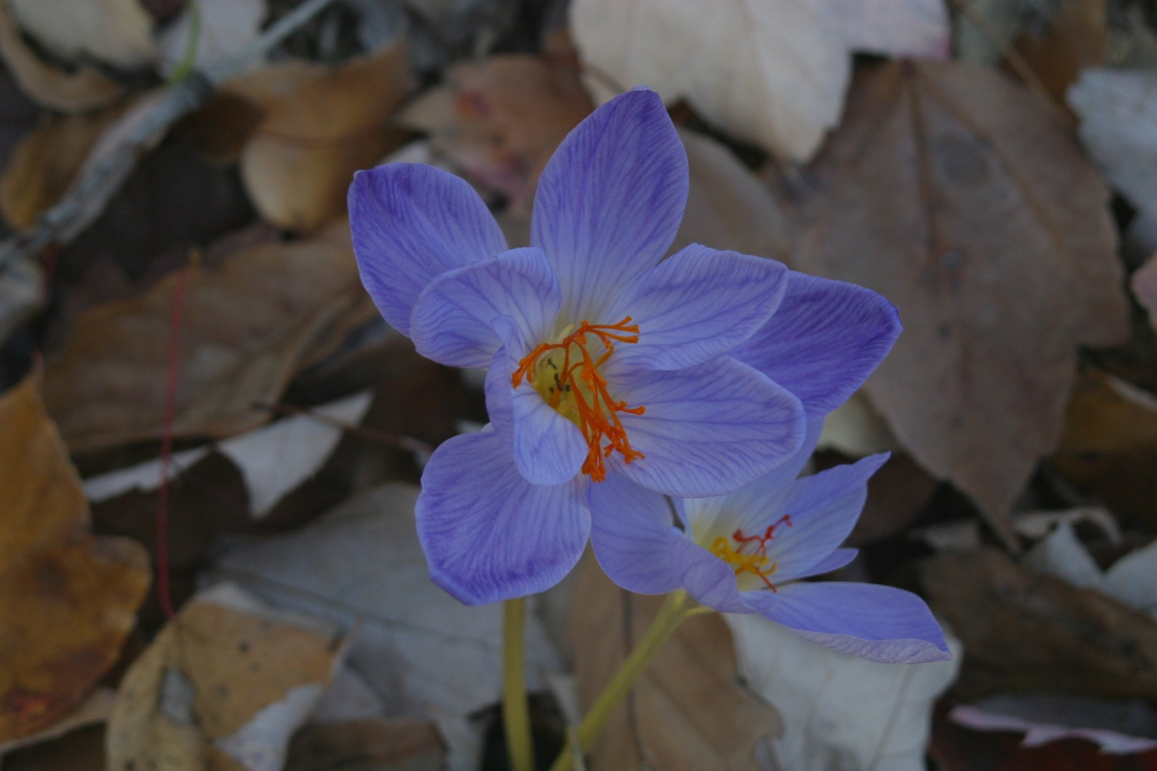
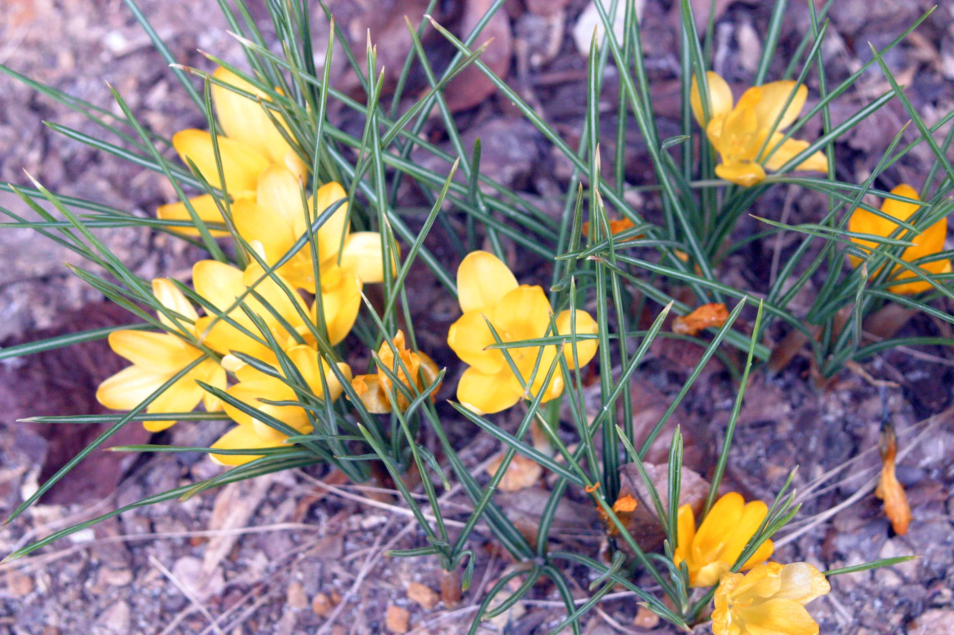
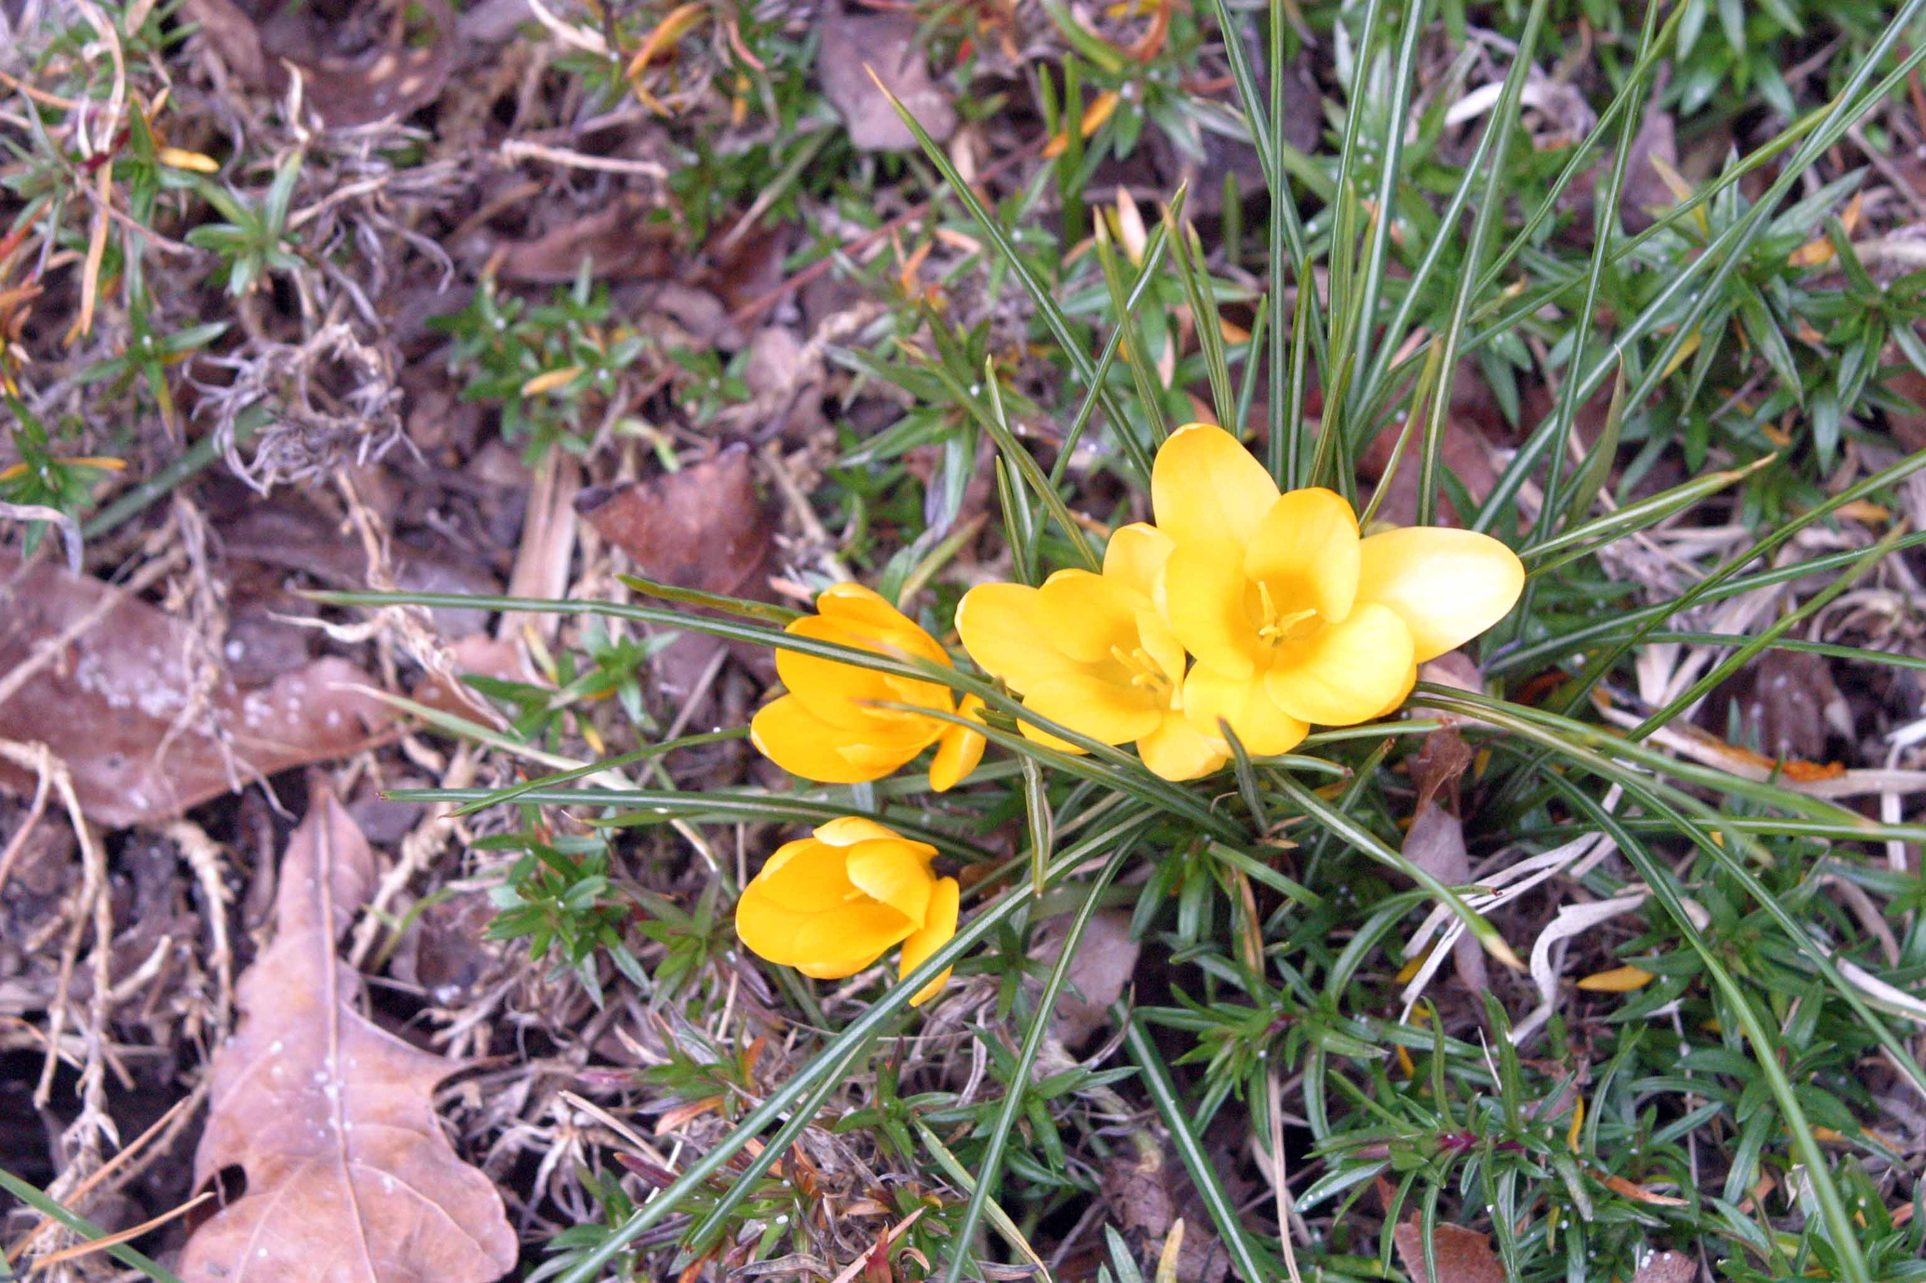
Iridacae
Crocus
Notes:
Crocus will grow and bloom in shade or sun. The most well known varieties bloom in the spring but there are also fall blooming crocus that bloom when there is little else blooming.

Slide 15
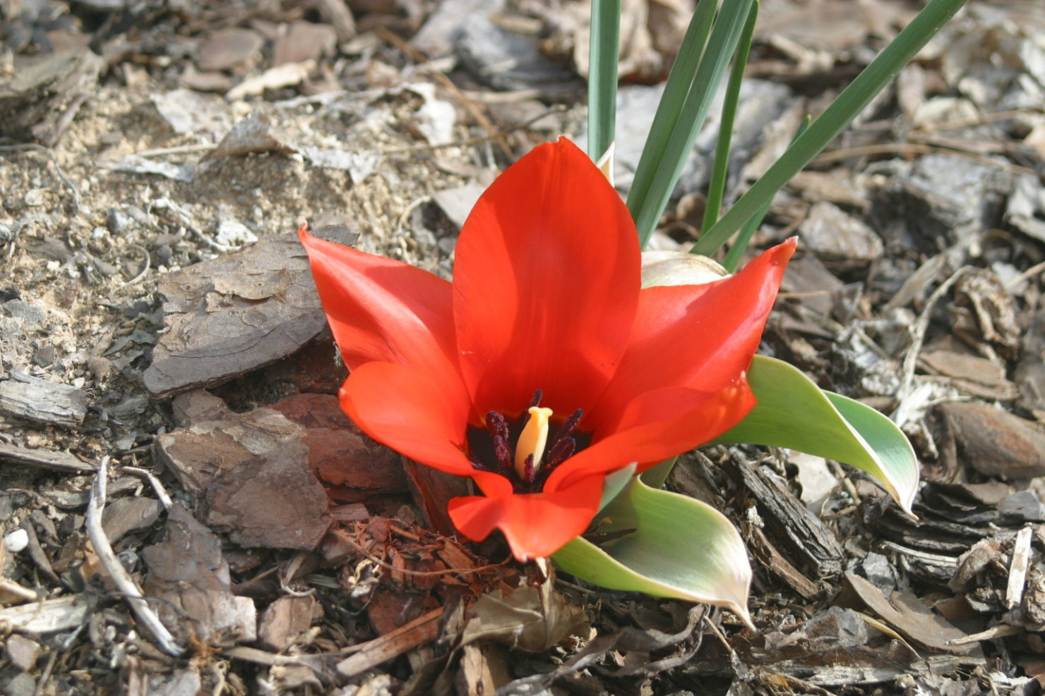
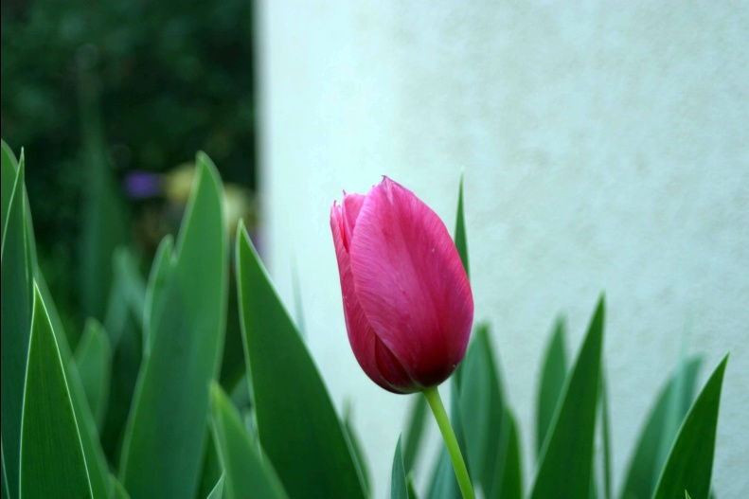
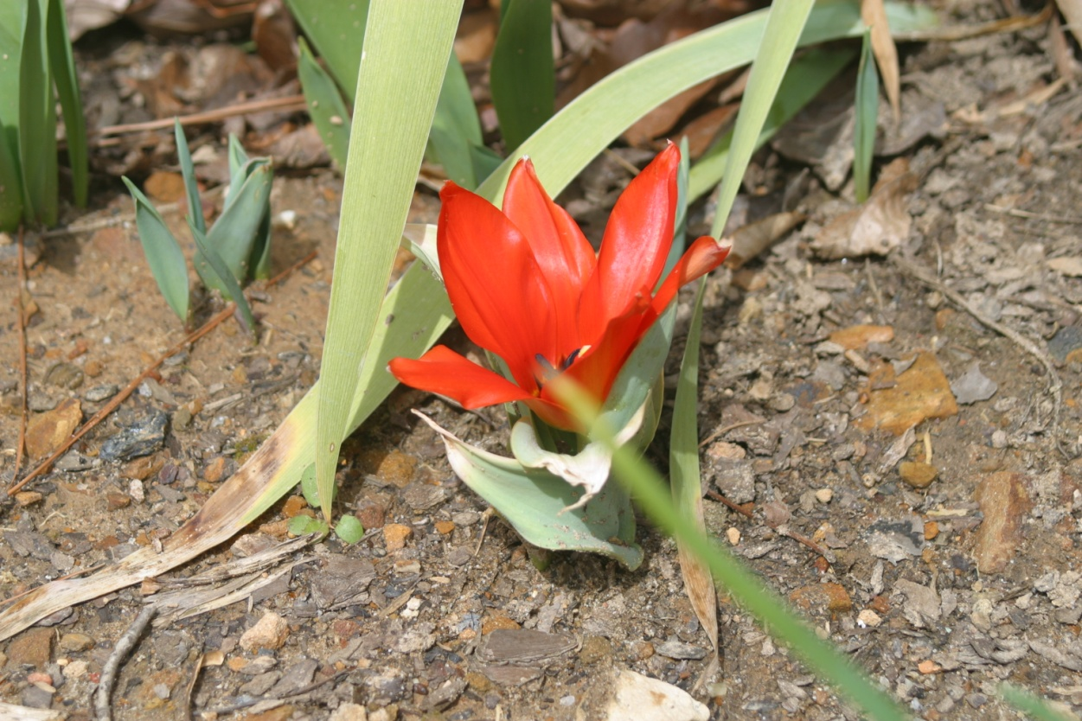
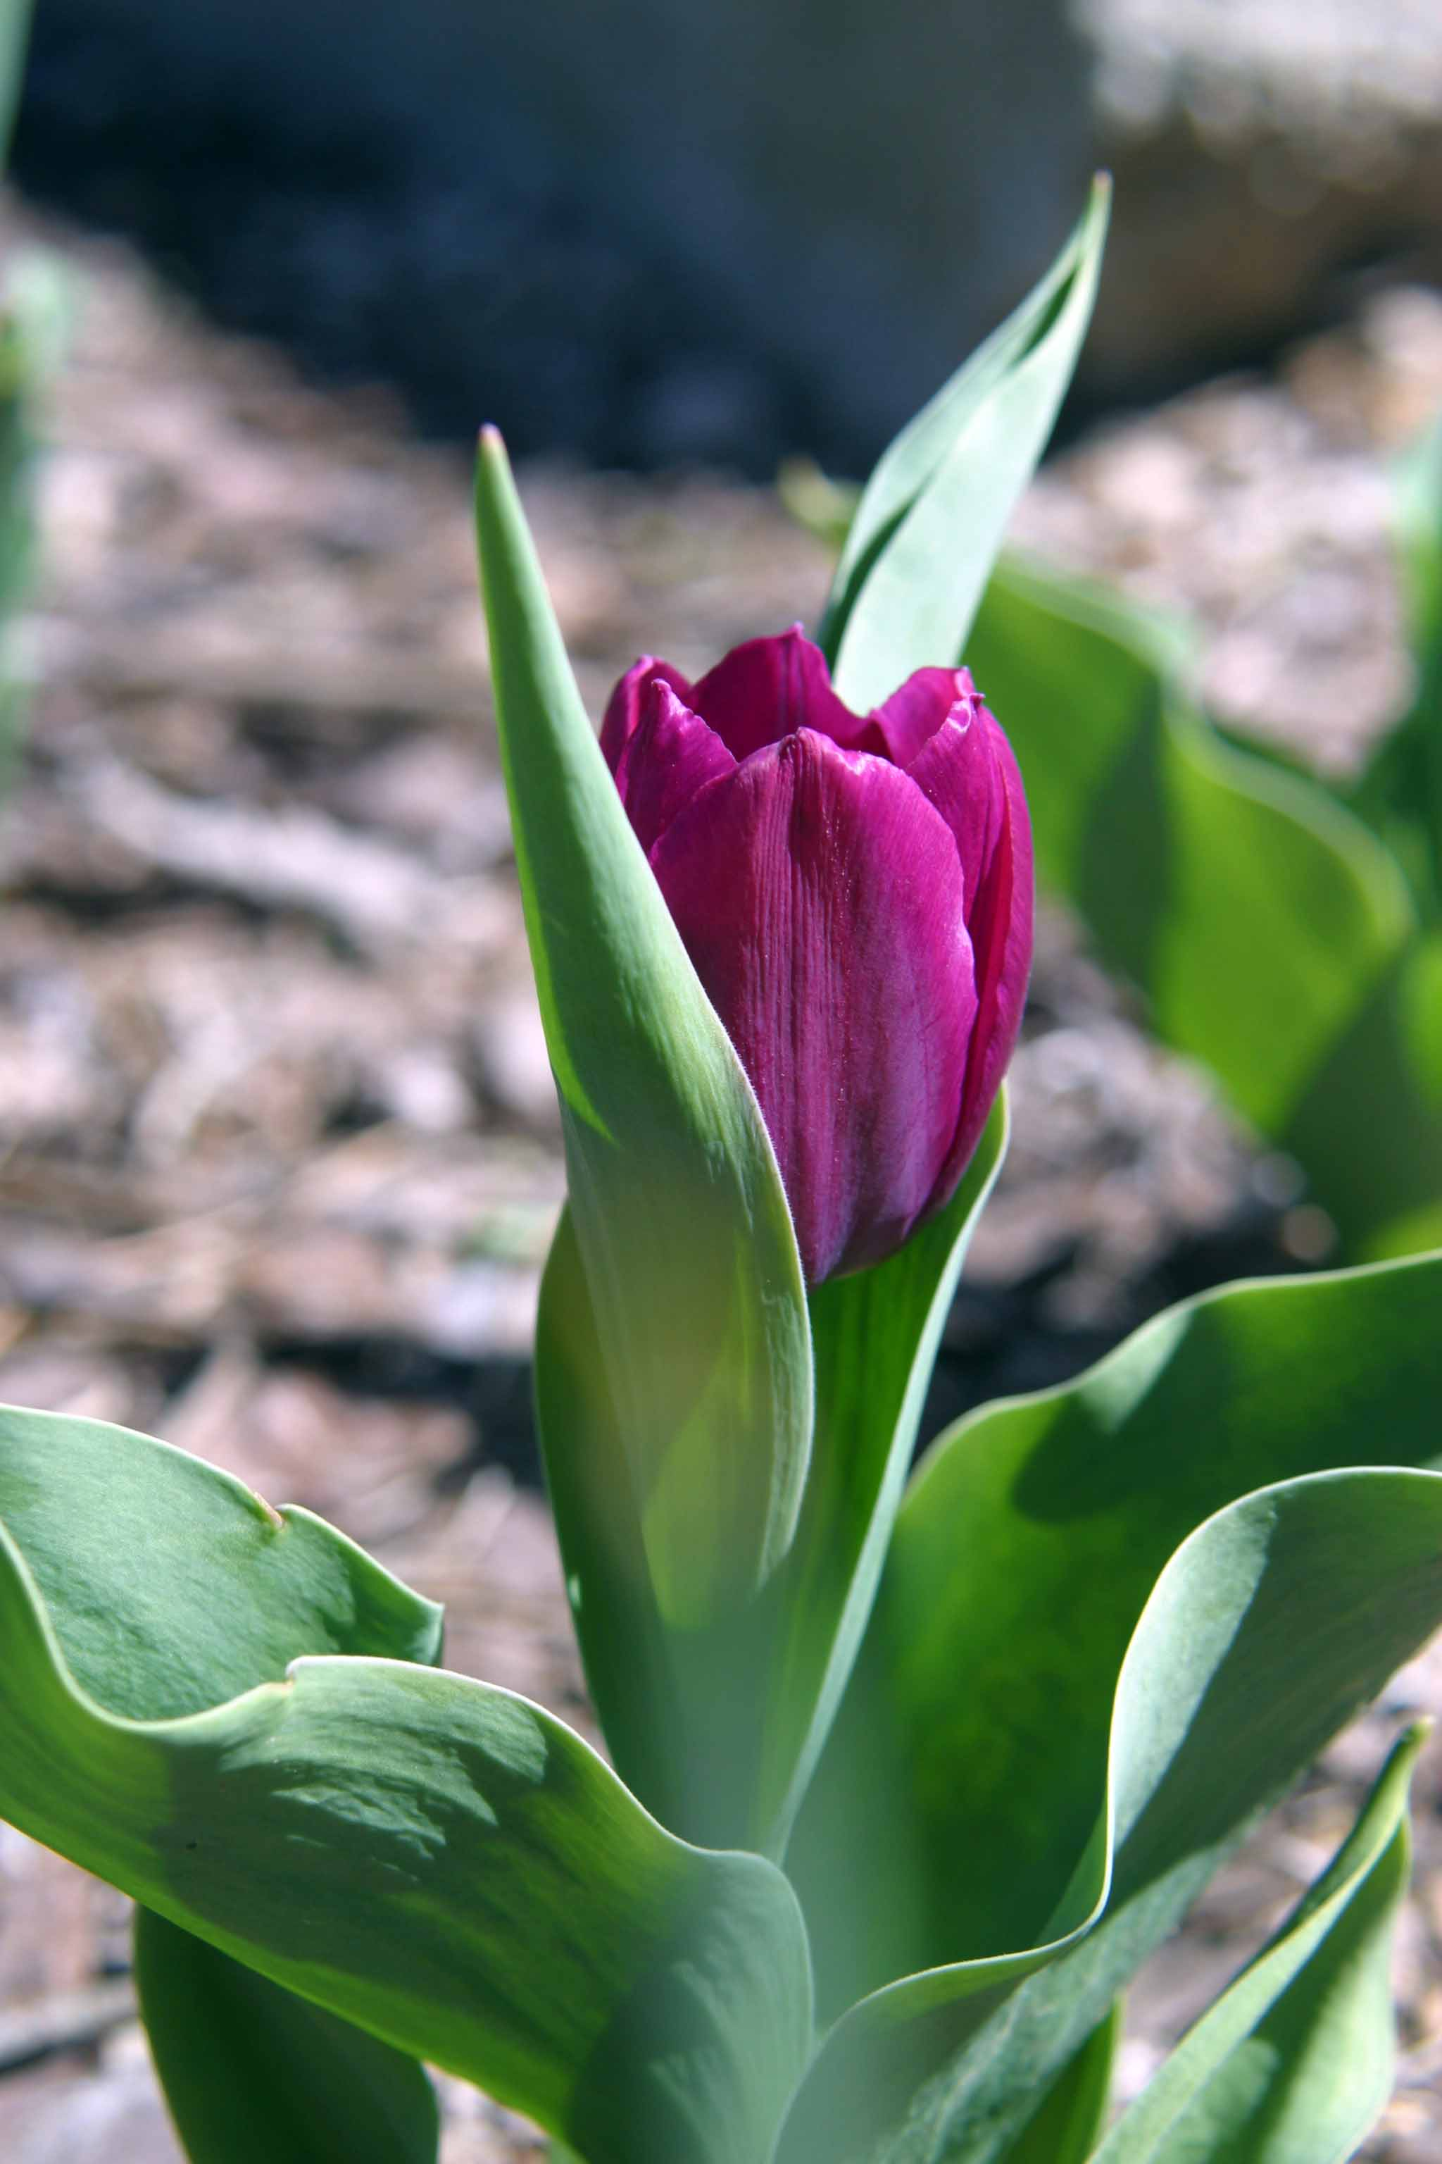
Tulipa
Tulips
Notes:
The most well known tulips are Darwinian tulips but in our area these function as annuals. Species tulips (the red flower) are true perennials here. They multiply and rebloom without special attention and are great to plant in wooded areas.

Slide 16
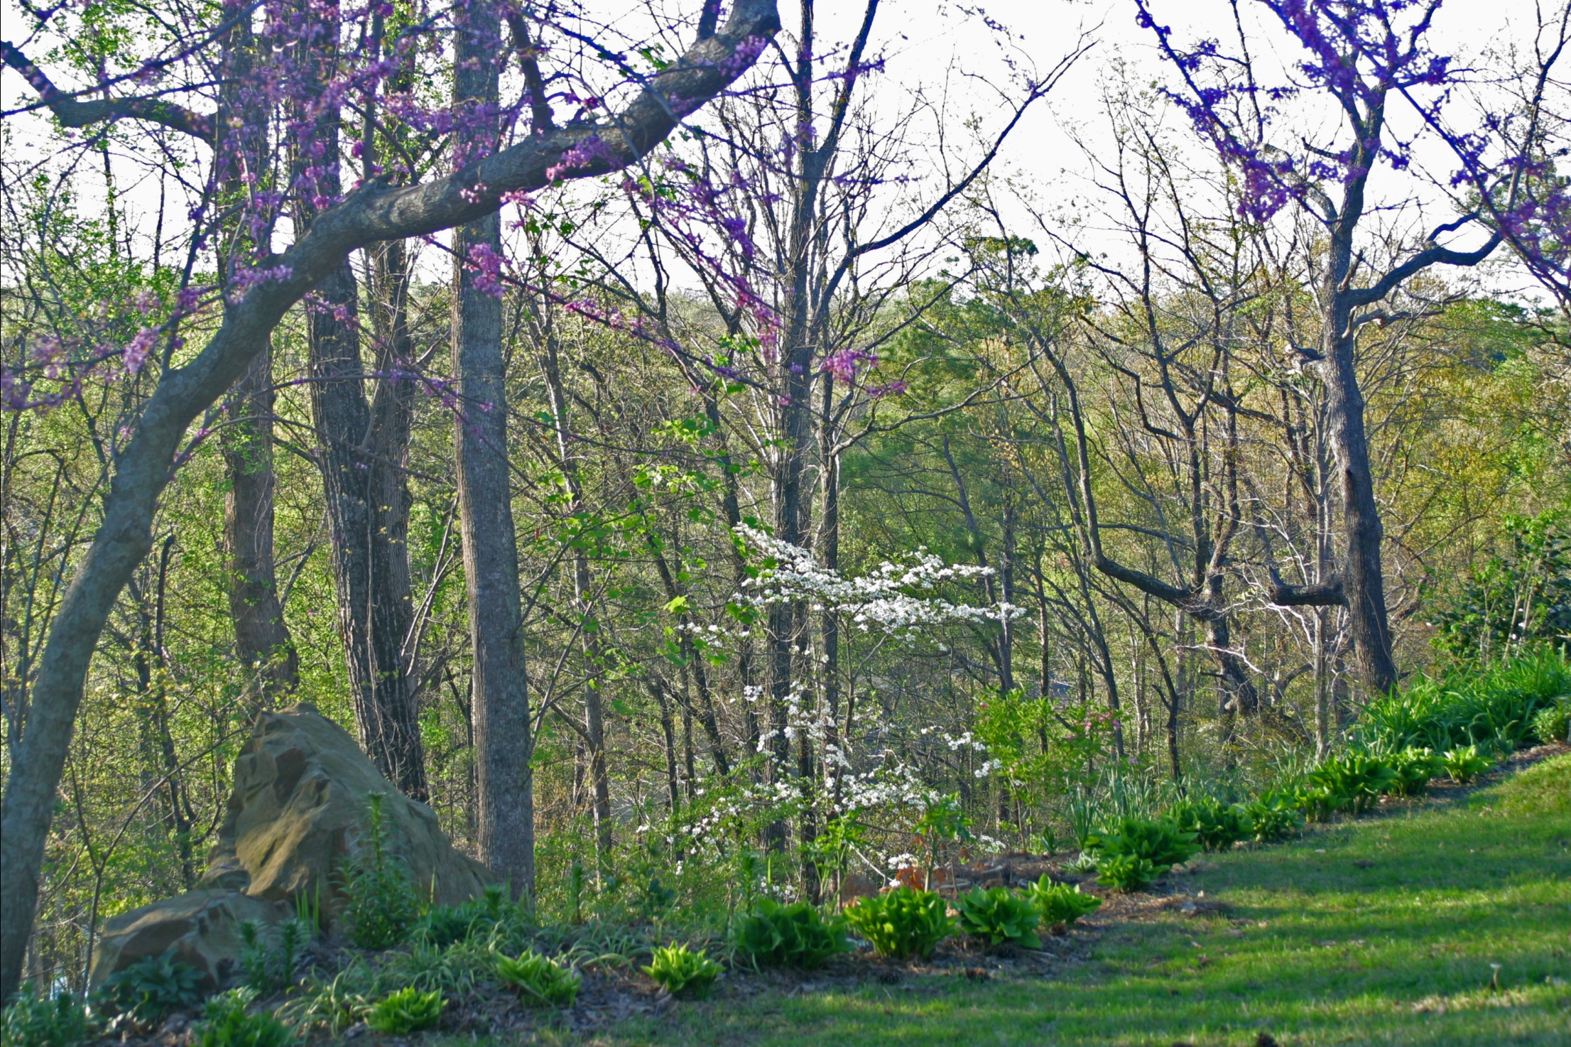
Spring
Notes:
Spring is probably the most beautiful time of the year in Alabama. We have an absolute wealth of flowering trees, shrubs, perennials, and annuals bursting into bloom.

Slide 17
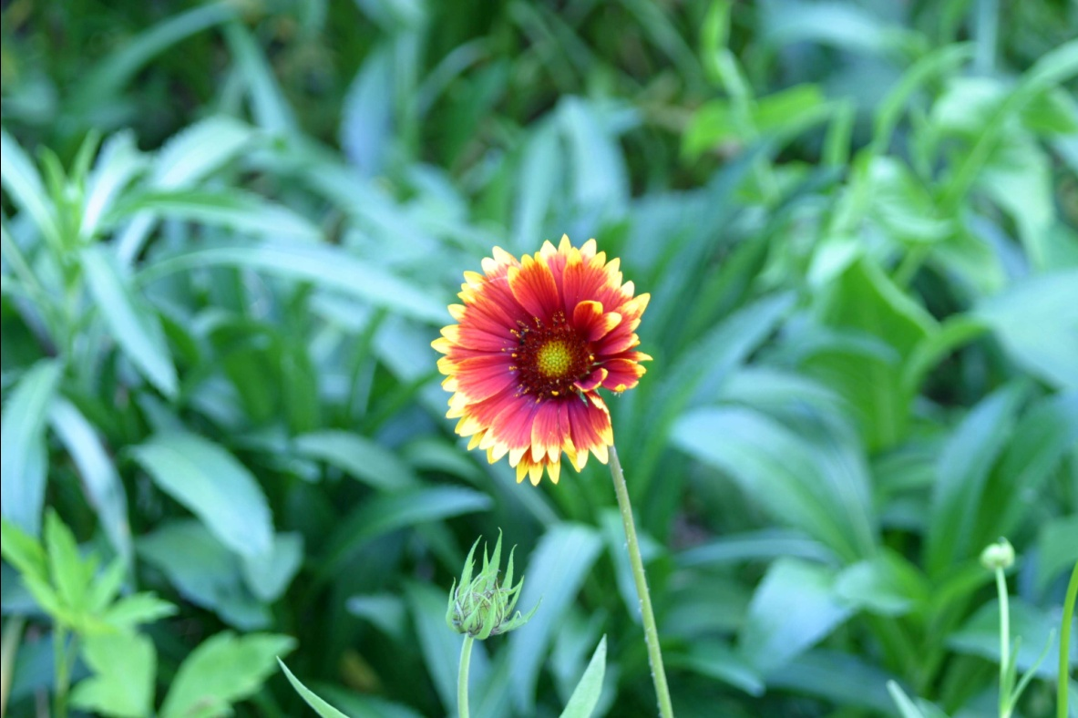
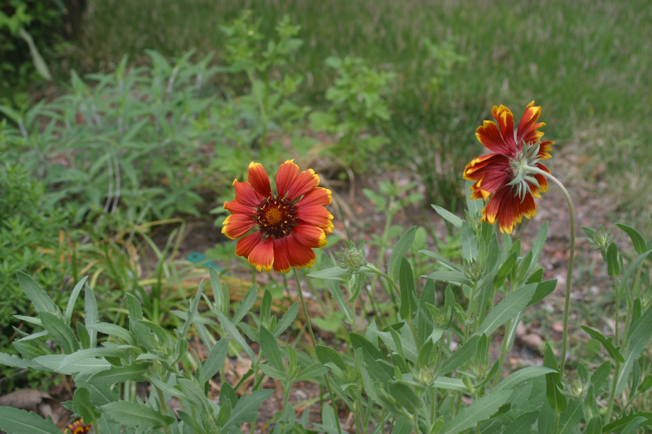
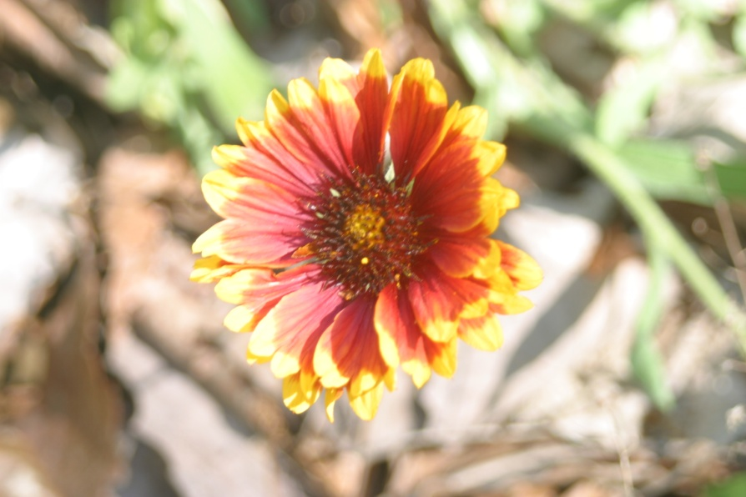
Gaillardia
Blanketflower
Notes:
There are both perennial and annual varieties of Gaillardia. It is one of the longest blooming perennials with flowers from March to frost. Deadheading will help the plants produce more flowers.

Slide 18
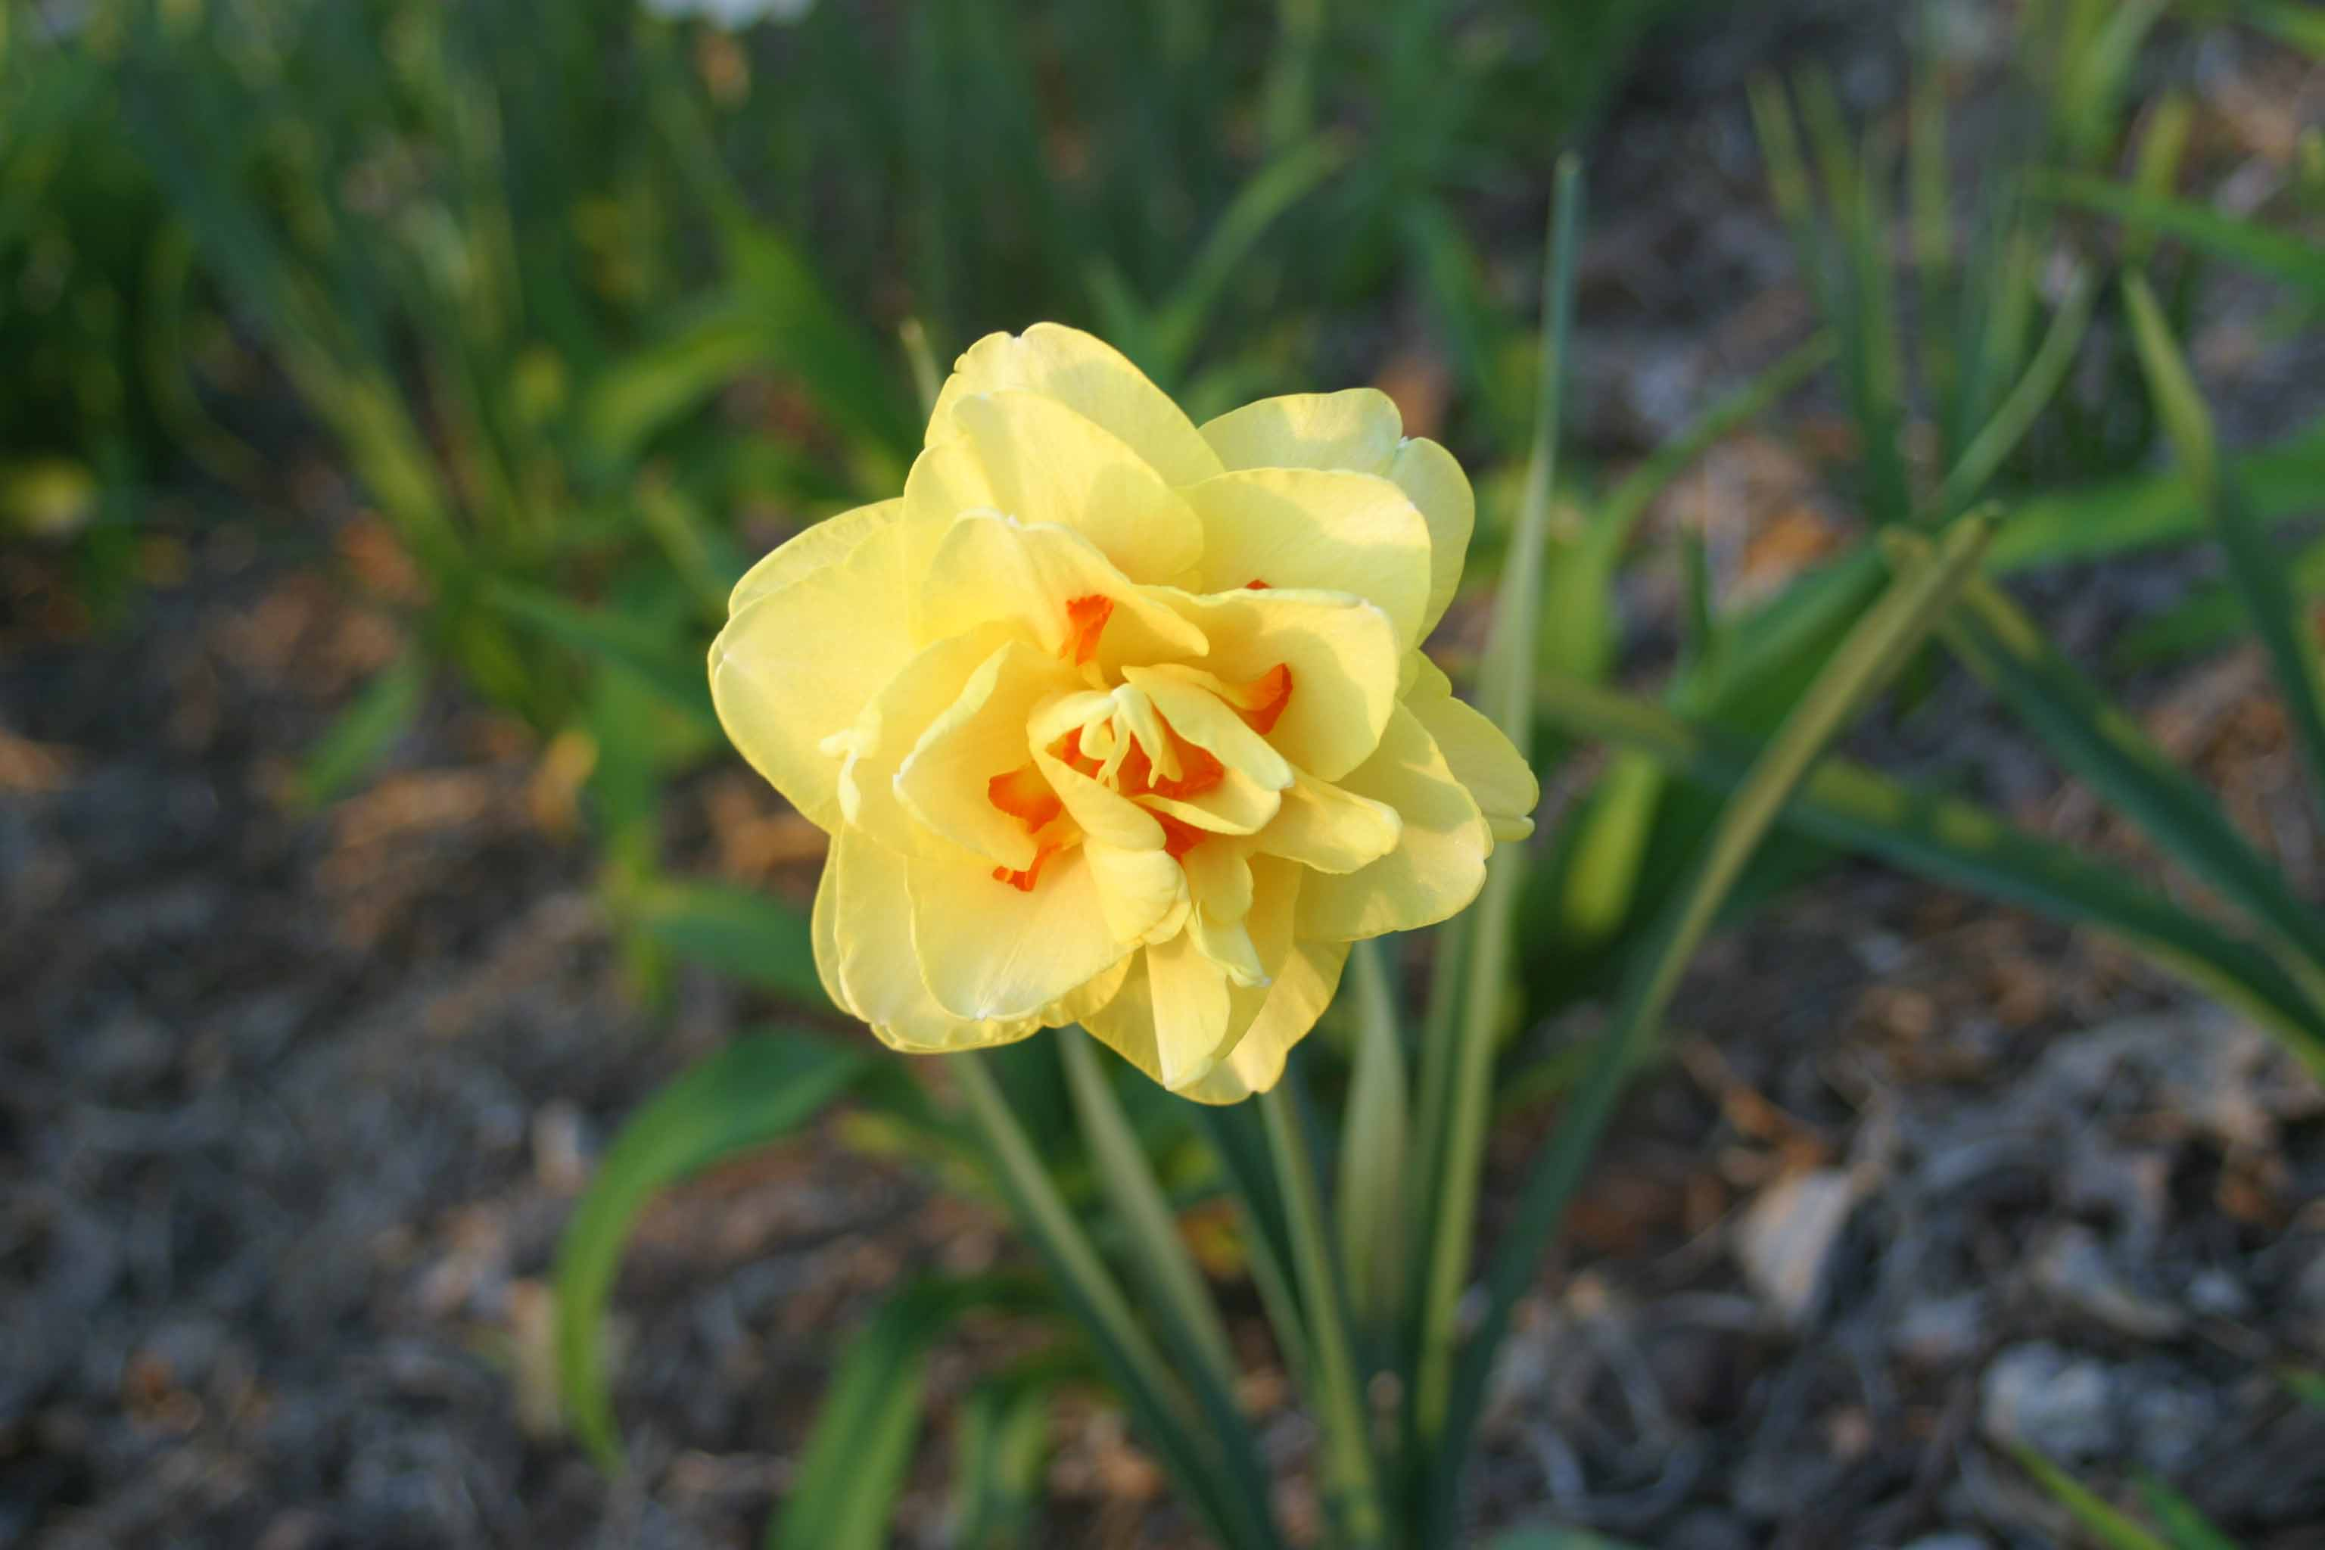
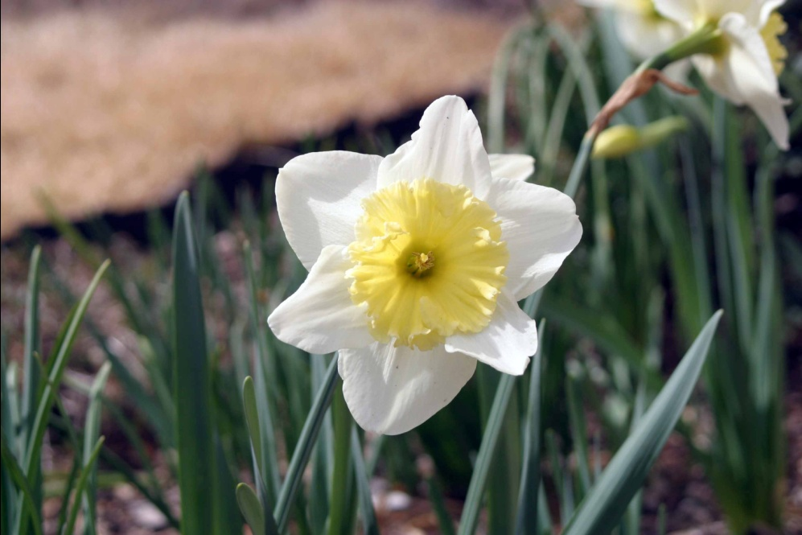
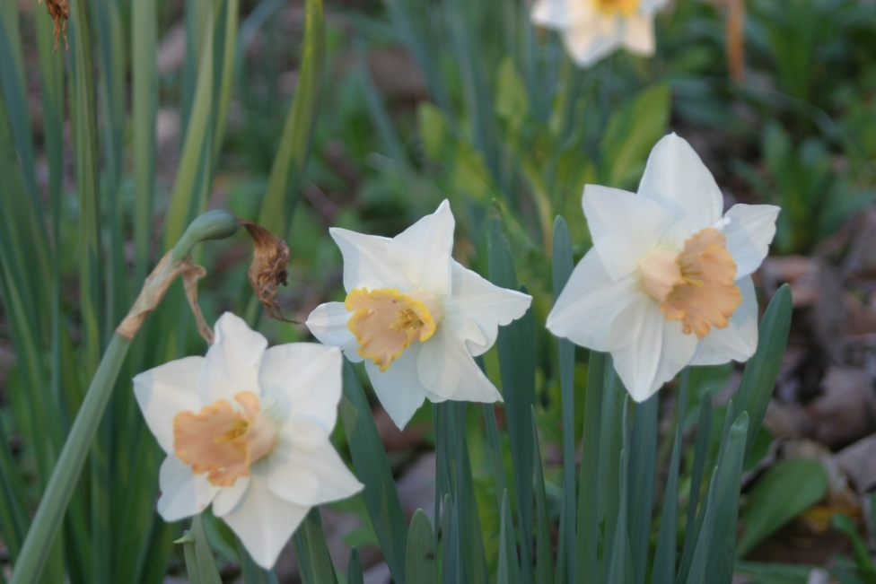
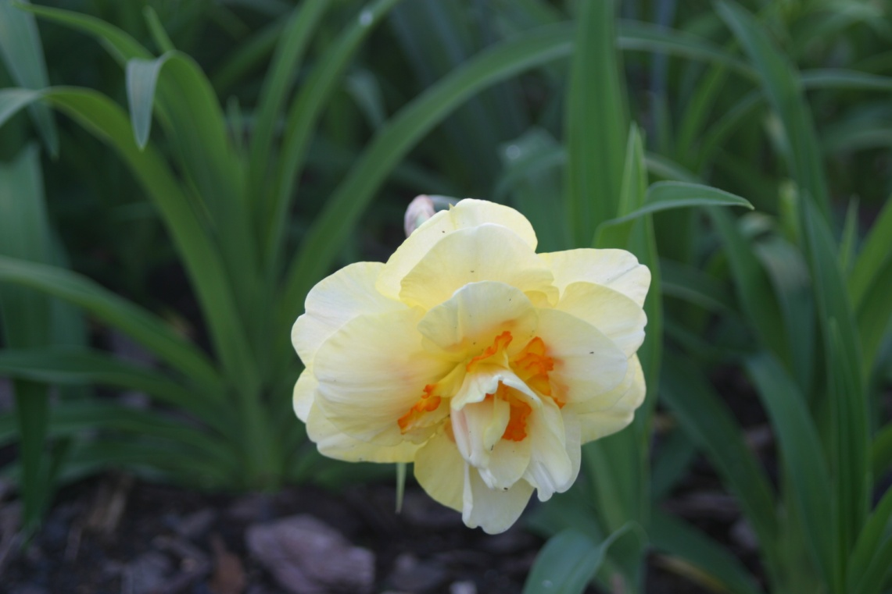
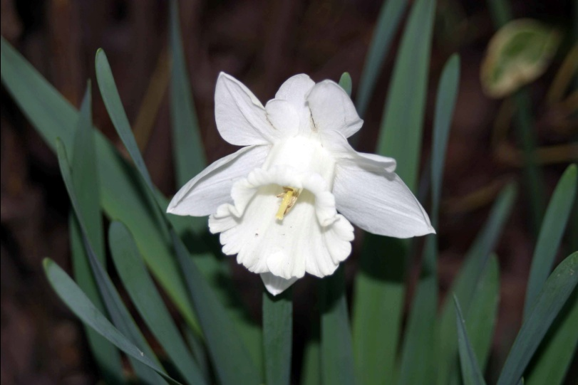
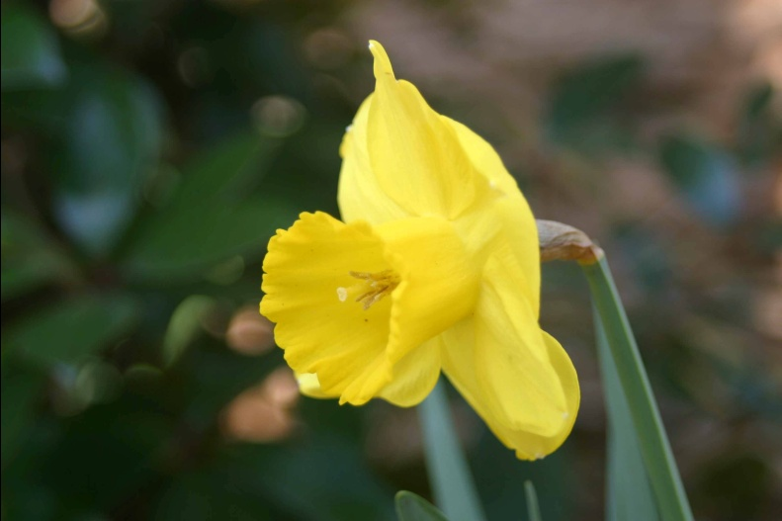
Narcissus (Amaryllidaceae), Daffodils
Notes:
There are at least hundreds (if not thousands) of varieties of daffodils. They thrive in sun or under deciduous trees. Daffodils multiply and will need to be divided every few years because blooming is diminished when they get too crowded.

Slide 19
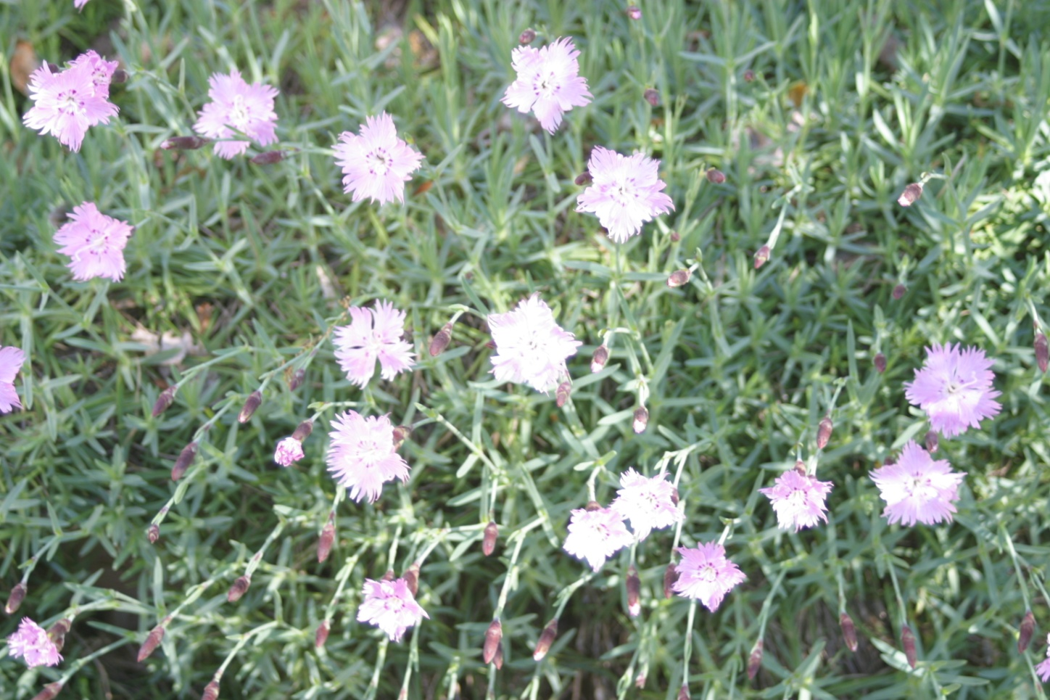
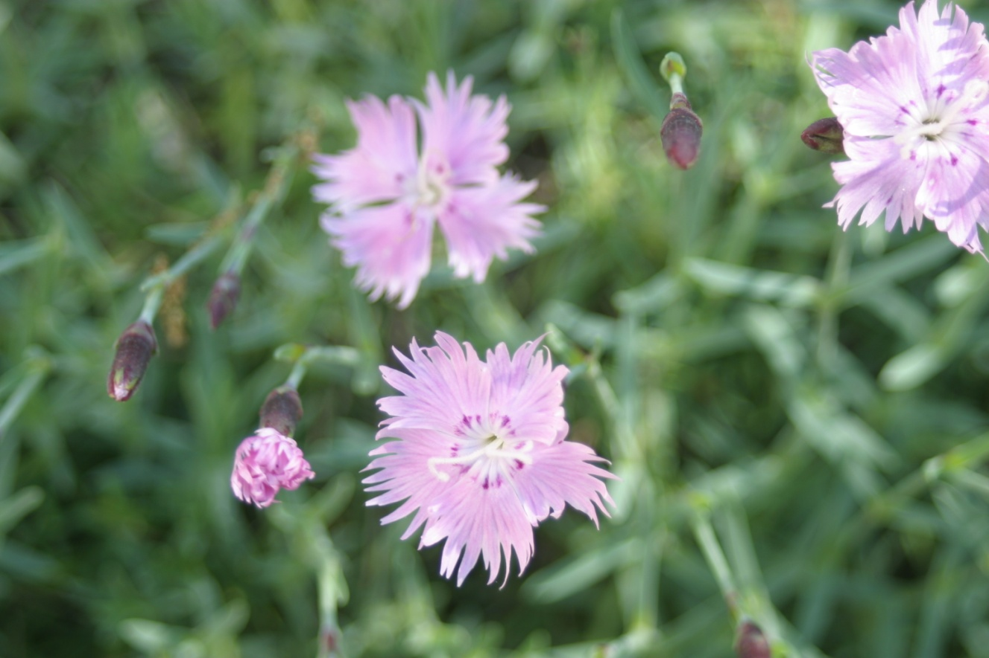
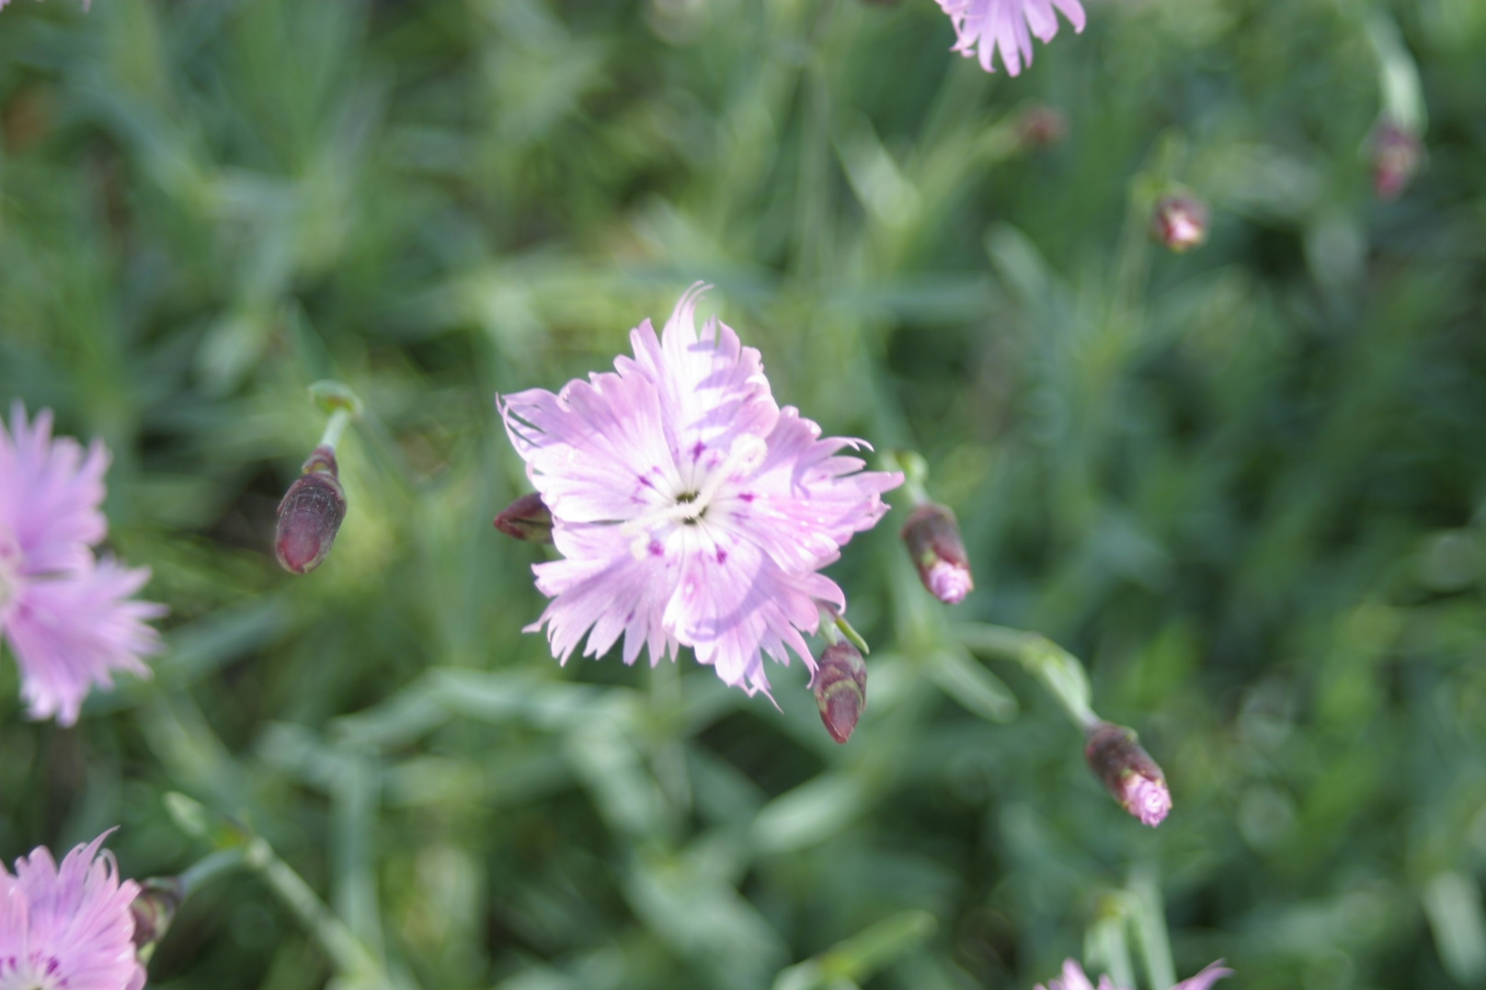
Dianthus
Pink
Notes:
Dianthus has evergreen, grasslike leaves. Low growing. Plant in full sun.

Slide 20
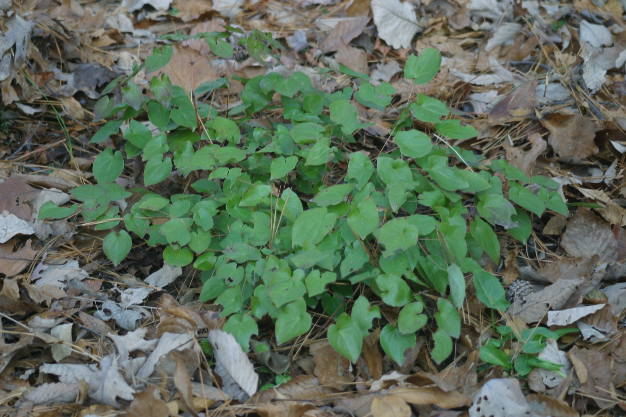
Epimedium
Notes:
Evergreen plant. Grows in half shade. In spring produce loose spikes of small, waxy flowers in various colors. Makes good ground cover.

Slide 21
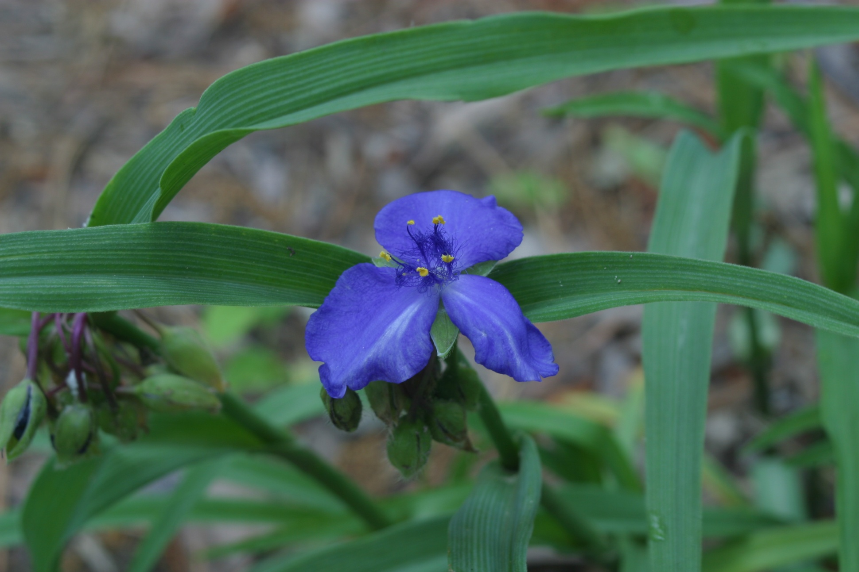
Tradescantia
Spider wort
Notes:
Grows in sun to half shade. Individual flowers are only open for a day, but many blooms per plant because buds come in large clusters.

Slide 22
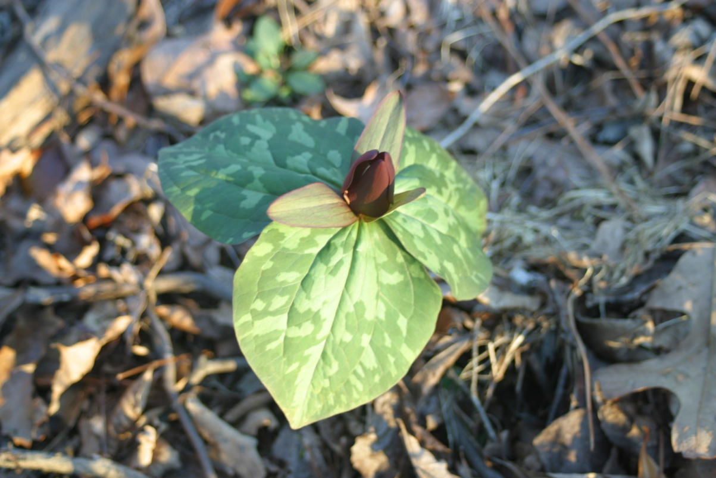
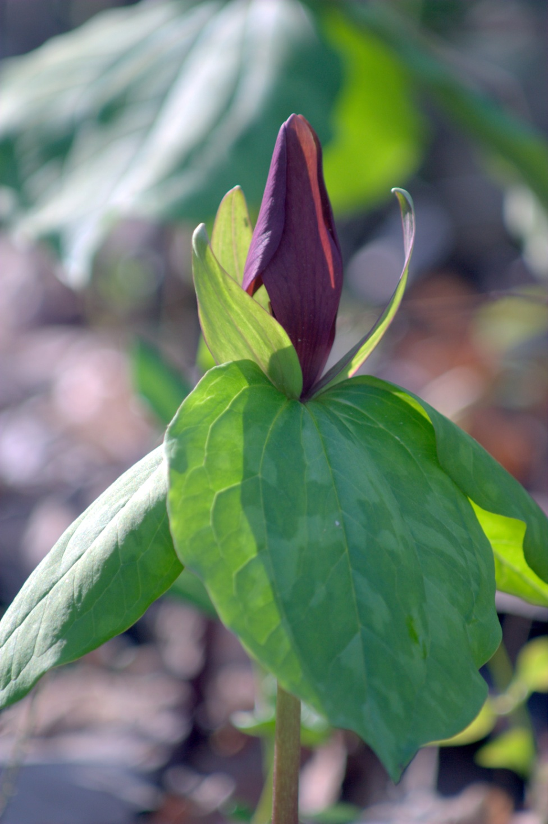
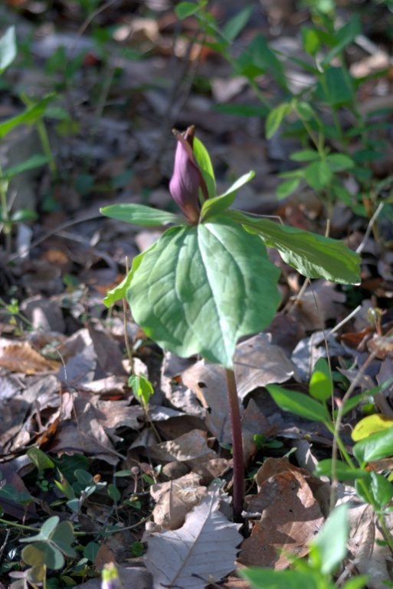

Trillium
Notes:
Wildflower that grows in shady, wooded areas. Propagated by ants. Many different varieties, but this is the most common one.

Slide 23



Primula
Primrose
Notes:
Evergreen plant with blooms in a variety of colors. Must be planted in shade here – cannot withstand our summer heat otherwise.

Slide 24


Phlox stolonifera
Creeping Phlox, Periwinkle
Notes:
Evergreen plant. Grows well and blooms in sun or shade. Excellent ground cover with variety of bloom colors.

Slide 25

Gladiolus
Notes:
Many colors of blooms. Excellent for cutting. Plant in full sun and divide every few years.

Slide 26



Polygonatum
Solomon’s Seal
Notes:
Grow well in woodsy area in half shade. Mix well with astilbe, ferns, hellebore, hosta, wild ginger.

Slide 27



Sissyrinchium augustiflolium
Blue Eyed Grass
Notes:
Plant in sunny area. Evergreen plant that likes wet feet.

Slide 28

Heuchera
Coral Bells
Notes:
Evergreen plant for shade. Foliage more interesting than blooms.

Slide 29






Paeonia
Peony
Notes:
Herbaceous peonies are perennials that die back to the ground in the fall. There are also tree peonies which are a shrub. Both types produce huge, showy flowers.

Slide 30



Iris germanica
Bearded
Notes:
This is the most widely grown group of irises. Wide group of colors. Plant in sunny area. Need dividing every 3 to 4 years to prevent overcrowding which results in fewer blooms.

Slide 31

Iris hollandica
Dutch
Notes:
Plant in sunny area or under deciduous trees. Wide range of colors. Make excellent cut flowers.

Slide 32

Foliage
Notes:
Some plants are grown exclusively or almost exclusively for their foliage rather than their blooms. Different shapes, textures, and colors of foliage add interest to any garden.

Slide 33


Artemisia
Notes:
Plant in full sun. Silvery foliage that remains colorful all summer. Excellent to cut for floral arrangements.

Slide 34




Ferns
Notes:
An entire talk could be given on ferns. Many varieties. Most grow in the shade although a few like sun. Some like wet shade, others dry shade. There are some evergreen types.

Slide 35



Hostas
Plantain Lily
Notes:
Again an entire talk could be given on hostas. Size ranges from 3 inches to 5 feet high. Some have very fragrant flowers. Plant in shady locations.

Slide 36

Summer
Notes:
Despite our long, hot summers, many blooming perennials contribute to Alabama’s beauty. Our lengthy growing season allows us to grow plants that are not possible in other areas of the country.

Slide 37



Iris kaempferi
Japanese
Notes:
Japanese iris like wet feet. Plant in sunny area. Very large flowers with flattened heads.

Slide 38

Iris sibirica
Siberian
Photo Courtesy of Thor Thorsson via Flickr
Notes:
Siberian iris also like wet feet and should be planted in full sun. As with all iris they make excellent cut flowers.

Slide 39



Rudbeckia
Brown-eyed or Black-eyed Susan
Notes:
We have both hybrid varieties and wildflower varieties of this plant. It is easy to grow even in poor soils. Prefers full sun.

Slide 40


Leucanthemum maximum
Shasta Daisy
Notes:
Prefers full sun. Many varieties. ‘Becky’ has stronger stems and blooms somewhat later than other types.

Slide 41

Astilbe
Photo Courtesy of dapawprint via Flickr
Notes:
Astilbe like shade with plenty of moisture. Their foliage contributes as much as the flowers to a landscape.

Slide 42

Coreopsis
Tick Seed
Notes:
Both perennial and annual varieties. Grow best in full sun.

Slide 43



Spigelia marilandica
Indian Pink
Notes:
Wildflower with poisonous roots. Grows in half shade in woodsy areas.

Slide 44






Lilium hybrida ‘asiatic’
Asiatic
Notes:
Wide assortment of bloom colors. Plant in full sun to partial shade. Excellent cut flower. Unfortunately voles like the bulbs.

Slide 45



L Lilium auratum
Oriental
Notes:
Gets taller than the Asiatic lily and blooms a little later. Likes full sun or partial shade. Has the same vole problem.

Slide 46

Lilium lancifolium
Tiger
Notes:
Gets 4 to 6 feet high so may need staking. Likes sun or partial shade. Flowers somewhat later than Asiatic or Oriental lilies.

Slide 47

Geraniums
Notes:
We need to grow geraniums in half shade due to our summer heat. They like moist, well-drained soil.

Slide 48

Echinacea
Purple Coneflower
Notes:
Does well in poor soil, likes full sun. Deadheading prolongs bloom time. Will self sow.

Slide 49

Platycodon grandiflorus
Balloon Flower
Photo Courtesy of Carl E Lewis via Flickr
Notes:
Grows well in sun or partial shade. Takes 2 or 3 years to get well established. Common names comes from fact that buds are inflated and balloonlike.

Slide 50





Hemerocallis
Day Lily
Notes:
There are thousands of varieties of day lilies. Their blooms only last for one day but there are many buds on each plant. Many varieties rebloom throughout the summer.

Slide 51



Phlox paniculata
Summer Phlox
Notes:
Thrives in full sun and blooms until first frost. Susceptible to powdery mildew so provide good air circulation around plants.

Slide 52

Monarda
Bee Balm
Photo Courtesy of bill barber via Flickr
Notes:
All parts of this plant are edible – flower petals are good as a soup garnish, leaves make tea. Plant in sun or half shade.

Slide 53

Dahlia
Notes:
There are many types and colors of dahlia blooms and many heights of plants. Most dahlias require lifting the tubers in the fall and replanting in the spring. The dahlia pictured has been in my family for well over 50 years and does not require lifting and replanting.

Slide 54

Lathyrus latifolius
Perennial Sweet Pea
Photo Courtesy of amandej2008 via Flickr
Notes:
Vines reach 9 feet or more. Grows in full sun. Blooms delightfully fragrant. Excellent pass along plant.

Slide 55

Fall
Notes:
After the glories of spring and summer fall is more subdued but color contrasts still provide garden interest. Due to more temperate weather it’s probably the best time of year to perform garden maintenance and absolutely the best time to plant perennials.

Slide 56


Chrysanthemum
Notes:
Chrysanthemums are probably the most widely grown fall blooming perennial. I obtained several varieties from Springhill Nurseries that are self-mounding and do not require pruning to maintain a nice shape.

Slide 57


Helianthus tuberosus
Jerusalem Artichoke
Notes:
Tubers are edible. Grows to 6 to 10 feet tall. Blooms mid to late fall when little else is blooming. Spreads readily so can become a pest.

Slide 58

Sedum
Stonecrop
Notes:
Drought resistant and also tolerates poor soil. Grows in sun or half shade. Many different varieties with varying heights and plant shapes.

Slide 59


Salvia leucantha
Mexican Bush Sage
Notes:
Plant in sun or light shade. Graceful arching stems with grayish green foliage bloom until hard frost.

Slide 60

Lycoris
Spider Lily
Notes:
Narrow, strap-shaped leaves are present fall through July then die down. Blooms on bare stems appear in September. Most common bloom color is red, but there are also pink, white or yellow ones. Grow in sun or half shade.

Slide 61

Zephyranthes
Rain Lily
Notes:
Plants bloom after a rain. Usually start blooming in mid summer. Plant in full sun.

Slide 62
Resources
Master Gardener Help Line 877/252-4769
The Southern Living Garden Book, edited by Steve Bender
The Illustrated Encyclopedia of Perennials, Prof. Marshall Craigmyle
Garden Perennials, Allan Armitage
Passalong Plants, Steve Bender & Felder Rushing
The Essential Gardener, Derek Fell
Trained staff at various local nurseries
Notes:
Master Gardeners are available weekdays and some weekends to answer questions. If there’s no answer when you call, leave a message and your call will be returned as soon as is possible. Any questions which the Master Gardener cannot fully answer will be referred to an Extension agent. There is a wealth of gardening books available. Books written by someone from the South are generally more specific to our region. If a book is not written by a Southern author one generally needs to cross reference light and water requirements. Plants that need full sun in the North often need partial shade in the South. The Powells at Petals from the Past in Jemison have been my best source of information. They also offer free talks on various plant topics throughout the year. Other nurseries (not usually big box ones) have trained staff who can be very helpful.

Slide 63
Web Resources
UGA Plant Trials –
http://ugatrial.hort.uga.edu/
http://www.ces.ncsu.edu/depts/hort/consumer/
hortinternet/perennials.html
Perennial List and Photos ACES Perennial Publication –
http://www.aces.edu/pubs/docs/A/ANR-0556
MSU Perennial Care – http://msucares.com/lawn/garden/flowers/perennial/
http://www.clemson.edu/extension/hgic/plants/ landscape/flowers/hgic1153.html
Clemson Perennial Publication - http://www.clemson.edu/extension/hgic/plants/
landscape/flowers/hgic1150.html
Notes:
There is a huge amount of gardening information available on the web. However one cannot always trust everything one reads on the internet! These are Extension Service and university sites so they offer reliable information.

Slide 64
Thank You
Any questions?

