Slide 1
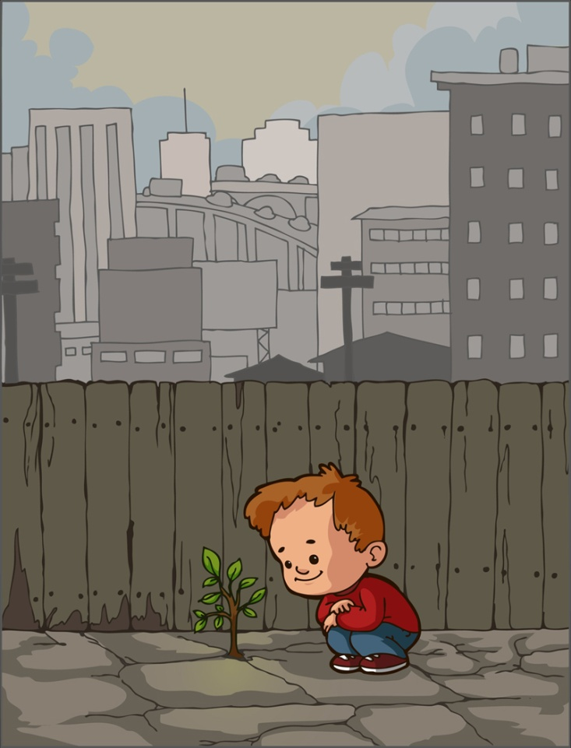
Selection and Installation of Trees in the Landscape
Tony A. Glover, Regional Extension Agent
Original presentation combined from Auburn University, University of Georgia and Florida (special thanks to:Dr. Edward F. Gilman and Traci Partin of IFAS)

Slide 2
Making the right tree choice?
Growth factors
Soil requirements
Other Environmental requirements
Maintenance requirements
Notes:
Another question to ask before planting a tree is what tree will best satisfy the reasons for planting it and be suitable for the site where it will be planted. In other words, plant the right tree in the right place. Many of the factors discussed about the site are also important ot consider when selecting a tree species. These factors include growth factors, soil requirements, other environmental characteristics ad maintenance requirements.

Slide 3
Right Tree
Growth Factors
Mature size and shape
Growth rate
Branching pattern
Leaves
Flowers, fruit, seeds and bark
Notes:
Several Factors of growth should be considered when selecting a tree species.
Mature size & shape: The mature size and form of the tree crown and root system are important because of the potential interference with utility lines, pavement, structures and signs. For example it would be best if a small sized tree were selected to be located under a utility line.
Growth rate: The reason for planting a tree may make the growth rate important in selecting the species. A fast growth rate could be important for shade or screening. However, some fast-growing species have weak wood and are prone to breakage. This makes tree susceptible to storm damage and other hazards.
Branching pattern: The branching pattern is important when selecting tress for a site that is subject to strong winds and storms. The best pattern to look for are branches with wide angles. This creates strong joint for the branch with little to no included bark.
Leaves: When selecting a tree leaves are a consideration when looking at texture, fall color, prickly foliage and density of shade desired. Also, the choice of evergreen or deciduous must be considered.
Flowers, Fruit, Seeds and Bark: Often a species is selected for the flowers, fruits, or seeds that it bears or the texture and color of its bark. These can add color and texture to the landscape, attract wildlife, or add winter interest. On the other hand they can also create a nuisance because of litter and or smells.

Slide 4
Right Tree
Soil situation
Compacted
Heavy clay
Poorly drained
Low/High pH
Etc
(don’t fight the site)
Notes:
Each species has different soil requirements but may adapt to different conditions. Some species prefer a wet compacted soil while others prefer a dry soil. pH is also another soil characteristic to consider. If soil conditions are less desirable for a specific species, it may be best to select either another site or another species for that site.

Slide 5
Right Tree
Other environmental factors
Hardiness zone
Wind and storm damage
Light requirements
Pollution tolerance
Insect and disease tolerance
Notes:
Several environmental factors need to be considered when considereing selecting a tree species.
They include:
Hardiness zone: Tree species have different tolerances to both heat and cold. Knowing the hardiness for a species will help determine if it can survive at the planted site. You must know what hardiness zone you are planting in.
Wind and Storm Damage: For sites where wind and storm damage are a concern, a species with strong branching structure and wood strength should be chosen. Trees with a fast growth rate should be avoided. The tree species should also have a strong root system.
Light requirements: You need to consider the light requirements of the site to match the correct species. Sun loving trees need at least 6 hours of direct sun. Partial shade/sun trees need 3-6 hours of direct sunlight. Shade loving trees need less than 3 hours of direct sun or filtered sun.
Pollution tolerance: If the site is located where possible air quality problems are likely to occur a pollution tolerant species needs to be considered.
Insect and disease resistance: Insects and diseases should be considered in selecting a tree. The species selected should be resistant to those insects and diseases common to the area.

Slide 6
Right Tree
Maintenance requirements
Pruning needs
Fertility needs
Pest concerns
Water needs – drought tolerance
Etc
Notes:
Some species require more maintenance, including pruning, watering, fertilizing and mulching than others. The maintenance requirements for a tree should match the resources, including time and money, available to care for the tree. Low maintenance trees may tend to live longer and healthier.

Slide 7
Web Resources for Plant Selection
http://www.onlineplantguide.com
http://www.southeasternflora.com
http://utgardens.tennessee.edu/ohld220/index.html
http://urbanext.illinois.edu/treeselector/search.cfm
https://fp.auburn.edu/sfws/samuelson/dendrology/ (this is Trees of Alabama – great resource – test your knowledge)
http://www.cnr.vt.edu/dendro/treeselector/search.htm
(Tree selector for urban areas – very helpful)
http://www.aces.edu/forestry/dendrology/leaves.php
(55 most common trees and leaf ID chart)

Slide 8
Types of Tree Stock
Bare-Root Ball and Burlap (B&B) Container
Notes:
Once you have selected the tree species to plant, the next step is to determine which type of tree stock that you want to use. There are four main types on the markets today. They are:
bare root, where the tree is grown in the field, dug, and the soil washed from the roots. Bare root trees are usually small, less than 2 inches in diameter.
balled and burlap other wised known as B&B, where a tree is grown in the field and dug out with soil remaining around the portion of the roots. This root ball is then wrapped in a natural fabric such as burlap and placed in a wire basket or wrapped in string.
fabric bag trees where the tree is grown in the nursery under ground in a non-biodegradable fabric bag that is supposed to promote fibrous root growth.
and container where the tree is grown above ground in a container filled with lightweight, artificial soil or planting mix.
. There are advantages and disadvantages to each type. Some of the most common ones are:
For bare root stock the advantages are: smaller and lighter, less expensive, easy to transport, and good root structure. The disadvantages are: extremely sensitive to temperature changes, roots must be kept moist at all times, can only be planted in spring and fall and the product is small requiring a long grow in time to reach maturity.
Balled and burlap trees advantages are that they are larger and have a better chance of surviving extreme weather conditions than bare-root trees. The disadvantages are extreme root loss when dug at the nursery, fabric and baskets may be difficult to remove, large species difficult to handle due to weight of root ball, can only be planted in the spring and fall, and could have soil interface problems.
Fabric bag trees advantages include reduced loss of roots at the nursery resulting in a more fibrous root system, smaller root ball making them easier to handle and few circling roots. The disadvantages include that they may require staking if they were crowded in the nursery and the fabric bag can be difficult to remove.
Container trees advantages are that they can be planted any time of the year, they are easier to handle than B&B trees, no root loss due to digging and they are larger trees than bare root. The disadvantages are they can have circling or girdling roots and they need to be watered frequently due to small container size and soil medium used tends to dry them out.

Slide 9
Selecting a Tree
Qualities to look for:
Healthy, well balanced crown with good color to the foliage
Straight trunk with evenly distributed branches with wide angels
Healthy white roots with good lateral distribution
No insect or disease problems
Notes:
Now that you have analyzed the site and selected the proper tree species and root stock for the site, the next step is to purchase a quality tree at the nursery. When shopping for a tree qualities that you want to look for are:
A healthy, well balanced crown filled with dark green leaves with no signs of insects or disease. A straight trunk with no wounds, splits or cracks evenly centered and firmly attached to the root ball. Evenly distributed branches with a wide angle of branch attachment. Healthy white roots with good lateral distribution and no circling, matted or girdling roots.

Slide 10
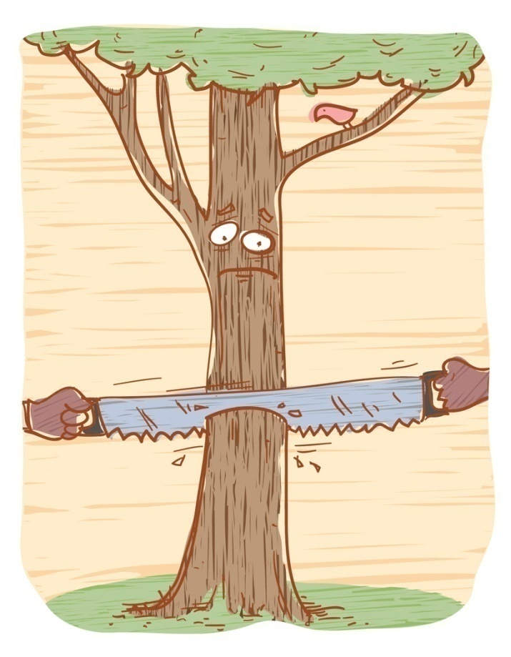
Landscape Tree Facts
Trees growing in commercial settings live an average of 13 years
Trees in residential areas average 37 years
Trees in rural, undisturbed sites average 150 years
Why?????
Quercus nigra
The Water Oak is a relatively short-lived tree.

Slide 11
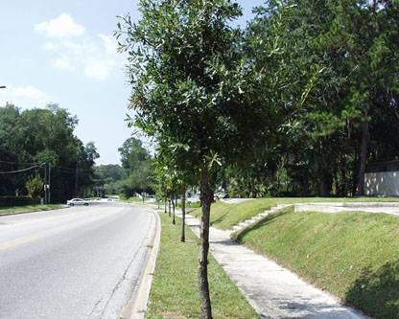
Why What You Know About Forest Situations Doesn’t Always Apply In Urban Sites and Home Landscapes
Improper planting
Over-pruning
Improper fertilization
Compacted soils
No topsoil
Limited space for roots
Improper staking
Mechanical injuries
Construction
Pedestrian and vehicle abuse
Adding/Removing soil

Slide 12
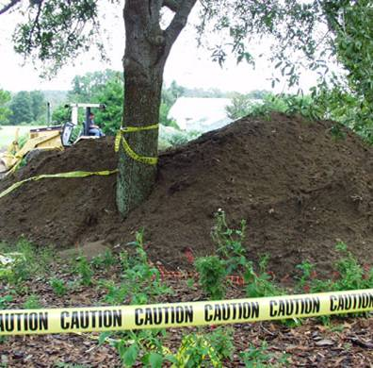
Construction Issues
Changing the soil grade by as little as 2-6 inches can seriously damage a tree
When building, remove a tree that cannot be adequately protected and plant younger, healthy trees

Slide 13
This tree was dying fast – why?

Slide 14
I dug 24” to the root flair

Slide 15
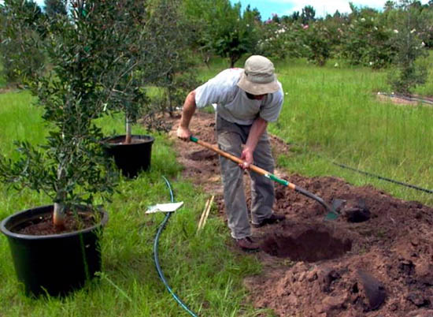
Planting and establishing trees

Slide 16
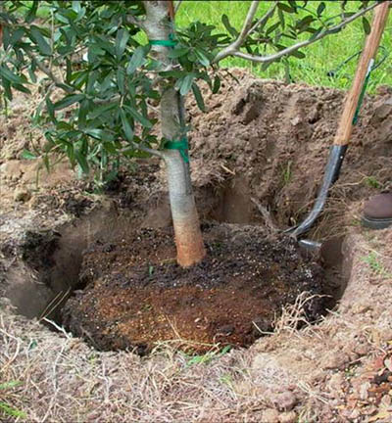
Steps for proper planting
Look up for wires/lights
Dig shallow/wide hole
Find the top-most root and treat root defects
Place tree in hole
Position top root 1-2 inches above landscape soil
Straighten tree
Remove synthetic materials
Add backfill soil and firm the root ball
Add mulch
Stake and prune if needed
What’s wrong with this picture?
Notes:
Ten simple steps to planting a tree.

Slide 17
Look up!
This is your last chance to be sure you have selected the right tree for the right place.
If there is a wire, security light, or building nearby:
Plant elsewhere, or
Plant a small-maturing tree
Notes:
Unfortunately, many trees are planted too close to wires. This increases costs of providing electrical service and reduces reliability.

Slide 18
Steps for proper planting
Look up for wires/lights
Dig shallow/wide hole
Find the top-most root and treat root defects
Place tree in hole
Position top root 1-2 inches above landscape soil
Straighten tree
Remove synthetic materials
Add backfill soil and firm the root ball
Add mulch
Stake and prune if needed
Notes:
Ten simple steps to planting a tree.

Slide 19
Measure the distance between the top most root and the bottom of the root ball.
Dig the hole to about 90 to 95% of this depth.
Notes:
This results in the point where the top-most root meets the trunk and inch or two above the landscape soil. This is appropriate for planting in well drained soils.

Slide 20
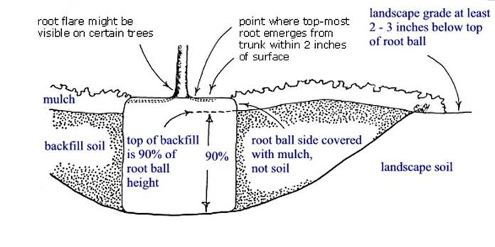
Dig the planting hole as wide as possible
The planting hole is at least 1.5 times the diameter of the root ball.
This provides loose soil for the expansion of new roots.
Notes:
The depth of the planting hole in the illustration above is about 90% of the depth of the root ball. No more than about 2 or 3 inches of the root ball needs to be above the soil unless the site is poorly drained. If the soil is poorly drained, plant even higher. If the hole was inadvertently dug too deep, add soil and compact it with your foot. Make the hole at least 1.5 times the diameter of the root ball. Breaking up compacted soil in a large area (out to the dripline of the tree) around the tree provides the newly emerging roots room to expand into loose soil. This will hasten root growth translating into quicker establishment.

Slide 21
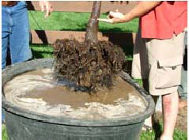
Steps for proper planting
Look up for wires/lights
Dig shallow/wide hole
Find the top-most root and treat root defects
Place tree in hole
Position top root 1-2 inches above landscape soil
Straighten tree
Remove synthetic materials
Add backfill soil and firm the root ball
Add mulch
Stake and prune if needed
This is where the soil was in the ball
Notes:
Ten simple steps to planting a tree.

Slide 22
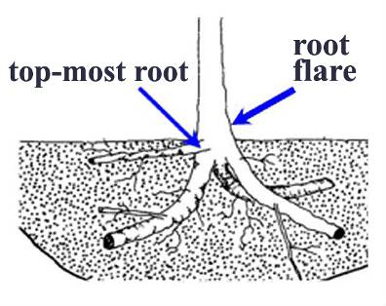
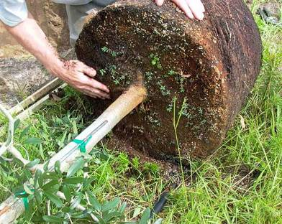
Find the top-most root
The point where the top-most root meets the trunk of the tree should be no more than 2 inches deep in the root ball. Wash the soil/bark away as much as possible.
Notes:
It is great if you can see the top-most root at the surface but not all root balls come from the nursery like that. The top most root in the root ball should be no more than 2 inches deep in the root ball.

Slide 23
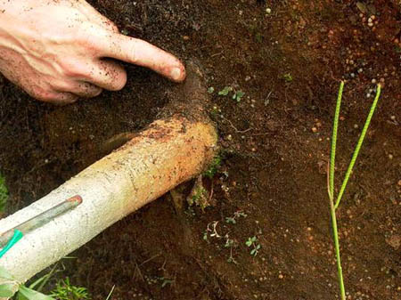
Desirable root ball
The point where the top-most root emerges from the trunk is at the surface.
Notes:
The point where the top-most root emerges from the trunk is at the surface on this root ball. This is good and makes it easy to check for circling and stem girdling roots.

Slide 24
Root ball quality
Good-quality root ball
Remove excess soil
Poor quality root ball
(RIGHT) Too much soil on top of the root ball can indicate a poor-quality root ball.
(LEFT) Trees with the top-most root near the surface of the root ball have more of a root system.
Notes:
The highest-quality root balls have the point where the top-most root emerges from the trunk within 2 inches of the surface as shown at left. Poorer-quality root balls have the the top-most root and root flare (if present) buried down inside the root ball as shown at right. A close look at the two root systems above will show that trees with the top-most root too deep in the ball have less of a root system than trees with the top-most root near the surface. As the distance between the top-most root and the soil surface increases, the percentage of the root system harvested from the field nursery decrease.

Slide 25
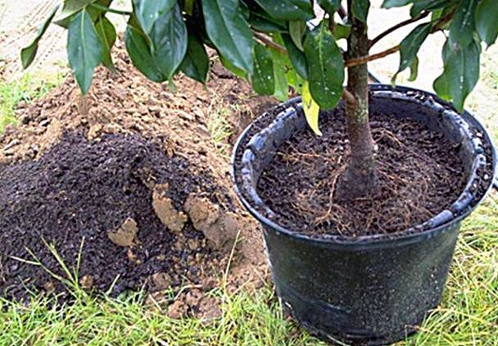
Remove excess soil
Remove excess soil from the top of the root ball.
Get the plant back to a near bare root plant
Three inches of soil and media were removed from the top of this ball before upper roots were located
Notes:
There were no roots evident where the trunk met the root ball. This indicated that the point where the top-most root met the trunk might have been too deep in the root ball. The black media on the ground to the left of the container was just removed from the top of the container to expose the top-most root and the swollen root flare. After cutting the circling roots growing at the base of the trunk, this tree is ready for planting.

Slide 26
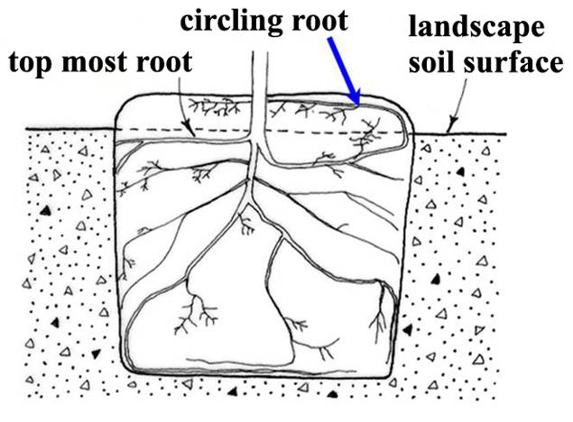
Treating root defects
Cut or spread out any circling or kinked roots growing up above the top-most root.
Notes:
To check for circling and kinked roots in containers or field-grown trees, you might have to displace or remove soil and media that is above the point where the top-most root emerges from the trunk. Cut or spread out any circling or kinked roots growing up into this media on top. Position the top-most root about even with or slightly above (like 2 inches above) the top of the landscape soil in well-drained soil. Plant even higher in soil that drains poorly.

Slide 27
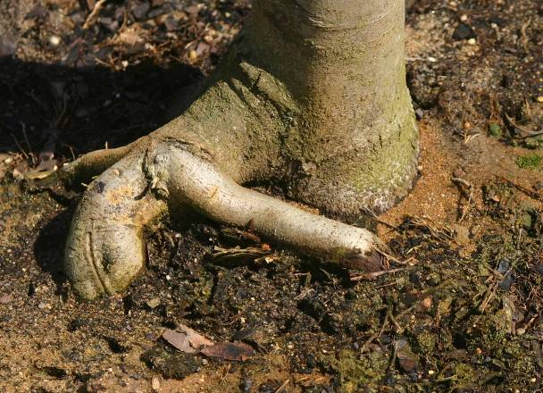
Defects at top of ball
At minimum remove soil/bark from top of root ball and cut circling and crossed roots
Notes:
Cut root at dotted line to prevent root from strangling the trunk a few years from now.

Slide 28
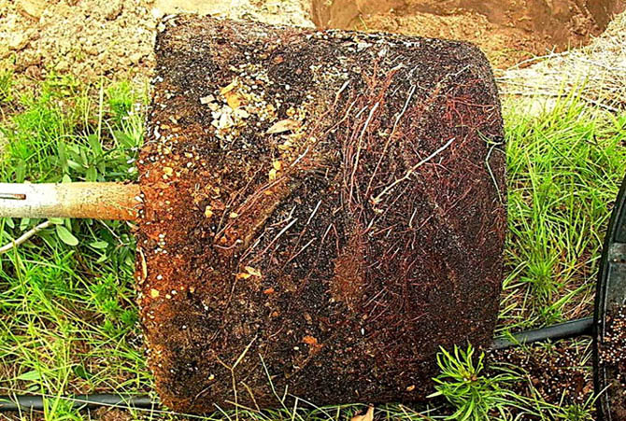
Circling roots – cut them, or tear up the edge of the root ball to spread roots out
Notes:
Look for roots that circle the outside of the container (arrows). These should be cut before planting.

Slide 29
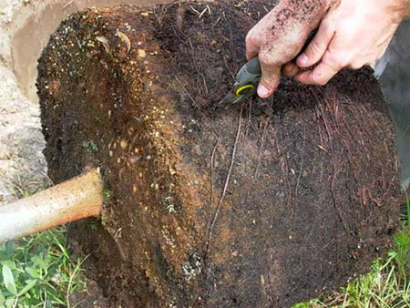
Cutting circling roots
New roots will grow quickly into backfill soil following cutting and stem girdling roots are less likely to form.
Notes:
Circling roots can be found on container trees, B&B trees (shown above) or bare root trees. Eliminate this defect by cutting roots at planting. This can be accomplished 1) on B&B or container trees with pruners before trees are placed in the hole or 2) by slicing the edge of a container root ball from top to bottom with a balling spade after trees are in the hole. Cut roots that are kinked or any that circle the top of the root ball. If these cut roots are large (larger than about 1/3 trunk diameter), the tree might shock and could die.

Slide 30
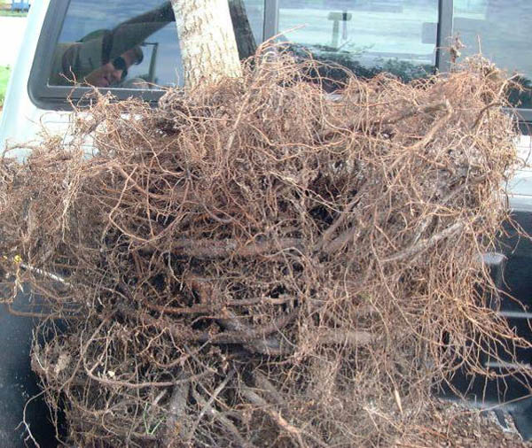
Defects can be inside root ball
Be sure to look for roots that circle when trees were in a smaller container
These are difficult to cut because they are hidden in the interior of the ball.

Slide 31
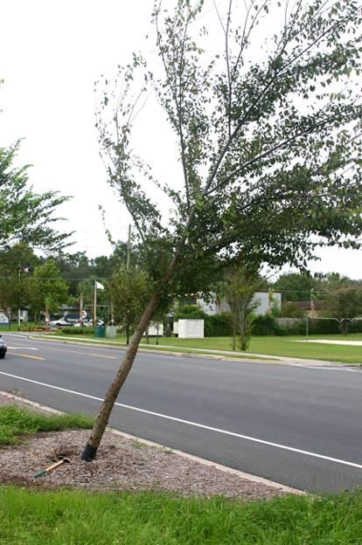
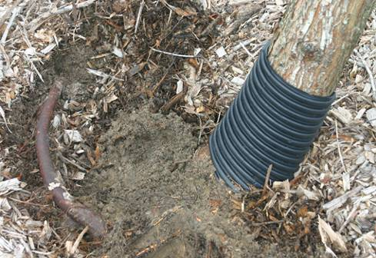
Trees with circling root defects are often found leaning or fallen after a storm.
Notes:
Circling roots do not always result in trunk girdling. This picture shows a tree with a healthy green canopy and no apparent above ground symptoms of root problems, however the tree developed a severe lean after a wind storm due to an issue with circling roots (see arrow).
Few branch roots form on the outside curve of a circling root, causing the tree to become unstable. Because few if any roots develop on the outside of a circling root there may be few if any supporting roots on one side of the tree. That is what happened for this elm tree.

Slide 32
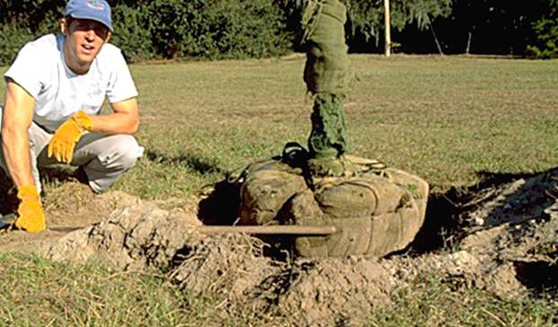
Steps for proper planting
Look up for wires/lights
Dig shallow/wide hole
Find the top-most root and treat root defects
Place tree in hole
Position top root 1-2 inches above landscape soil
Straighten tree
Remove synthetic materials
Add backfill soil and firm the root ball
Add mulch
Stake and prune if needed
Notes:
Ten simple steps to planting a tree.

Slide 33
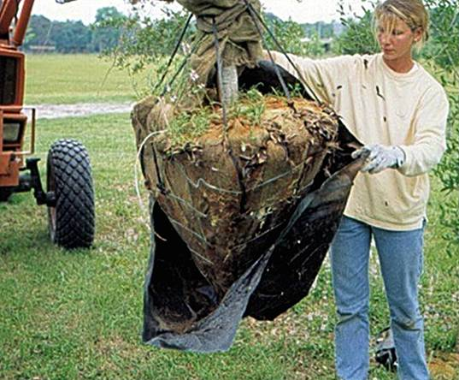
Lifting tree into the planting hole
To avoid damage when setting the tree in the hole, lift the tree with straps or rope around the root ball, not by the trunk.
Notes:
Special strapping mechanisms need to be constructed to carefully lift trees out of large containers and to handle large B&B trees as shown above. This prevents bark damage on the trunk and branches. B&B trees should be handled by the root ball as shown. Remove any plastic wrapped around the root ball before planting as shown above.

Slide 34
Steps for proper planting
Look up for wires/lights
Dig shallow/wide hole
Find the top-most root and treat root defects
Place tree in hole
Position top root 1-2 inches above landscape soil
Straighten tree
Remove synthetic materials
Add backfill soil and firm the root ball
Add mulch
Stake and prune if needed
Notes:
Ten simple steps to planting a tree.

Slide 35
Position the tree in the soil
Many professionals agree that it is better to plant the tree a little high than too deeply.
When the top-most root is too deep in the root ball, set the top of the ball several inches higher than the landscape soil to adjust as shown above.
Notes:
The point where the top-most root emerges from the trunk on some trees may not be at the soil surface. This can result from deep planting in the nursery, soil naturally washing over the roots in the nursery, cultivation between rows, soil pushing in toward the trunk during the digging process, from soil shifting up the trunk during transportation, soil pushing against the trunk when the top of the root ball is squeezed to tighten the ball, or for other reasons. A shovel handle provides a convenient tool for gauging proper height. Shown is a shovel handle (see arrow) used to help position the root ball at the appropriate depth. Be sure to pack the bottom of the hole with your feet to prevent the tree from settling.

Slide 36
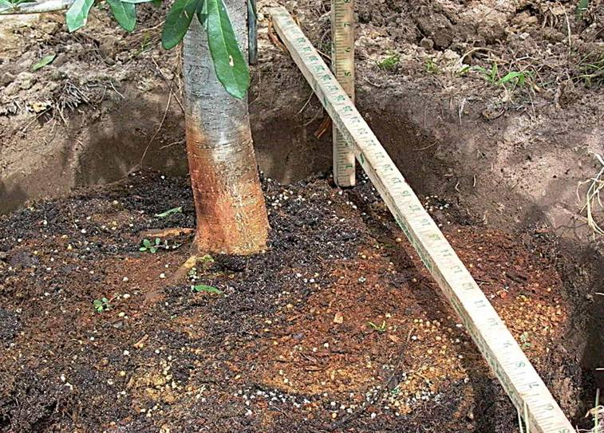
TOO DEEP! - add soil to bottom of hole
Notes:
Use a shovel or another convenient device for checking root ball depth. This hole is way too deep! Look carefully at the vertical ruler and you will see that the tree is about 6 inches too deep. Remove the root ball and add soil to the bottom of the hole and pack is by bouncing on it several times. If the tree is too deep, tip it from side to side or raise the tree up while sliding soil under it until the root system is at the appropriate depth

Slide 37
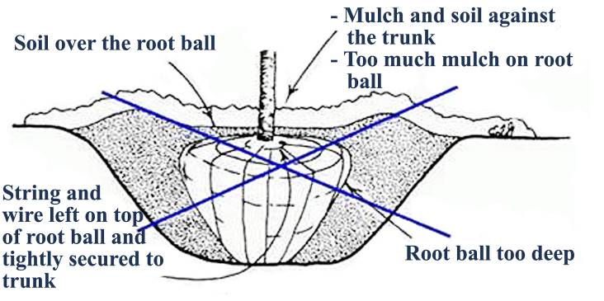
Effect of planting depth on stress after planting
Soil intercepts water meant for the root ball causing roots to dry out.
Notes:
This diagram shows many common mistakes made when planting trees.

Slide 38
Steps for proper planting
Look up for wires/lights
Dig shallow/wide hole
Find the top-most root and treat root defects
Place tree in hole
Position top root 1-2 inches above landscape soil
Straighten tree
Remove synthetic materials
Add backfill soil and firm the root ball
Add mulch
Stake and prune if needed
Notes:
Ten simple steps to planting a tree.

Slide 39
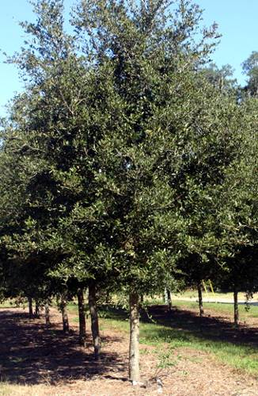
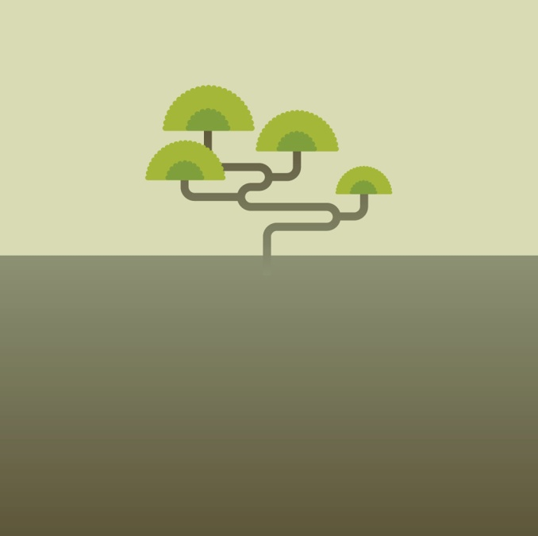
Straighten the tree
Before adding backfill, be sure to check that the tree is straight by looking at it from two perpendicular directions.
Notes:
Before you begin backfilling have someone view the tree from two directions perpendicular to each other to confirm the tree is straight. Fill in with some more backfill soil to secure the tree in the upright position. Once you add large amounts of backfill, it is difficult to reposition the tree.

Slide 40
Steps for proper planting
Look up for wires/lights
Dig shallow/wide hole
Find the top-most root and treat root defects
Place tree in hole
Position top root 1-2 inches above landscape soil
Straighten tree
Remove synthetic materials
Add backfill soil and firm the root ball
Add mulch
Stake and prune if needed
Notes:
Ten simple steps to planting a tree.

Slide 41
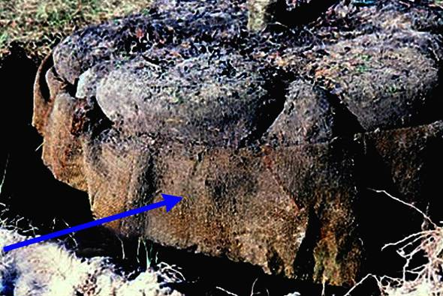
Balled-in-burlap trees
Burlap should at least be removed from the bottom of the trunk and the top of root ball. Better if removed entirely – some “burlap” is synthetic and will not rot.
Notes:
Some contractors leave the burlap pinned in place. This seems to be alright as long as the top-most root is not too deep and there are no root defects to treat. Removing burlap from the top of the ball allows you to check for root defects including deep planting in the root ball and circling roots. If the burlap is made from synthetic material that will not decompose, remove all of it at planting.

Slide 42
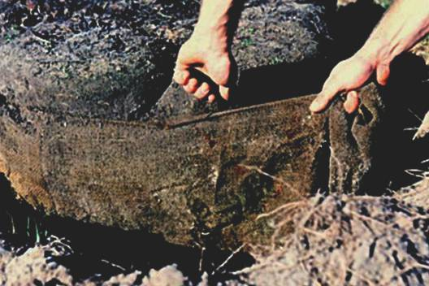
Remove all synthetic burlap
Synthetic burlap melts into a plastic goo while real burlap flames and turns to ash when lit.
If burlap is synthetic, be sure to remove all of it with a pruner, knife or other sharp blade.
Notes:
The top tier of wire on this wire basket was removed when this tree was planted making it easier to remove synthetic burlap.

Slide 43
Synthetic burlap can girdle roots
Roots grow through artificial burlap with little difficulty, but as the roots attempt to expand in diameter, they become girdled or strangled.
Each of these roots is very easy to break off at the burlap because there is very little wood that developed through the burlap.
Notes:
These trees were struggling about ten years after planting. The close up on the bottom shows that roots are able to grow through artificial burlap but are unable to expand in diameter sufficiently to remain vigorous. The artificial burlap is still intact 10 years after planting. Only natural burlap, either treated or not treated, should be used for wrapping root balls.

Slide 44
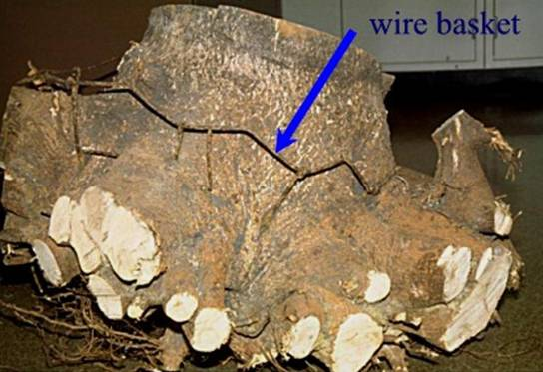
Wire baskets
Baskets made from heavy gauge wire are often used to help keep a root ball intact during shipping and handling.
There is no research documenting the detrimental effects of wire baskets on trees but this can’t be good.
Notes:
The dead maple that was excavated above was planted with a wire basket. This does not mean the basket killed the tree because many factors are associated with tree death in urban landscapes. Live oaks appear to grow around a wire basket just fine with little or no effect on the tree. If wire was a huge problem I would think we would know about it by now because there would be reports of problems from all corners of the industry – this has not happened. Some arborists have stated that the wire basket can present a risk to the operator of a stump grinder, or could damage the machine itself, should the tree need to be removed from the landscape and the stump ground before the wire degrades.

Slide 45
Steps for proper planting
Look up for wires/lights
Dig shallow/wide hole
Find the top-most root and treat root defects
Place tree in hole
Position top root 1-2 inches above landscape soil
Straighten tree
Remove synthetic materials
Add backfill soil and firm the root ball
Add mulch
Stake and prune if needed
Notes:
Ten simple steps to planting a tree.

Slide 46
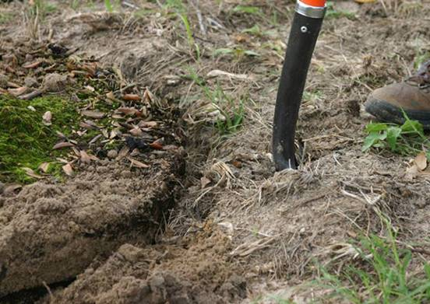
Slice a shovel into the soil at the edge of the hole to enlarge the hole or better yet till a large ring around planting hole.
Use the same soil taken out of the hole as backfill.
Firm the soil against the root ball.
Notes:
Slice a shovel into the soil around the edge of the hole and push it toward the root ball. Then use landscape soil to finish filling in around the root ball. Slice the shovel into the backfill soil 20 to 30 times all around the tree as you add backfill soil. Attempt to break up the large clayey soil clumps as much as possible. Do not pulverize the soil because small soil clumps help add air space to the soil. When the planting hole is filled with soil the root ball should remain 1 (small trees) to 3 (larger trees) inches above the backfill soil.

Slide 47
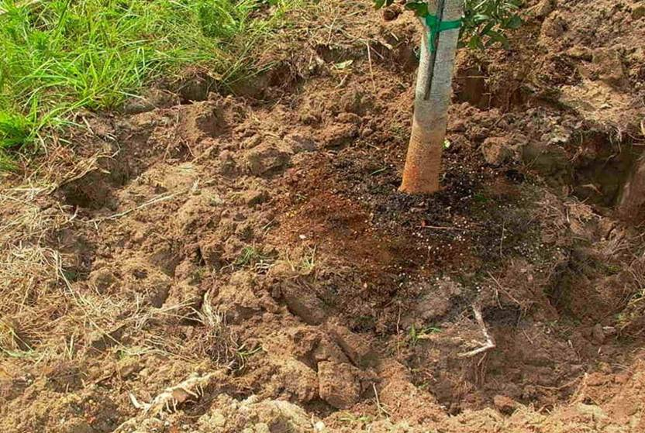
Moderately pack the backfill soil
Notes:
The root ball is now surrounded by about 18 inches of loose soil on all sides. No soil was placed over the root ball – you can clearly see the media of the container root ball near the trunk. Roots will grow freely into this loosened soil and help trees establish quickly. Moderately pack the backfill soil so root ball does not move. Do not over pack, especially when soil is wet.

Slide 48
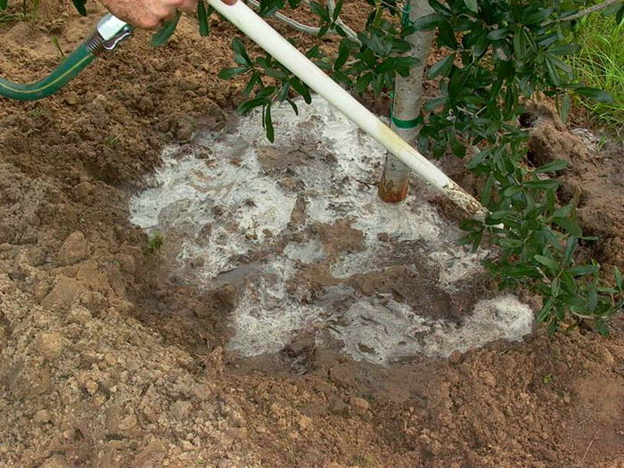
Water the backfill to settle
Notes:
Add water to the root ball and soil after adding the backfill soil. Here you see a one-inch pvc pipe being inserted into the backfill soil. This is an effective means of eliminating air pockets around the root ball. Add 10 to 20 gallons of water to the root ball and backfill on a small tree pictured here, more for larger trees. Fill in any holes or depressions with additional backfill soil. Do not firmly pack backfill soil in an attempt to eliminate air pockets because this could cause too much soil compaction. The water infiltrating the backfill soil will eliminate the large air pockets. The presence of small air pockets could even be of benefit because they could allow more air to reach the roots.

Slide 49
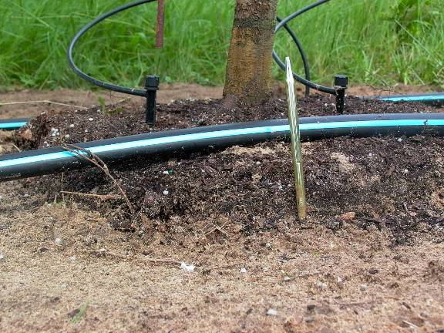
Ready for mulch
About two inches of the root ball should remain above ground after all the backfill soil is added.
This ensures the top-most root remains above ground, even if the root ball settles.
Notes:
Mulch will cover the sides of the ball but will not be placed on top. A thick layer of mulch placed on top of the ball could cut off oxygen and water to roots. Leave this open to the air. Recent research showed that mulch OVER the root ball provides NO BENEFIT to the tree, and it could hurt by reducing air exchange and reducing water infiltration into the root ball. Mulch over the root ball can also encourage growth of stem girdling roots next to the trunk. The root ball should not settle very much if the bottom of the hole is packed with your feet.

Slide 50
Steps for proper planting
Look up for wires/lights
Dig shallow/wide hole
Find the top-most root and treat root defects
Place tree in hole
Position top root 1-2 inches above landscape soil
Straighten tree
Remove synthetic materials
Add backfill soil and firm the root ball
Add mulch
Stake and prune if needed
Notes:
Ten simple steps to planting a tree.

Slide 51
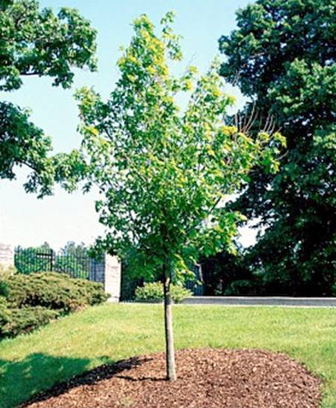
Mulching
Apply a 3-inch thick layer of mulch to at least an eight-foot diameter circle
Apply a thinner 1” layer of mulch over the root ball if necessary, but keep it at least 10” from the trunk
Better yet leave it bare over the root ball.
Notes:
Apply a 3-inch thick (after settling) layer of mulch to at least an eight-foot diameter circle around the plant, or maintain the area weed free with herbicides, to help discourage weeds and turf. This area should be maintained during the establishment period at least two feet in diameter (preferably three feet) for each inch of tree trunk diameter (to encourage rapid establishment. Minimum diameter should be eight feet for trees with a trunk diameter less than 3 inches. Apply a thinner layer of mulch over the root ball, for aesthetic reasons if you wish, but keep it at least 10 inches from the trunk (20-inch diameter mulch-free area) so the trunk bark can dry. This also allows rainwater, irrigation, and air to easily enter the root ball since it does not have to drain through the mulch. Mulch resting on the trunk and applying too thick a layer can kill the plant by holding water meant for the roots, oxygen starvation, death of bark, stem and root diseases, prevention of hardening off for winter, vole and other rodent damage to trunk, keeping the root ball too wet, encouraging stem girdling roots, and repelling water if the mulch dries out.

Slide 52
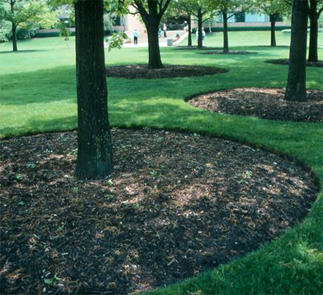
Mulching
Mulch as large an area as possible to allow the tree roots to expand without competition from turf roots.
What would you do differently than pictured here?
Notes:
Turf roots are very competitive with tree roots. This competition can dramatically slow the rate of tree root growth and establishment into the landscape soil, and this can cause the tree to become unhealthy. Once the tree is established, the mulch area can shrink.

Slide 53
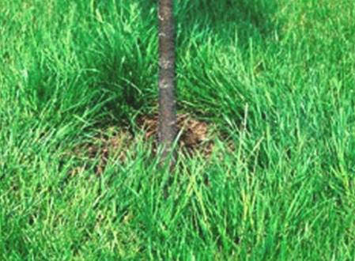
Improper mulching
If turfgrass grows up to the trunk, trees often perform poorly.
Turf and weeds rob trees of moisture and nutrients and some produce chemicals that inhibit tree growth.
Lawn mowing equipment or weed eater damages trunk (no matter how careful you are)
Notes:
If turf grass grows up to the trunk, trees often perform poorly (Watson and Green, 1989; Gilman et al 2004). Turf and weeds rob trees of moisture and nutrients, and some produce chemicals that inhibit tree growth.

Slide 54
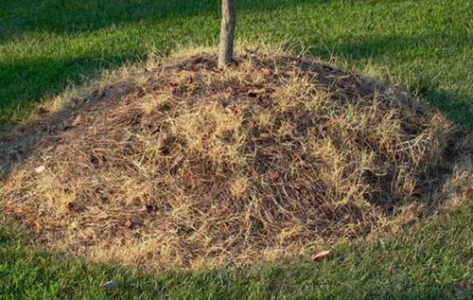
Improper mulching
Never pile mulch in a volcano-like manner against the trunk. This can rot the trunk, cut off oxygen to roots, keep vital irrigation and rain water out, and can keep roots too wet in poorly drained soils. Stem girdling roots form from this on some trees.
Notes:
Some rodents, such as voles, can also cause damage to the trunk easily if mulch is piled there. Trees could decline from this problem.

Slide 55
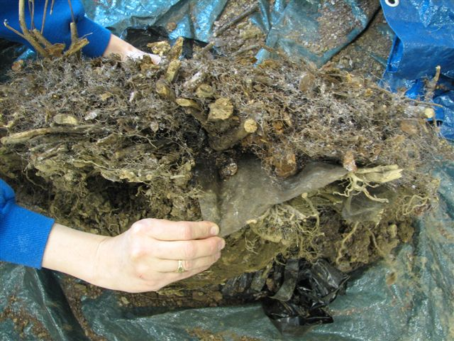
Too much mulch over time
These hollies were dying one by one – quickly
Landscape fabric was used 10 years prior at planting
Mulch was added each year
Most roots were on top of the
fabric in the mulch

Slide 56
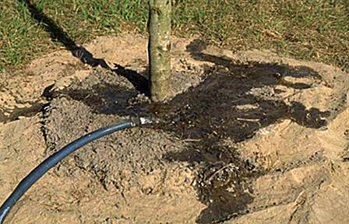
Adding a berm
A 3 to 4-inch berm could be constructed at the edge of the root ball to prevent water from running off as seen here.
Notes:
If you believe a berm is needed to hold water from a high volume delivery system such as a large hose or water trunk, use mulch, not soil to construct a berm. Soil can wash over the root ball with time burying the roots too deep. The berm will ensure that water penetrates to where it is needed most, i.e. in the root ball. If soil is sandy or very well drained, a berm may not be needed.

Slide 57
Steps for proper planting
Look up for wires/lights
Dig shallow/wide hole
Find the top-most root and treat root defects
Place tree in hole
Position top root 1-2 inches above landscape soil
Straighten tree
Remove synthetic materials
Add backfill soil and firm the root ball
Add mulch
Stake and prune if needed
Notes:
Ten simple steps to planting a tree.

Slide 58
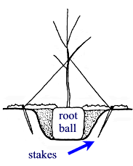
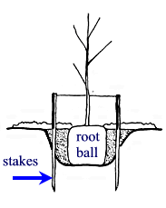
Traditional staking methods
Figure 1
Figure 2
Figure 3
All these systems require removal within one year of planting.
This is the system to use if you remove soil/media as described earlier
Notes:
Figure 1: Three short stakes (2 shown) attached to the trunk with straps, similar material. Stakes driven in as shown above may be better secured in the soil than those shown in Figure 2.
Figure 2: Three short stakes (2 shown) driven into soil in a traditional manner attached to the trunk with stretchable material.
Figure 3: Two or three (2 shown) 2 x 2 (or lodgepole pine) wood stakes driven through the backfill soil.
Recent research shows that stakes driven straight into the ground, not at an angle as shown in Figures 1 and 2 above, are most secure in the soil.

Slide 59
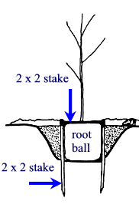
Alternative staking methods
Figure 4
This inexpensive alternative staking system does not need to be removed because they simply decay in a few years.
Use this method on smaller B&B plants that are not very top heavy – deciduous trees planted in the fall/winter
Notes:
Figure 4: Photo of the system shown in Figure 5.
Figure 5: One horizontal 2 in. x 2 in. screwed to two vertical 4 feet long 2 x 2s against the side of the root ball. This works for trees at least 3 inch caliper.

Slide 60
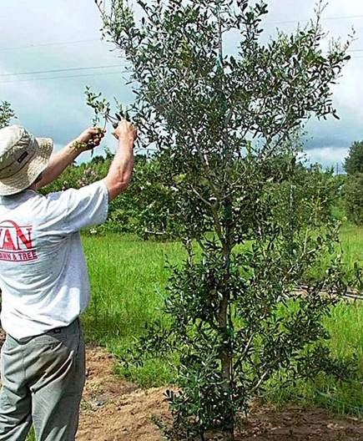
Prune to finish the job
Remove broken branches.
Perform structural pruning if needed (but leave all foliage possible for the first year).
Do not prune to compensate for root loss (water instead).
Notes:
Prune to remove or reduce codominant stems if no pruning is planned in the next couple years. Wait until later if there is pruning is planned in the next two years.

Slide 61
Fertilizer at planting?
Not necessary – fertilizing at planting time is not likely to improve survival or growth. A small benefit might occur in very poor sandy soils.
Soluble fertilizers could burn roots if too much is applied, which could injure or kill the tree.
Homeowners may apply very weak (1/4 rate or less) liquid feed while watering during growing season
Notes:
Adding slow release fertilizer of any type at planting has never been associated with improved or reduced survival. Response to fertilizer applications at planting is most likely to occur in poor soils. Application of slow release fertilizer is not likely to hurt the plant provided it is applied according to the directions on the product. On the other hand, adding soluble fertilizer to a newly installed plant could burn roots if too much is applied. Burned roots will injure the plant and could kill it. Since survival will not be improved, growth increases are unlikely (except in very poor soils), and the potential for fertilizer burn is real, it might be best to make the first fertilizer application at least a few months after planting. Any nitrogen source can be applied to established trees with about the same effect on the tree.

Slide 62
Establishment
Establishment period: the time it takes for a tree to regenerate enough roots to stay alive without irrigation.
Roots grow to pre-transplanting length
Trunk and shoot growth match pre-transplant rate
Time: about 3 - 4 months/ inch trunk caliper is a good estimate
Notes:
In moist climates, by the end of the establishment period a tree has regenerated enough roots to keep it alive without supplemental irrigation in a landscape where roots can expand uninhibited by urban structures. In the drier parts of central and western US, the turf and landscape irrigation system may have to supplement rainfall to provide enough water for survival after establishment. Trees in unirrigated landscapes in dry climates may need supplemental irrigation beyond the end of the establishment period. This is especially important if the trees are not adapted to the dry climates.

Slide 63
Establishment rate is influenced by a variety of factors other than climate
Encourages growth | Limits growth | Little or no effect (or harmful)
Loose soil | Compacted soil | Peat or organic matter added
Proper irrigation | Little or no irrigation | Water absorbing gels
Mulch applied correctly | Grass and weeds close to trunk | Root stimulant products
Root flare above soil surface | Planting too deeply | Adding spores of mycorrhizae *
Leaving shoots intact | Pruning at planting | Fertilizing at planting
Notes:
Climate in another factor influencing establishment – in warm, wet climates the period will be much shorter than in dry, cold climates. The longer the growing season, the less time needed for establishment.
*can enhance growth on seedlings under certain circumstances

Slide 64
During establishment
Irrigate
- 2 – 3 times weekly until established
- 2 gallons per inch trunk caliper on root ball
Mulch
- Control weeds
- Increase mulch diameter over time to keep pace with root growth
Minimize soil compaction
Remove stakes and ties before the end of the first year, protect lower trunk
Notes:
Trees provided with regular irrigation through the first growing season after transplanting require approximately 3 months (hardiness zones 9-11), 6 months (hardiness zones 7-8), or one year or more (hardiness zones 2-6) per inch of trunk diameter to fully establish roots in the landscape soil. Trees in desert climates may take longer to establish. Trees that are underirrigated during this establishment period are likely to require additional time to establish because roots grow more slowly. Most trees are underirrigated during the establishment period. Because roots are not fully established, be prepared to irrigate through the entire establishment period, especially in drought. Since most root growth occurs in summer, be sure soil moisture is appropriate during this crucial season.

Slide 65
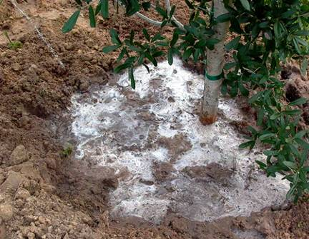
Irrigation: is it volume or frequency?
It’s frequency!
Experiment done on 4-inch hardened-off B&B trees where 1.5, 3, or 5 gallons of water were applied per inch trunk caliper.
Results show that volume did not matter but frequency did.
Notes:
Irrigating daily makes for healthier trees, but 2-3 times per week keep plants alive.

Slide 66
Frequency of irrigation based on tree size when planted in spring (less if fall planted or rainfall is plentiful)
Size of nursery stock | Irrigation schedule for vigor | Irrigation schedule for survival
< 2 inch caliper | Daily: 2 weeks Every other day: 2 months Weekly: until established | Twice weekly for 2-3 months
2 – 4 inch caliper | Daily: 1 month Every other day: 3 months Weekly: until established | Twice weekly for 3 – 4 months
> 4 inch caliper | Daily: 6 weeks Every other day: 5 months Weekly: until established | Twice weekly for 4 – 5 months
Notes:
Do not irrigate daily when planting in winter, cool climates, or during the rainy season. Irrigation frequency can be reduced to 2-3 times each week instead. Never apply irrigation if the soil is saturated.
Establishment takes 3 months (hardiness zones 10-11) to 4 (hardiness zones 8-9) to 8 (hardiness zones 6-8) to 12 (hardiness zones 2-5) per inch trunk caliper.
At each irrigation, apply 1-2 gallons (cool climates) or 2-3 gallons (warmest climates) per inch trunk caliper to the root ball. Apply it in a manner so all water soaks into the root ball. Do not water if root ball is wet/saturated on the irrigation day.

Slide 67
Months of irrigation to provide based on climate and tree size at planting
 | USDA Hardiness Zone
Max. trunk diameter at planting | 5 | 6 | 7 | 8 | 9 | 10
1 inch | 12 months | 10 months | 7 months | 5 months | 3 months | 3 months
2’’ | 24 | 20 | 15 | 10 | 6 | 6
3’’ | 36 | 30 | 23 | 16 | 9 | 9
4’’ | 48 | 39 | 30 | 21 | 12 | 12
Notes:
Maximum recommended tree size at planting depends on climate and how long trees can be irrigated after planting. For example, if irrigation can be provided for six months after planting in USDA hardiness zone 9, maximum trunk diameter at planting is two inches. Basically, this graph shows that areas with a longer growing season require less irrigation time for tree establishment. Also, the greater the size of the tree diameter at planting, the longer a period of time is needed for irrigation.

Slide 68
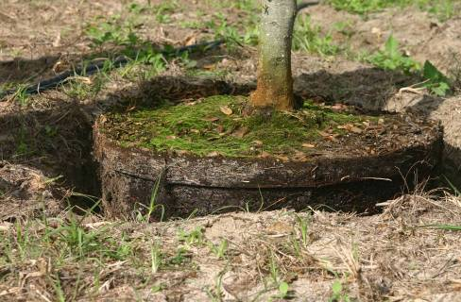
This tree is set too deeply and needs adjusting
By the way this tree is the correct depth
Notes:
Point out that the slide they have been seeing on each outline slide is planted too deeply (right photo). The tree on the left is positioned correctly.

Slide 69
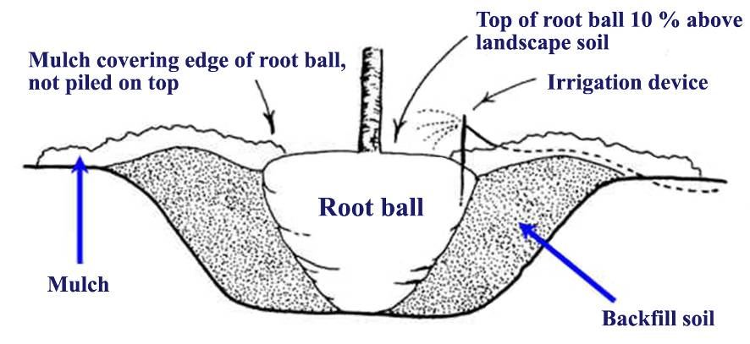
Summary of proper planting
For more information on related topics…
Visit the website Trees and Hurricanes:
http://treesandhurricanes.ifas.ufl.edu
Notes:
This sums up the entire presentation. Proper hole depth and width, proper planting depth, a gently sloping 3 to 4 inch soil berm covered with mulch, mulch applied around ball but not applied on the root ball, and provisions for irrigation.

