Slide 1
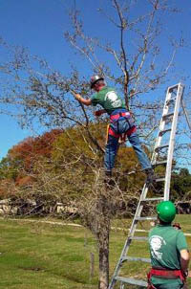
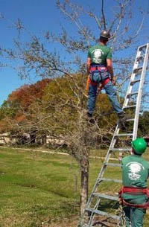
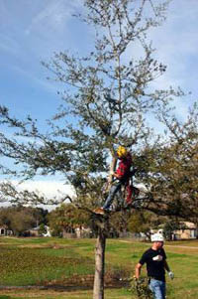
Urban Tree Pruning Program :
Tony Glover, Regional Extension Agent
Originally prepared by: Dr. Ed Gilman and Traci Jo Partin, University of Florida

Slide 2
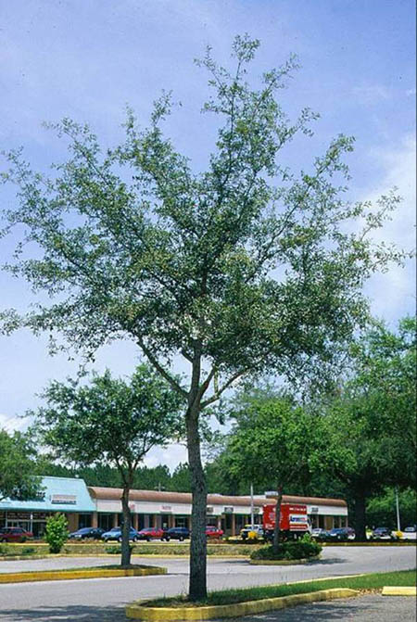
Preventive Pruning: young trees
Set objectives
Determine pruning cycle and dose
Execute pruning plan - make good cuts - prioritize trees with structural issues - temporary vs. permanent branch management

Slide 3
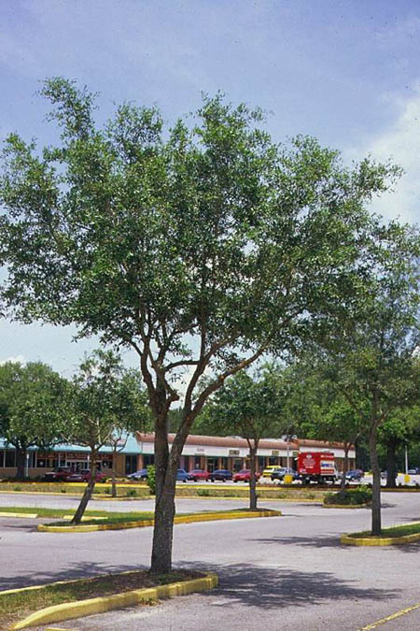
Poor form
Good form
Principles of strong structure:
One dominant trunk
Strong branch unions
Balanced canopy
Notes:
Well structured shade trees have a single trunk, stem, or leader up through the center of the tree, strong branch unions without bark inclusions, and a balanced canopy. The tree on the left is likely to turn out like some of the defective and broken trees shown in the following several slides.

Slide 4
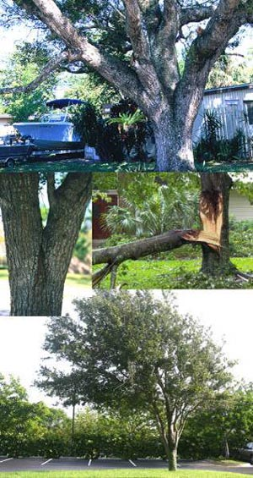
Objective: Reduce structural issues that cause tree failure
Codominant stems: stems of equal size originating from the same point on the tree
Included bark: bark pinched between two stems, indicating a weak union
Unbalanced canopy: one side much heavier, or most weight at the tips of branches
Large low branches:
Notes:
These three issues or conditions can cause failure in shade trees. These conditions should be minimized when pruning young trees. Arborists reduce structural issues by using structural pruning techniques.

Slide 5
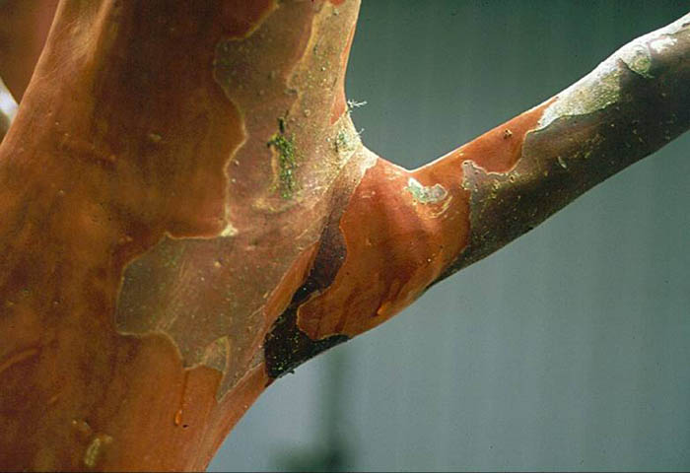
Strong connection
Collar
Notes:
Strong branch unions are ‘U’ shaped and have a prominent collar. The collar is a swelling formed by overlapping trunk and branch wood. This forms a strong union resistant to breakage.

Slide 6
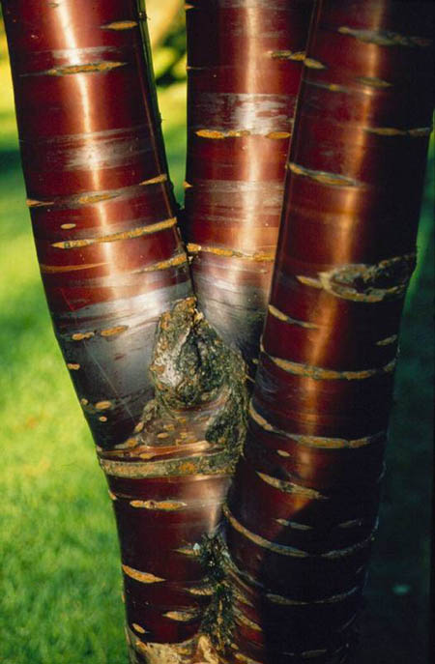
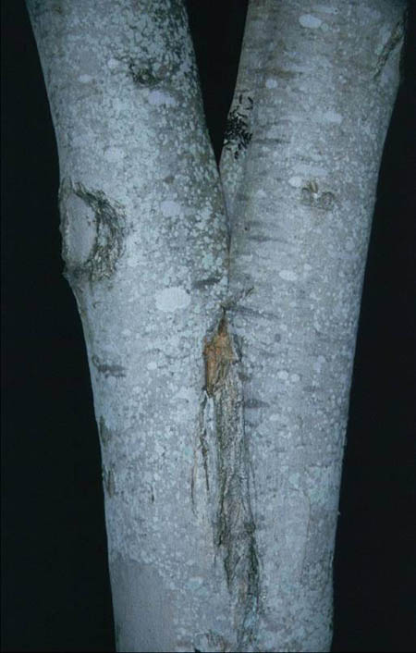
Weak structure:
codominant stems and bark inclusions
Notes:
Here are two examples of weak branch unions. Both have bark inclusions and ‘V’ shaped unions. There is no physical connection between the stems where there is a bark inclusion. Instead of wood overlapping forming a strong connection wood from one stem grows against wood from the other.

Slide 7
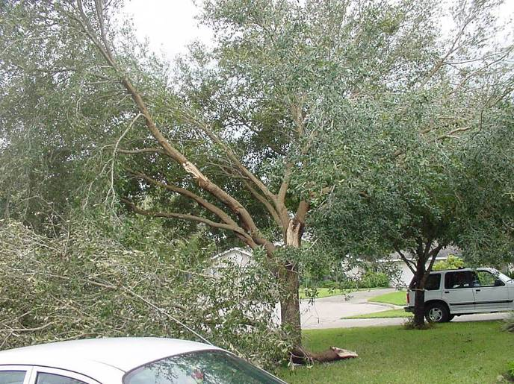
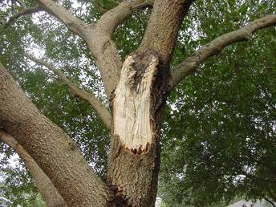
Codominant stems often cause branch failure in storms
Notes:
Researchers at UF have visited several hurricane sites, and found time and time again that trees failed due to structural issues like codominant stems and bark inclusions. This tree is ruined and should be cut down.

Slide 8
Failure due to bark inclusion
Notes:
A 70 mph wind peeled this codominant stem out from the rest of the tree. There was a severe bark inclusion in the union.

Slide 9
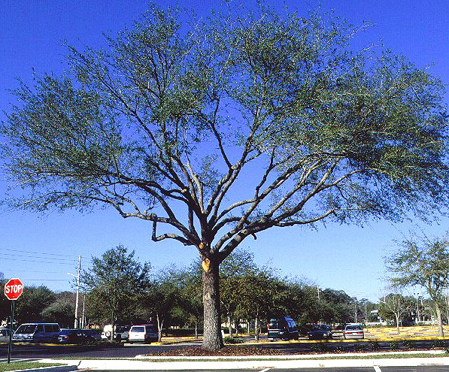
Unbalanced canopy
Lions-tailing: trees with foliage concentrated at the tips of branches because inner branches were removed.
More susceptible to hurricane damage
Difficult to restore
Notes:
Lions-tailed trees are cleared of live foliage all along the lower and interior parts of the main branches. This may reduce storm damage if the storm occurs in the weeks following a wind storm but professionals believe this makes them more susceptible to storm damage in the long run. Lions-tailing encourages more growth at the tips of the branches resulting in a taller and wider tree because new growth occurs primarily from the branch ends. This places more foliage exactly where you do not want it; that is, higher off the ground. Sprouts routinely form along the portion of the main branches where branches were removed from quickly filling the canopy back in with foliage. Branch diameter on the end of the branch closest to the trunk increases more slowly following this type of pruning. Some branches can break easily as a result. In addition, lions-tailed trees that are damaged in storms are difficult to restore because the branches arborists would normally cut back to have already been removed.

Slide 10
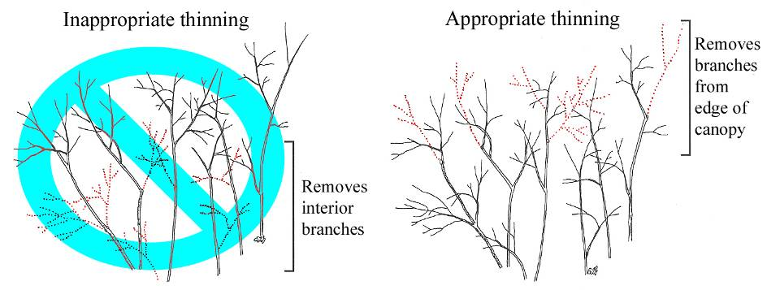
Pruning to: Thin
The selective removal of small live branches to reduce crown density .
Increases light and air penetration.
Reduces the risk of storm damage.
Notes:
Appropriate thinning reduces damage in storms and hurricanes. Proper thinning retains crown shape and should provide an even distribution of foliage throughout the crown. This means removing branches that have foliage at the edge of the canopy. Increased light and air stimulates and maintains interior foliage, which can encourage taper on scaffold branches. Thinning reduces the wind-sail effect of foliar clumps in the crown and reduces the load on branch unions. Do not remove branches from the interior of the canopy since this can make a tree more susceptible to damage by encouraging branches to grow taller and wider.

Slide 11
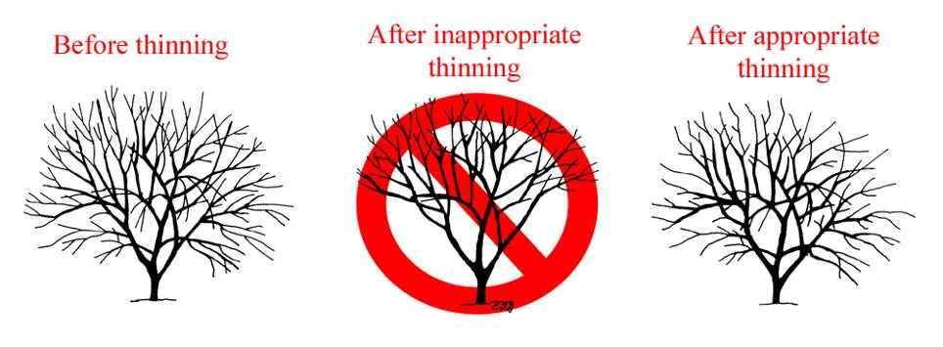
How to thin a canopy
Lions Tailing
Notes:
Excessive branch removal on the lower two-thirds of a branch or stem (center illustration) can have adverse effects on the tree and therefore is not an acceptable pruning practice. Some arborists call this lionstailing.

Slide 12
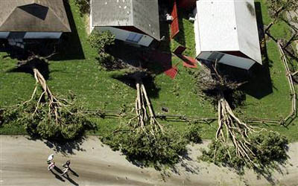
Lions-tailed trees failed
Notes:
These lions-tailed trees caught the wind as it blew over these homes. Proper pruning could have reduced the likelihood of this occurring.

Slide 13
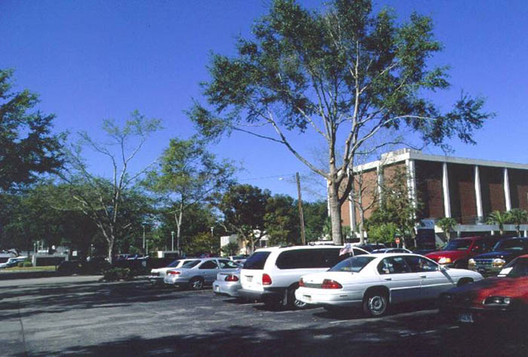
Nothing to cut back to should the tree be storm damaged.
Notes:
These trees were severely over lifted (lions-tailed) a week ago. The pruning wounds are still lightly colored indicating a recent pruning job. Imagine a storm breaking some of the main branches - because there are no interior branches, broken main branches would have to be headed or removed entirely back to the trunk.

Slide 14
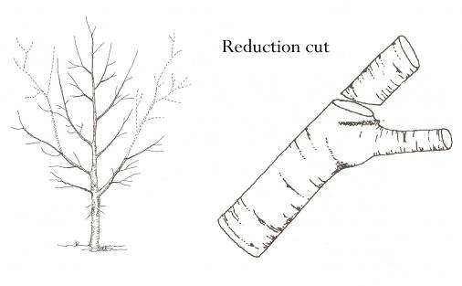
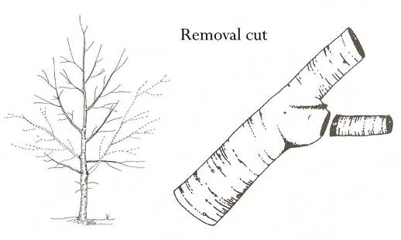
Types of pruning cuts:
Reduction cut shortens the length of a stem by pruning back to a smaller limb.
Removal cut prunes a branch back to the trunk or parent branch.

Slide 15
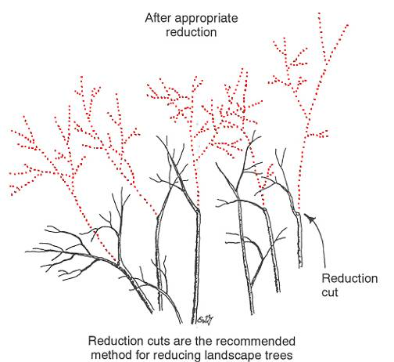
Pruning to: Reduce
The selective removal of branches and stems to decrease the height and/or spread of a tree
Notes:
Trees sometimes grow larger than desired for aesthetic or safety considerations. These trees may interfere with overhead utility wires, grow into buildings or other trees, or become hazardous because of their size, length, or condition. Reduction can be used to make the entire tree or portions of the tree smaller which can reduce the likelihood of failure, and it can direct branch growth away from buildings or signs. Reduction can open a view, or bring one side of the canopy in balance with another. Crown reduction should be accomplished with reduction cuts, not heading cuts.

Slide 16
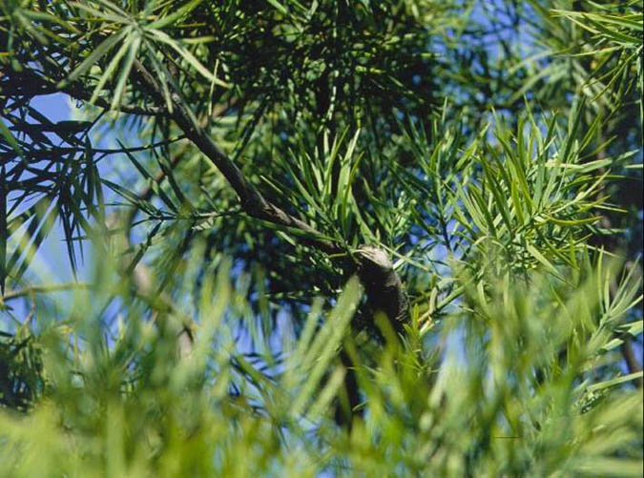
Reduction
cut
Lateral branch assumes dominance
Notes:
Reduction cuts shorten the length of branches back to a live lateral branch that is large enough to assume the role of dominance. Typically this lateral branch should be at least 1/3 the diameter of the stem you are cutting off.

Slide 17
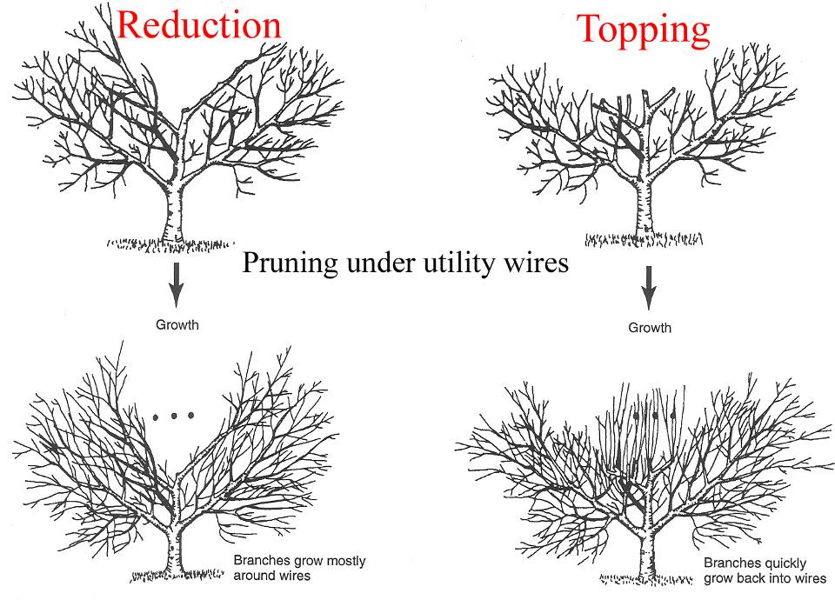
Excessive sprouting
Notes:
Notice that topping results in excessive sprouting. This creates the need for more frequent pruning and promotes poor structure in the canopy that can become more susceptible to hurricane winds. Proper reduction cuts limit sprouting and regrowth. These trees will have to be pruned less often to clear the utility lines from branch interruptions.

Slide 18
Reduction Pruning Proper vs. Improper (Topping)
Proper reduction
reduces size while maintaining form
minimizes re-growth
cuts barely noticeable
branch tips visible in outer canopy
Improper reduction
drastic form change
sprouting
cuts very noticeable
branch tips not visible in outer canopy
compromises structure
promotes defects and decay
Notes:
Canopy reduction makes a tree smaller by removing the end portion of branches with reduction cuts. Inappropriate reduction uses heading cuts and can result in more problems in the future such as decay and structural defects.

Slide 19
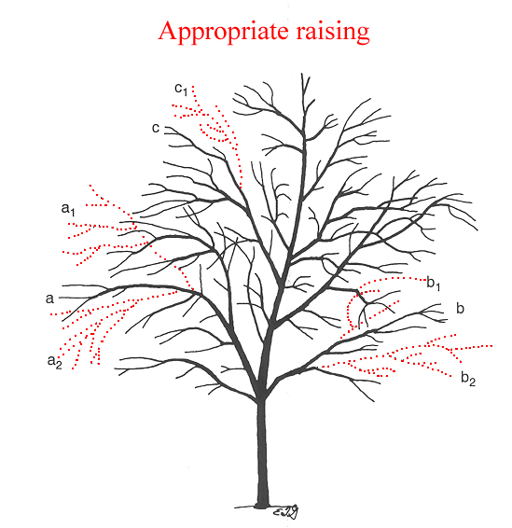
Clearance can be achieved by shortening low branches rather than removing them.
Notes:
Here is a more moderate method of raising compared to removing many low branches all at once. Lower branches a and b can be removed to raise the crown. However, subordinating branches a and b by removing upper and lower branches a-1, a-2, b-1, and b-2 will cause less stress for the tree. Removing a-2 and b-2 helps raise the crown. Removing a-1 and b-1 ensures that the branches will not grow up to become part of the permanent canopy. Left unpruned, these branches are likely to remain vigorous-forming low, codominant stems. Because it is important to also remember structural pruning issue, branch c should be reduced to keep it from competing with the leader.

Slide 20
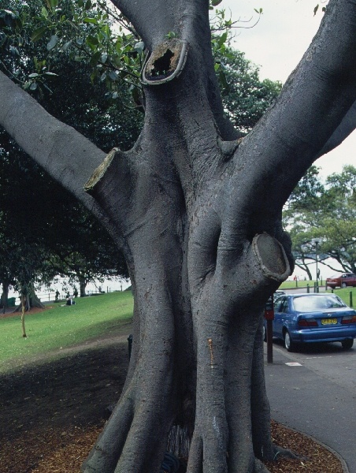
Big cuts can result in decay and cracks.
Notes:
Large cuts like these should not be made on this decay prone species. Attempt to reduce the length of these large low branches and retain them on the tree. This tree should have been pruned many years ago to keep these low branches small relative to the trunk. The goal is to keep branches smaller than half the trunk diameter if they will require removal later.

Slide 21
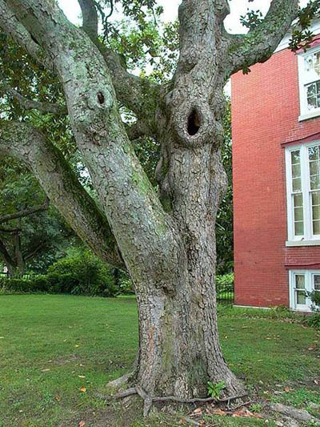
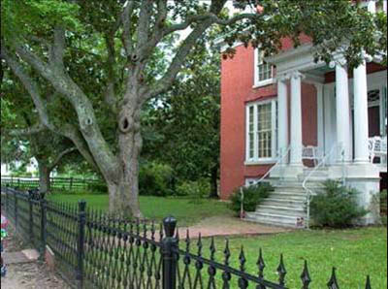
Low and big cuts can be avoided with early pruning.
Notes:
Even trees planted near residences should be pruned to prevent low branches from growing to a large size. Large low branches may be upright when trees are young but they often droop as they gain weight. They interfere with walks, streets, and visibility and have to be removed.

Slide 22
Objective: Prune to promote strong structure
Trees require about 25 years of training to develop strong structure.
Structural Pruning Strategies:
Develop or maintain a dominant leader
Identify lowest branch in the permanent canopy
3. Prevent branches below the permanent canopy from growing too large
4. Space main branches along dominant trunk
Keep all branches less than ½ the trunk diameter
Suppress growth on branches with included bark
Notes:
Structural pruning reduces the likelihood of the tree failing in a storm.

Slide 23
Preventive Pruning: young trees
Set objectives
Determine pruning cycle and dose
Execute pruning plan - make good cuts - prioritize trees with structural issues - temporary vs. permanent branch management

Slide 24
Pruning cycle: the interval or time between each pruning event
Depends on quality of nursery stock, growth rate, climate, and species.
Should be shorter in warmer climates where trees grow faster.
A longer pruning cycle can lead to larger cuts having to be made to correct structural issues.
Notes:
Typical pruning cycle for an active, preventive urban forestry pruning program in Florida is about three years. Some species such as ficus can use it more often. If the pruning cycle is too long defects become more severe. This results in having to make large pruning cuts in order to accomplish objectives. Larger pruning cuts can initiate larger pockets of decay.

Slide 25
Determine a pruning cycle
Pruning cycle: - more than 3-5 years = higher pruning dose - every 1-2 years = smaller pruning dose
Suggested program:
- At planting (only dead or damaged limbs) - Year two or three - Year five or six - Year ten - Year fifteen

Slide 26
Pruning dose: the amount of live tissue removed at one pruning
Depends on your expectations, the size of the stems, and the pruning cycle.
Low pruning dose ( < than 20%) | Higher pruning dose ( > than 20%)
Mature or recently planted trees | Young, established trees
Cooler climates with short growing season | Warm climates where trees have longer growing season
Decay prone species | Good compartmentalizers
Notes:
Good compartmentalizers are those trees such as lysiloma and live oak that resist decay following injury such as a wound or a pruning cut. Pruning dose on mature trees should typically be less than 10% unless there is a good reason (e.g. a major defect) to remove more. Dose is used in the sense of the entire tree or on individual branches and stems. The above mentioned doses are for the entire tree. Much larger doses can be applied to individual branches. For example the next slide shows a branch that was pruned so that 75% of the foliage was removed from one branch.

Slide 27
Appropriate Pruning Dose for Specific Applications
Large Pruning Dose | Small Pruning Dose
Municipality | Residences, commercial properties
Long pruning cycle | Short pruning cycle
Aesthetics of some concern | Aesthetics are a great concern
Effects on the Tree from Applying Pruning Doses
Large Pruning Dose | Small Pruning Dose
Larger pruning wounds | Smaller pruning wounds
Larger void in canopy | Smaller void in canopy
Greatly encourages growth in unpruned portions of tree | Encourages some growth in unpruned portions of the tree

Slide 28
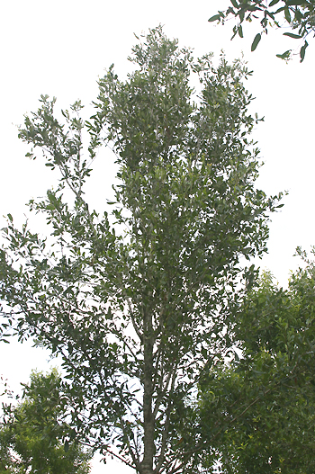
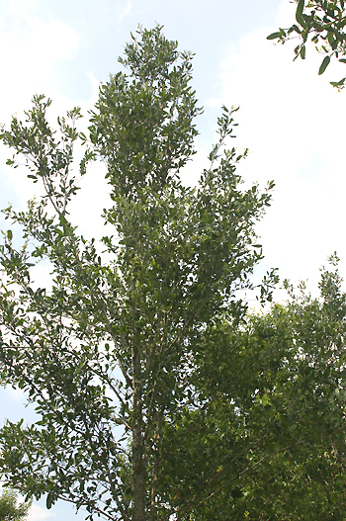
Impact of pruning dose on co-dominant stem growth
before
after 75% dose
Notes:
75% of the foliage on the right stem in the upper canopy (arrow) was removed. A small void is now noticeable in the canopy. Removing more foliage from a branch slows that pruned branch more.

Slide 29
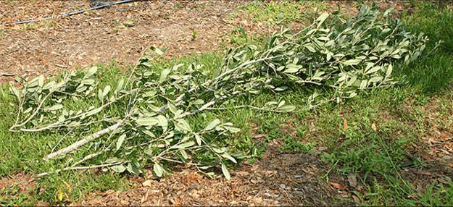
Impact of pruning dose on co-dominant stem growth
Foliage removed for 75% dose of that individual limb
Notes:
This shows the foliage removed from the right hand stem in the upper canopy on the tree in the last slide.

Slide 30
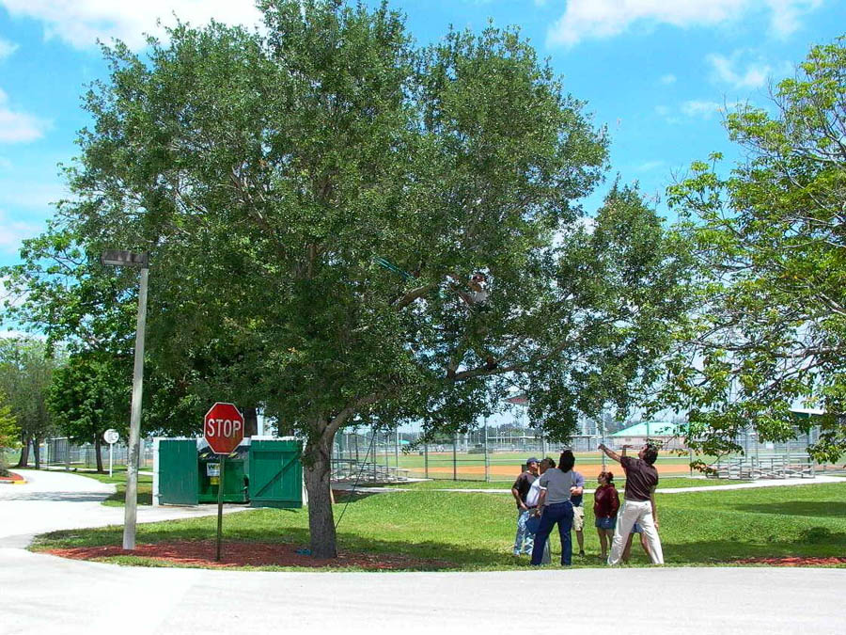
Notes:
This group of arborists are deciding how much to prune on this live oak.

Slide 31
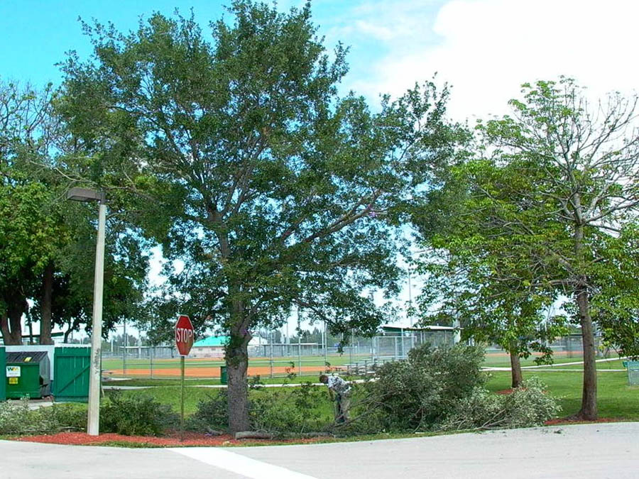
Notes:
They decided to remove about 25% of the foliage from throughout the tree. Notice that following pruning the main trunk is clearly visible (arrow), This is a good example of structural pruning which we will cover in detail later in this slide show. Trees pruned in this manner fair better in storms than trees that are lions-tailed, or those that are not pruned at all.

Slide 32
Maximum critical diameter: the largest diameter pruning cut you are willing to make on a certain species
This limit should be set for both removal and reduction cuts.
Should be smaller for decay-prone species.
Is controlled by the pruning cycle (longer cycles require larger cuts to accomplish goals)
Notes:
Larger pruning cuts are more likely to form pockets of decay than smaller cuts. You might want to set the maximum pruning cut smaller for more decay prone tree species. The longer the pruning cycle the larger the cut required to accomplish your goals. Ideally, limit pruning cuts to 2-4 inches on decay prone trees and 5-6 inches on decay resistant trees.

Slide 33
Branch size: - proportion relative to trunk - actual diameter of stem
Branch size | Consequences of Removal | Recommended Action
Less than 1/3 trunk diameter | Few consequences | Remove if needed
1/3 to ½ trunk diameter | Some trunk defects could result | Consider shortening instead
More than ½ trunk diameter | Defects likely | Shorten instead of removing
Large enough to have heartwood | Defects likely | Shorten instead of removing
Notes:
This is a general guideline from which to work. There will always be exceptions to these guidelines. As branch size increases to 12 inches or more branches are likely to contain heartwood in those trees capable of forming heartwood. Professional arborists keep records of when species begin forming heartwood. This should help them decide when low interfering branches should be removed from trees and not allowed to grow larger.

Slide 34
Preventive Pruning: young trees
Set objectives
Determine pruning cycle and dose
Execute pruning plan - make good cuts - prioritize trees with structural issues - temporary vs. permanent branch management

Slide 35
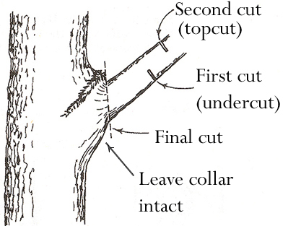
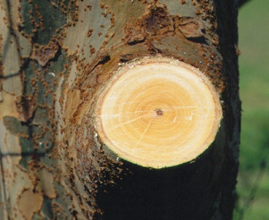
Make good pruning cuts
Step 1
Make an undercut about 12 inches from the trunk.
Step 2
Make a topcut farther out on the limb.
Step 3
Remove the stub with final cut, being careful not to cut flush against the trunk. Leave the collar intact.
Notes:
Most good pruning cuts leave a round-shaped wound, whereas flush cuts are oval-shaped.

Slide 36
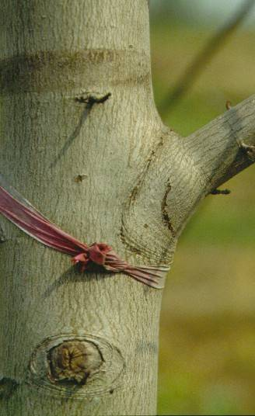
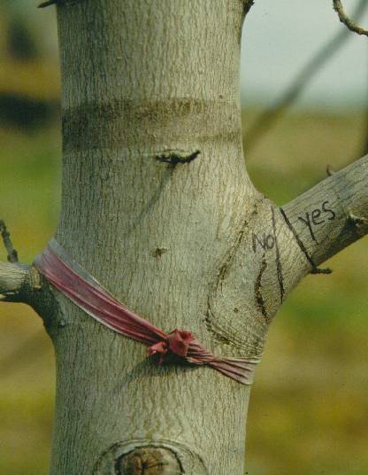
Branch bark ridge
Collar
Collar: swollen area at the base of the branch where it joins the trunk. The tissue is rich in energy reserves and chemicals that hinder the spread of decay. Good pruning cuts avoid cutting into the collar.
Notes:
The branch bark ridge is where trunk bark pushes up into the union as it grows against branch bark. This indicates a strong union. Never cut off the branch bark ridge since this removes the branch protection zone inside the collar. The protection zone helps retard decay organisms from entering the trunk. Cutting along the “yes” line represents an appropriate removal cut. Cutting through the “no” line cuts through the collar and represents a flush cut.

Slide 37
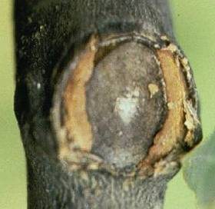
Bad cut- called a flush cut
Wound wood does not develop evenly.
Notes:
Flush cut removes the top of the branch bark ridge (look at the photo to see that it is gone) Flush cuts prevent the wound from sealing over properly. Flush cuts typically expose more bark on top of the cut than on the sides and bottom (see blue arrow). Flush cuts typically close first on the sides then on the top and bottom. Severe decay can occur behind flush cuts, especially when they are large in diameter.

Slide 38
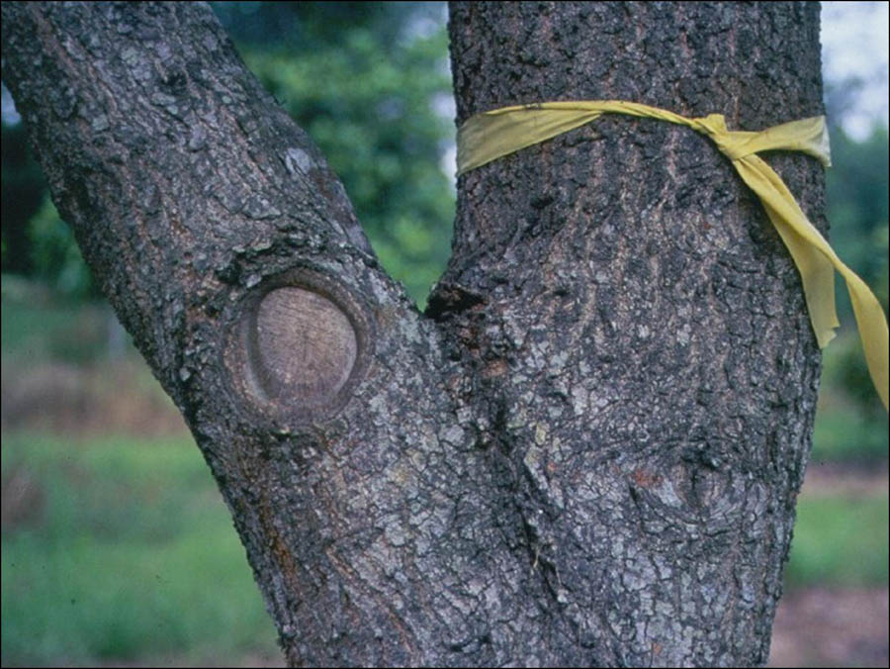
Reduction cut
Notes:
Reduction cut bissects the angle between an imaginary line (dotted line) drawn perpendicular to the stem to be removed (wrapped in yellow) and the branch bark ridge (dotted line)

Slide 39
Pruning strategies
Execution
Prioritize which trees to prune
Decide location of lowest permanent limb temporary branch management vs. permanent branch management
Notes:
Sell a pruning program, not an event

Slide 40
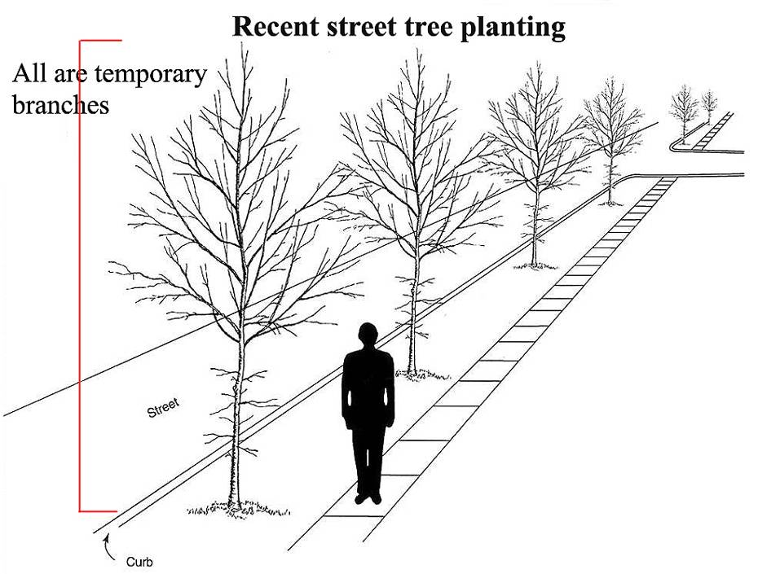
Temporary vs. permanent branch management
Notes:
All existing branches on these recently planted beautiful trees will eventually be removed to provide clearance for buses, garbage trucks, and tractor trailers. That means that you should execute your pruning program so that none grow larger than about half the trunk diameter. If these are let to grow with their tips high up into the canopy then they will become large, eventually drooping to get in the way of vehicles. At this point the branches are likely to be quite large. Removal will require creation of a large pruning wound. A better plan is to shorten them in a year or two from now so that the tree puts more growth into the leader and the branches that will develop in the next few years higher off the ground.

Slide 41
Pruning Plan: First 5 years
Most low branches are temporary.
Do not remove more than 35% of live foliage at a pruning visit.
Reduce all branches greater than ½ trunk diameter.
Reduce and/or remove all branches or stems competing with the one selected to be the leader.
Reduce and/or remove large, low vigorous branches.
Remove broken, cracked or severely damaged branches.
Notes:
Basically, the pruning plan for the first five years after planting will accomplish these objectives. The pruning cycle and dose will be determined individually for each tree type and size – for example, a pruning visit could be scheduled for year two and year four, or only one visit may be necessary during this period.

Slide 42
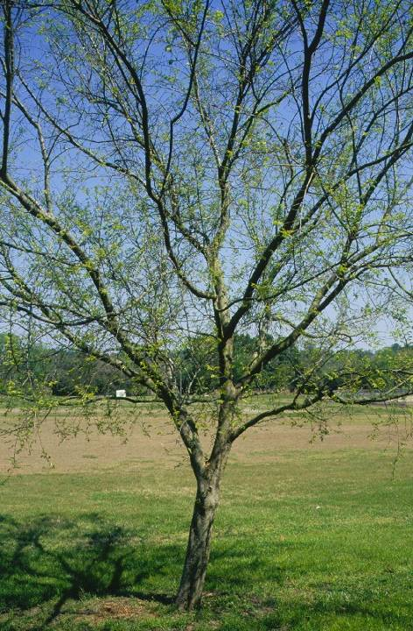
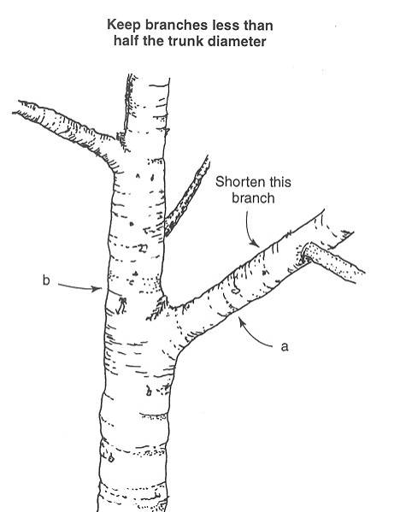
Reduce growth rate of low aggressive branches
Notes:
Reduce lower branches to push growth into the upper canopy and reduce growth rate on low aggressive limbs.

Slide 43
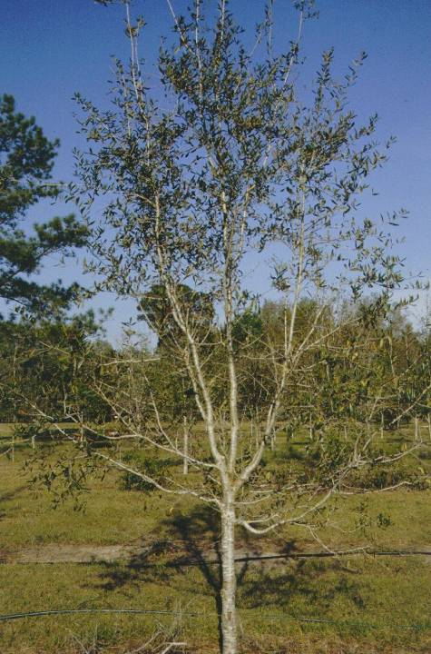
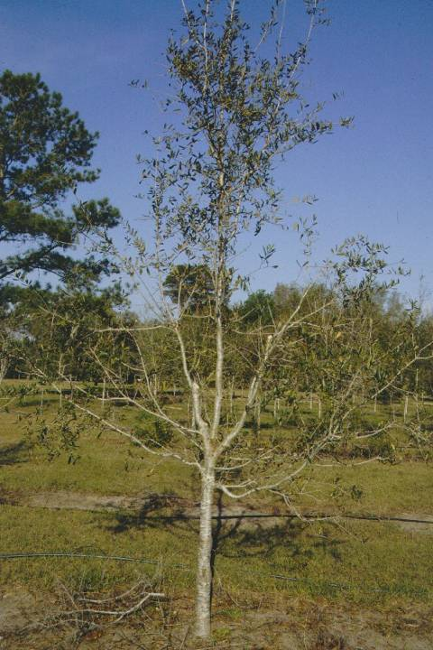
Before
After
Make reduction cuts here
Year two
Notes:
Shorten the two stems (arrows) that are competing with the main leader located in the center of the tree.

Slide 44
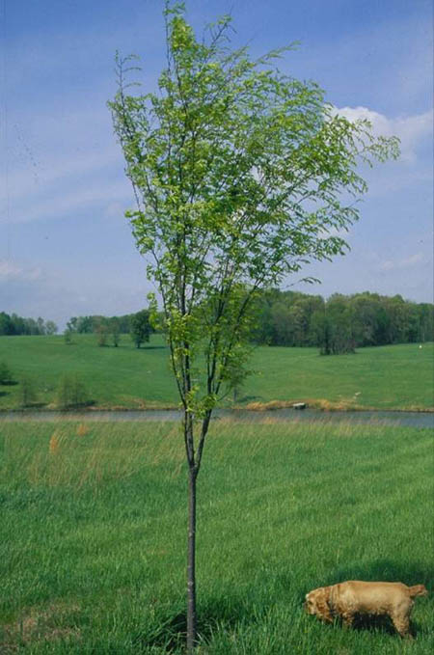
Before
After
Structural pruning is a three step process:
Identify the stem that will make the best leader.
Identify which stems are competing with this leader.
Decide where to shorten these competing stems.

Slide 45
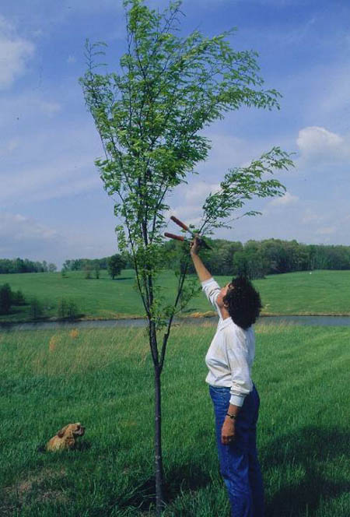
Before
After
Notes:
Certainly the stem on the lower right is competing with the leader. It was shortened by making a reduction cut back to a live lateral branch. This slows the growth rate on the reduced stem resulting in more growth in the leader.

Slide 46
Pruning Plan: 5 – 20 years
Do not remove more than 25-35% of live foliage.
Reduce all branches greater than ½ trunk diameter.
Identify lowest scaffold limbs of the permanent canopy and reduce all aggressive lower branches.
Reduce branches with included bark.
Reduce or remove competing leaders (if there are more than 3 competing leaders, this can be done in stages).
Reduce branches within 18’’ of largest limbs.
Notes:
Again, the pruning cycle will vary. At least 3 pruning visits should be made during this period. In the warmest parts on the US such as Florida, pruning cycles of three years are not uncommon.

Slide 47
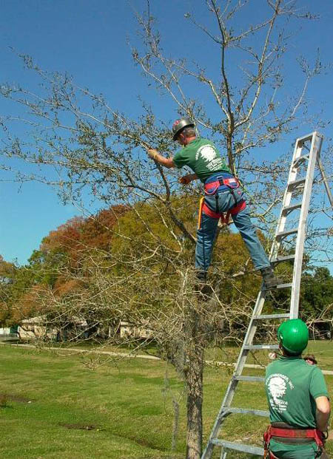
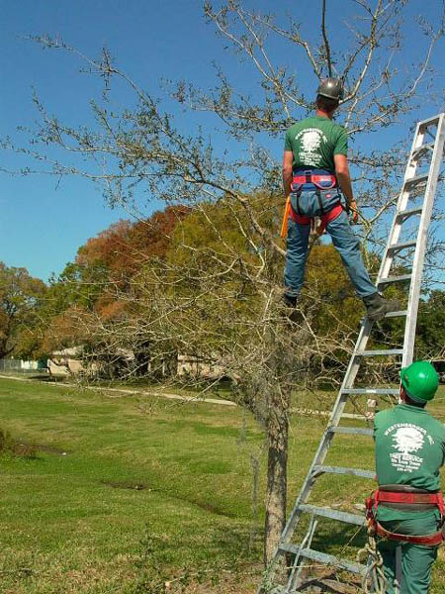
Before
After
Reduction cut here
Notes:
Making one reduction cut on the lower left stem slows its growth and allows the leader to grow faster. Pruning cut is shown at orange arrow.

Slide 48
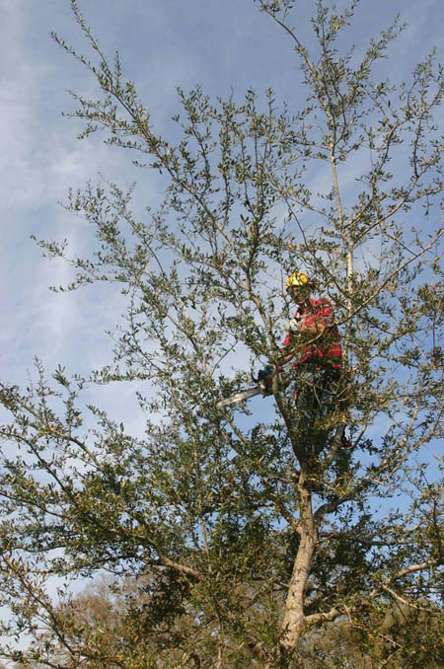
Two years later
Before
after
Notes:
Here is the same tree two years later.

Slide 49
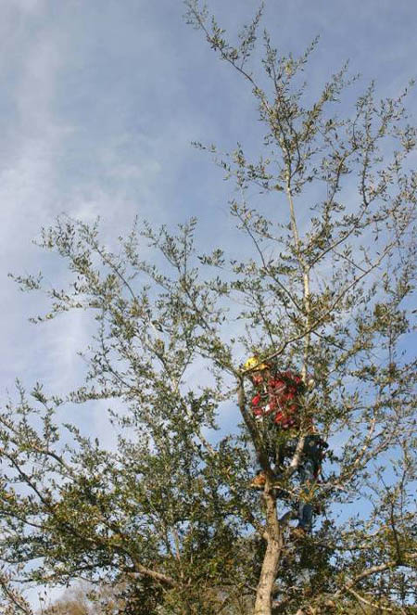
Before
After
Notes:
Again, the aggressive stem was reduced in length.

Slide 50
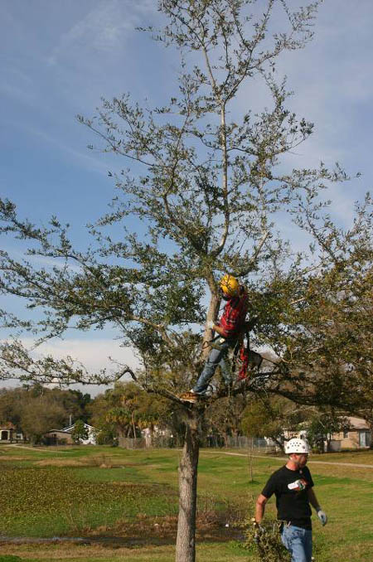
Dominant leader structure after two pruning visits
Notes:
The tree now has a good structure with one leader to the top of the tree. Lower branches (those where the arborist is now positioned in the tree) will be removed later as the tree gets larger. The tree will not miss the shortened, small low branches when the canopy is much larger five years from now. The tree has a high capacity to resist decay from these small pruning cuts on the lower trunk. This tree is on its way to develop a strong hurricane resistant form.

Slide 51
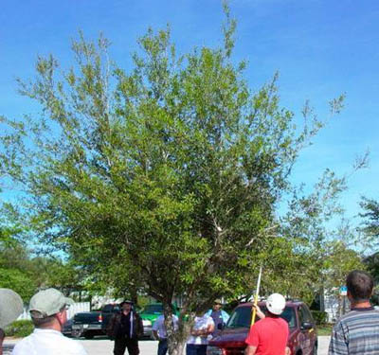
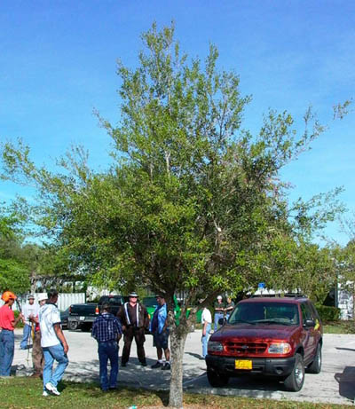
Before pruning
After pruning
Transforming a bush into a tree
Notes:
This laurel oak was a mess before pruning. Six or seven upright stems were removed during the pruning.

Slide 52
Two years later
Notes:
The tree has a better structure two years later. A main leader is beginning to emerge from this mess. Another pruning could be performed now to continue development of good structure. We are converting a bush into a tree.

Slide 53
Pruning Plan: 20 – 30 years
Identify 5 to 10 permanent scaffold limbs and reduce branches within 18-36’’ to avoid clustered branches.
Space permanent scaffold limbs to reduce wind resistance.
Remove many or all of the branches below the first permanent limb.
Reduce branches with included bark.
Reduce and/or remove competing leaders.
Notes:
With seven prunings in the first 25 to 30 years after planting, a good structure can be developed that can place the tree on the road to becoming a permanent fixture in the landscape. Less frequent pruning may be needed if good quality nursery trees were planted with a dominant leader, and trees were irrigated appropriately until established. But even well structured nursery trees will require regular pruning after planting.

Slide 54
Notes:
Here is an illustration summarizing the pruning program during the first 30 years or so after planting.

Slide 55
Reduce growth on branches below permanent canopy
Notes:
You can see that two years ago two branches were shortened (orange arrows) below the position of the lowest permanent limb (dashed line). Now, two close branches were removed from further up the tree (red arrows).

Slide 56
2 years later
After
Notes:
Two years later the tree has grown to a much larger size (left). Now, all branches below the lowest permanent limb were removed (right). This was the third time this tree was pruned. We shortened lower temporary branches years before we removed them.

Slide 57
before
after
Notes:
Before pruning there are several upright stems competing with the leader. After pruning, one leader is much more prominent.

Slide 58
Here is a tree that was damaged in a storm. As a result, many stems are growing upright
Notes:
Here is a tree that was damaged in a storm several years ago. There are six stems growing upright from the same location on the trunk. Ask the audience where they would make pruning cuts to encourage good structure. The next slide shows where to make the pruning cuts. The next series of slides shows that over 8 years we can restore this tree to a strong single leader habit by making strategic pruning cuts about every two years.

Slide 59
Remove two upright, interior stems
Notes:
See the two cuts on the left slide. One is easy to see, the other is just to the right mostly hidden.

Slide 60
After removing right codominant stem
Before
Notes:
Several years later, a close up (left) of the center of the canopy shows that two stems are very poorly connected with a severe bark inclusion (arrow). One must be removed now to prevent this tree from splitting apart. This is a common occurrence for trees damaged in storms and then never pruned. This results from many upright stems competing for the same space on the tree. The photo on the right shows this stem removed.

Slide 61
Before - year 8
After
Debris
Notes:
Here is the same tree four years later. Most folks will be shocked by this treatment! Note the pile of debris at the base of the tree on the right. There is clearly one stem at the top of the tree as all competing leaders were removed or shortened. Now show the next slide which is the same tree one year later.

Slide 62
Before - year 8
One year after pruning
After
Debris
Notes:
The tree has filled in the voids created by last year’s pruning and the tree is structurally sound. Now show the next slide which shows the tree the following spring.

Slide 63
One year after pruning
Before - year 8
18 months after pruning
Notes:
No one would ever suspect that this tree was pruned. This is a great example of how restoration pruning can help develop strong structure! All branches borne on the lower third of the trunk are temporary and will be removed so the tree has a clear trunk. This elm tree normally grows to 60-80 feet tall.

Slide 64
With dedication to a management plan, your community can become a model for others

