Slide 1
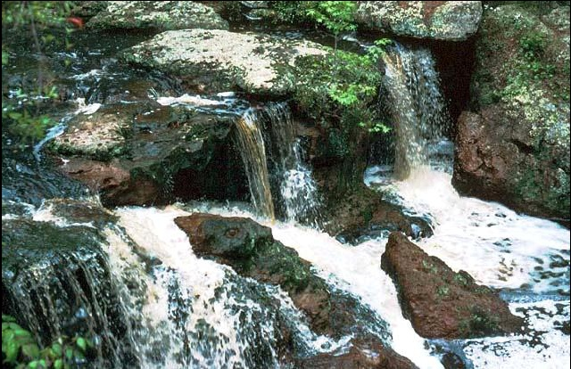

Developing a Smart Yard
Landscape In Alabama
Tony Glover, Cullman County Extension Coordinator

Slide 2
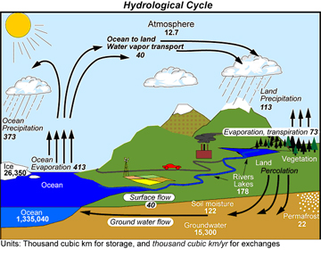
It All Starts With Water

Slide 3
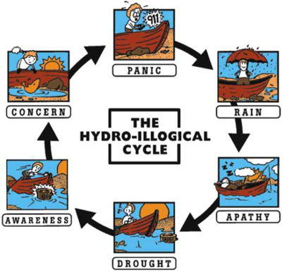
The Hydroillogical Cycle

Slide 4
Facts About Water
61% of our drinking water in the U.S. comes from surface water supplies (streams, lakes, rivers) while 39%
comes from groundwater (underground aquifers).
In Alabama, 60% of our drinking water comes from surface water, while 40% comes from ground water.
Alabama receives approximately 55 inches of rainfall each year, but, on average, only 6 inches move underground to become ground-water recharge.

Slide 5
Facts About Water
Since 1930, Alabama has experienced severe drought, on average, every 12 years. Each drought event lasts from one to seven years.

Slide 6
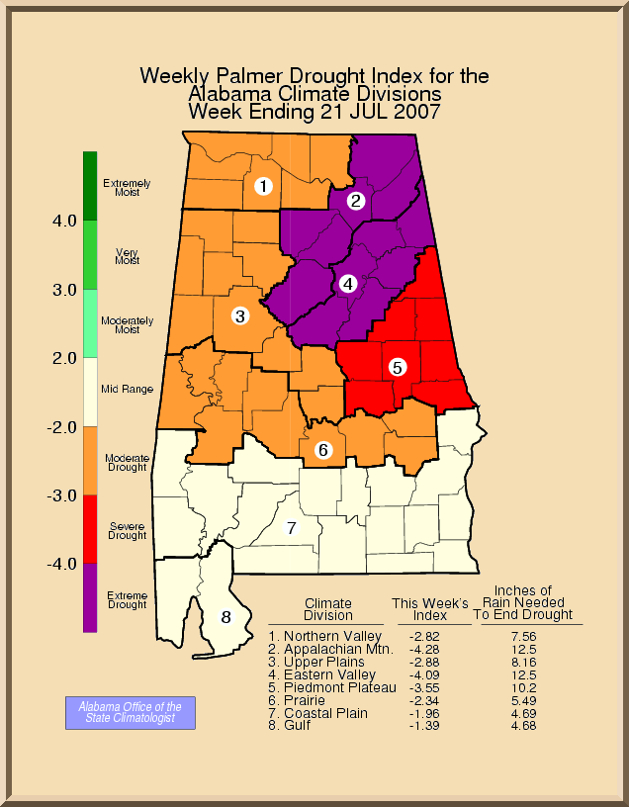
Alabama
2007

Slide 7
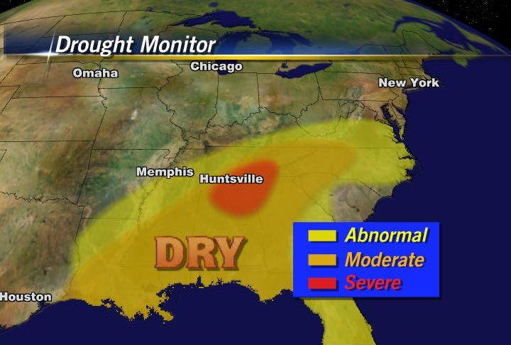
Dealing with Drought
as Alabama Gardeners

Slide 8
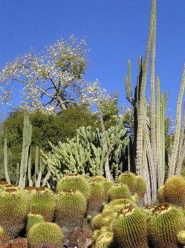
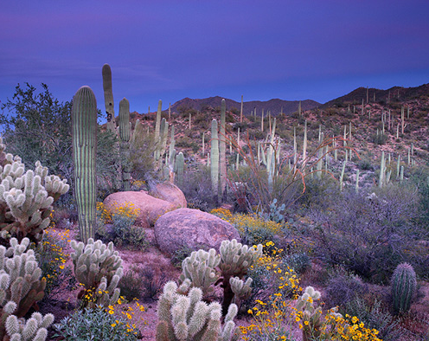
Xeriscape
Do the words
“water efficient landscape”
make you think of
cacti & sand?

Slide 9
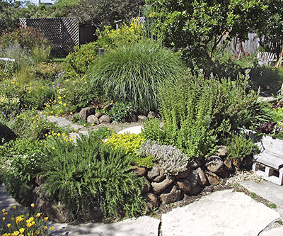
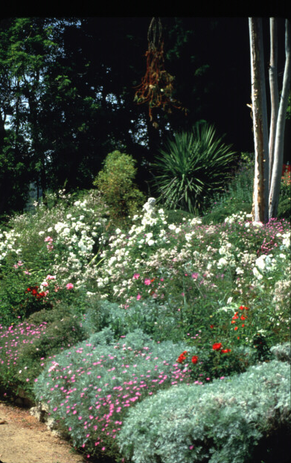
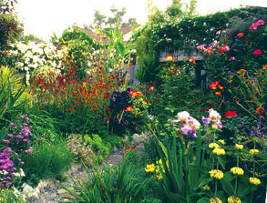
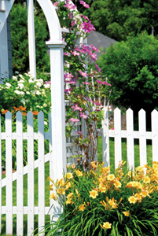
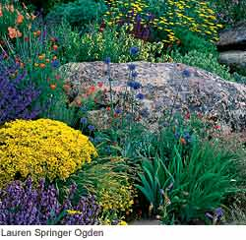
Think again!

Slide 10
Coined in Colorado
in 1981
From the Greek word
“Xeros”
meaning dry
Pronounced zir’ i-skap’

Slide 11
In our region Sustainable Landscaping is a more appropriate Term but we like to say smart Yard Landscaping
Xeriscape = Sustainable=Smart Yard

Slide 12
Seven Smart Yard Principles
Planning and Design
Soil Analysis
Appropriate Plant Selection
Practical Turf Areas
Efficient Irrigation
Use of Mulches
Appropriate Maintenance

Slide 13
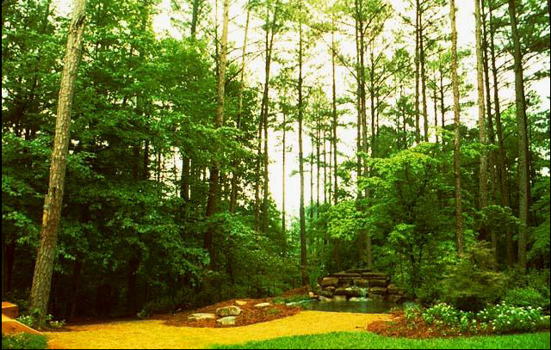
Planning and Design

Slide 14
Notes:
In the planning phase you want to consider all asthetic an environmental factors including wind, sun light, noise, etc.

Slide 15
Divide the Landscape into
Water-use Zone
High Water-use Zone
(Oasis Zone)
2) Moderate Water-use Zone
(Transition Zone)
3) Low Water-use Zone
(Xeric Zone)
Note: Turf is the #1 water hog and irrigation is mostly unnecessary
Notes:
Zoning plants by water use is a practical way to reduce overall water needs and is a good horticultural practice for overall plant health. Three zones is an arbitrary number of zones but is fairly practical in most landscapes.

Slide 16
High Water-use Zone
(Oasis Zone)
Small “high impact” or high visibility
area of the landscape where plants
are provided their optimum water
requirement at all time
Entrance Areas – Flowers or high water need plants
Notes:
Think of these areas as the most highly visible or frequently used areas within the landscape. Container plants or a small annual flowerbed are examples. Turf areas are high water use and often are too large for efficient water use. Reducing these areas to a minimum is the main objective of these principles. These areas may be an an automated or regular water schedule.

Slide 17
Moderate Water-use Zone
(Transitional Zone)
Plants are watered during
establishment. Then, once established,
they are watered only when they show
signs of water stress.
Azaleas, dogwoods, redbuds,
herbaceous perennials
Notes:
For the most part these areas should be considered transitional from high to moderate water use as they become established. This area will include plants that do quite well w/out supplemental water once established except under extreme or prolonged droughts. They are best served by deep infrequent irrigation only as needed and not on a regular schedule.

Slide 18
Low Water-use Zone
(Xeric Zone)
Once established, plants are provided
no supplemental irrigation, except
during periods of extreme drought
Juniper
Crape Myrtle
Yaupon Holly
Oaks
Natural Areas
Notes:
These areas are made up of plants that withstand long periods of drought and will likely never need supplemental irrigation (except under poor general health or especially extreme conditions).

Slide 19
10% of the landscape is irrigated regularly
30% of the landscape is irrigated on demand
60% of the landscape is not irrigated
Notes:
Ideally a well designed landscape would have high water use areas making up 10% or less of the total area. The rest of the landscape would be watered infrequently or not at all.

Slide 20
One Goal of a Smart Yard Landscape
Reduce and minimize the
size of the area irrigated
and the frequency of
irrigation
Xeric
Xeric
Transition
Oasis
Transition
But I use lake water why should I worry?
Notes:
We need to change our mindset about the indiscriminate and overuse of water and realize that water is a commodity just like any other and the supply is not increasing but the demand is. Market forces are in effect and prices will continue to rise.

Slide 21
Typical Landscape: Water-Use Areas
80% High 5% Mod 15% Low

Slide 22
Year 2 or 3: Water-use Areas
*
Low
*
*
*1st yr. Junipers, Daffodils & Jasmine
5% High 65% Mod 30% Low

Slide 23
Year 2 or 3
This is what was done
Another option
Use hybrid bermuda to border sidewalk & driveway.
Plant low growing shrubs between pinestraw & liriope beds.
Add Asiatic jasmine between existing beds for color at street.
Plant daffodil bulbs among jasmine for spring interest.
Remove high water-use annuals from front bed. Add container at entrance. Change out with annuals for seasonal color.
Use hardwood mulch on remaining portion of side bed.

Slide 24
Year 3-5: Water-use Areas
5%
20%
75%
High
Mod.
Low

Slide 25
Seven Smart Yard Principles
1.Planning and Design
2. Soil Analysis
3. Appropriate Plant Selection
4. Practical Turf Areas
5.Efficient Irrigation
6. Use of Mulches
7. Appropriate Maintenance

Slide 26
Don’t guess….soil test!
Soil Analysis

Slide 27
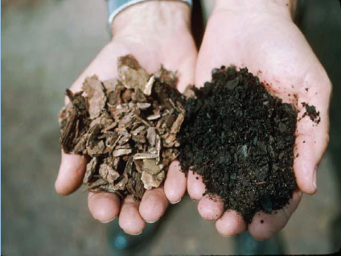
Use only decomposed organic material (right)
as a soil amendment

Slide 28
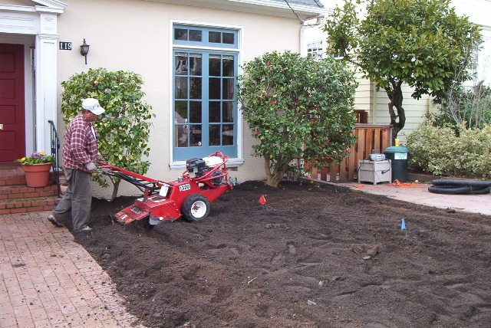
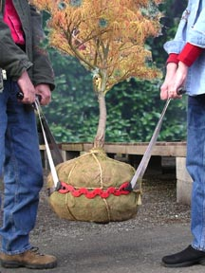
Never add organic material to individual planting holes
Incorporate organic material uniformly in the top 12 in.

Slide 29
How Much Amendment?
25% by Volume
3 inches incorporated to a 12 – inch depth
1 cu. yd. / 100 sq. ft. = 3 in. on soil surface
1 cu. yd. = 27 cu. ft. = Nine 3 cu. ft. bags

Slide 30
Seven Smart Yard Principles
Planning and Design
Soil Analysis
Appropriate Plant Selection
Practical Turf Areas
Efficient Irrigation
Use of Mulches
Appropriate Maintenance

Slide 31
Appropriate Plant Selection
Select Plants Adapted to the Site and
the Stresses of the Environment
Drought tolerance is important, but
also consider potential insect and
disease problems, sunlight and soil
requirements.

Slide 32
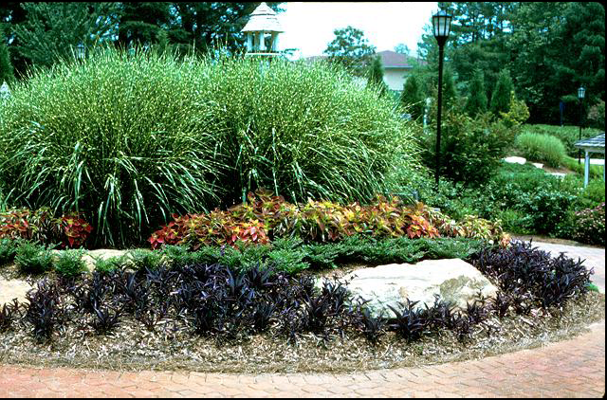
Sun
Zebra Grass
Sun Coleus
Mexican Heather
Purple Passion

Slide 33
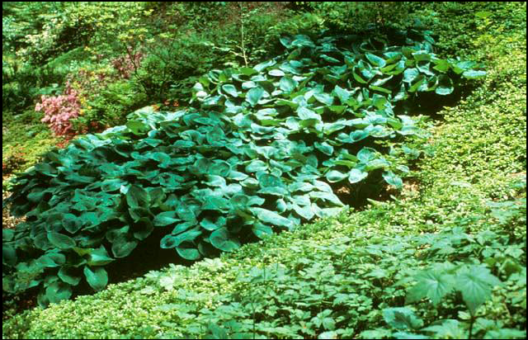
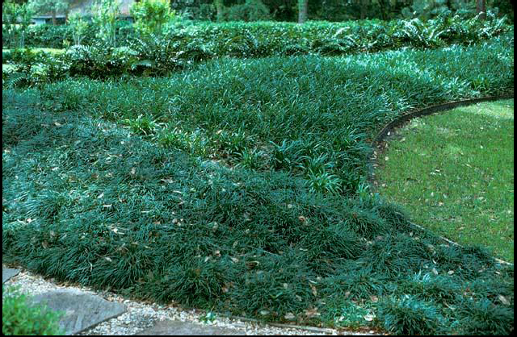
Azalea
Shade
Hosta
Pachysandra
Liriope
Mondograss

Slide 34
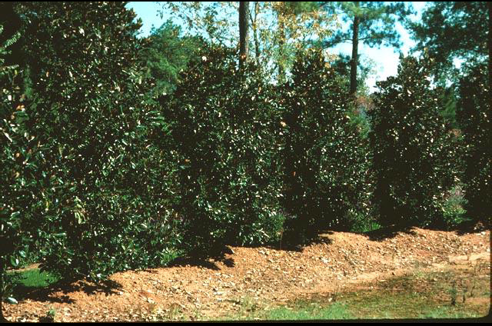
Trees
Chinese Pistache
Willow Oak
Japanese Zelkova
Hollies
Chastetree
(V itex agnus-castus)
Baldcypress
Sourwood
Silverbell
Crape Myrtle
Trident Maple
Little Gem Magnolia
(M agnolia grandiflora ‘Little Gem’)

Slide 35
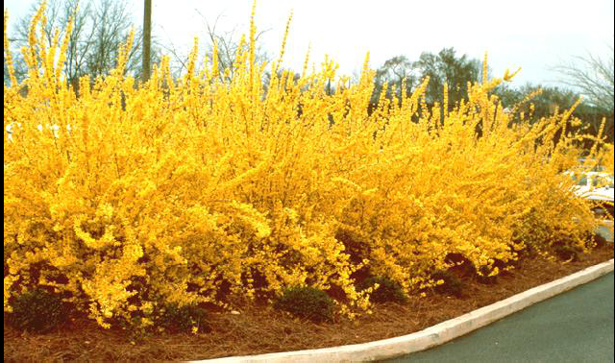
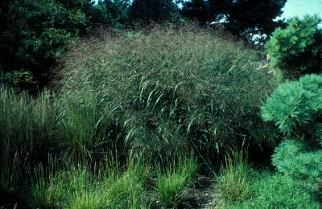
Shrubs
&
Ornamental Grasses
Forsythia
(Forsythia intermedia)
Aucuba
Barberry
Chinese Holly
Spirea
Virginia Sweetspire
Dwarf Yaupon Holly
Ornamental Switch Grass

Slide 36
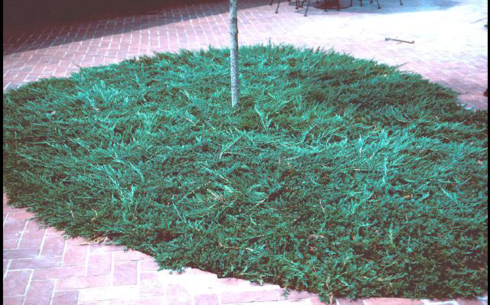
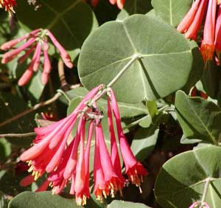
Ground Covers
&
Vines
Blue Rug Juniper
(Juniperus horizontalis ‘Blue Rug’)
Honeysuckle
(Native Lonicera)
Asiatic Jasmine
St. John’s Wort
Trumpet Honeysuckle
Carolina Jessamine

Slide 37
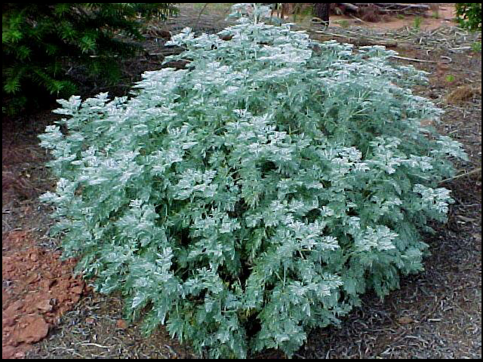
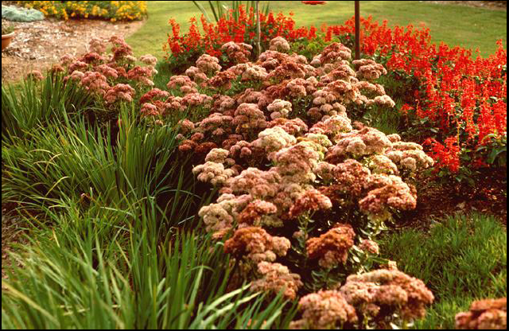
Herbaceous Perennials
Wormwood
(Artemisia “Powis Castle”)
Red Hot Poker
Rosemary
Aster
Gaura
Butterfly Weed
Daylilly
Sedum
‘Autumn Joy’

Slide 38
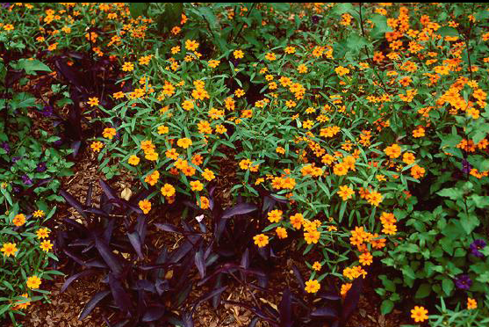
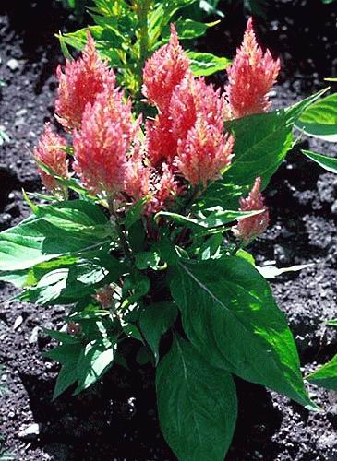
Annuals
Creeping Zinnis
(Zinnia linearis)
Ornamental Pepper
Verbena
Annual Periwinkle
Dusty Miller
Gazania
Portulaca (RoseMoss)
Celosia cristata

Slide 39
Seven Smart Yard Principles
Planning and Design
Soil Analysis
Appropriate Plant Selection
Practical Turf Areas
Efficient Irrigation
Use of Mulches
Appropriate Maintenance

Slide 40
Use Turfgrass for a Purpose
Aesthetic Value
Recreational Surface
Erosion Control
Minimize the amount of
irrigated turfgrass

Slide 41
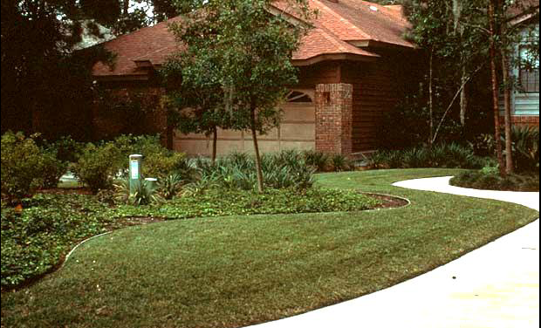
Practical Turf Areas
Design turf in practical shapes that can be efficiently irrigated and maintained.
Avoid sharp angles and long narrow strips that are difficult to mow and water.

Slide 42
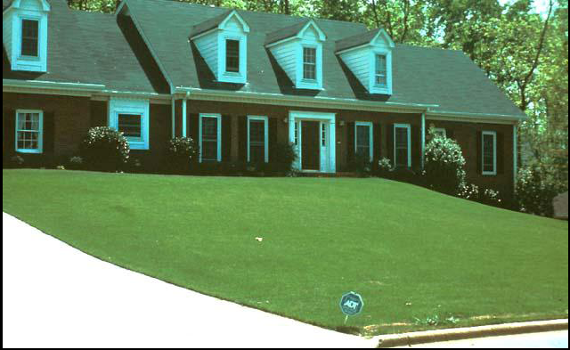
Practical Turf Areas
Avoid using irrigated turfgrass just to fill space.

Slide 43
Practical Turf Areas
Drought
Tolerance Water-use
*Hybrid Bermuda
Raleigh St. Augustine
*Zoysia
Centipede
Fescue
Very High Very Low
Very High Very Low
High Medium
Med.-High Low
Low-med. Low-High

Slide 44
Seven Smart Yard Principles
Planning and Design
Soil Analysis
Appropriate Plant Selection
Practical Turf Areas
Efficient Irrigation
Use of Mulches
Appropriate Maintenance

Slide 45
Efficient Irrigation
Don’t water during mid-day heat

Slide 46
Efficient Irrigation
A smart yard landscape requires a minimal amount
of supplemental water from irrigation.
When irrigation is used, water is applied efficiently
and effectively to make every drop count.
Just as we zone plants in the landscape according to
their different water needs, zone the irrigation
system so that plants with different water needs are
irrigated separately.

Slide 47
Efficient Irrigation
Irrigation systems with rain sensors
prevent auto-watering during rain

Slide 48
Efficient Irrigation
A low cost rainfall sensor will prevent the irrigation system from running during rain

Slide 49
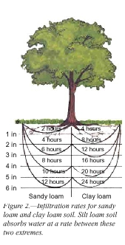
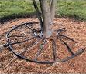

Efficient Irrigation
Use drip or trickle irrigation
Puts water at the roots, where it is needed
Decreases water waste and disease

Slide 50
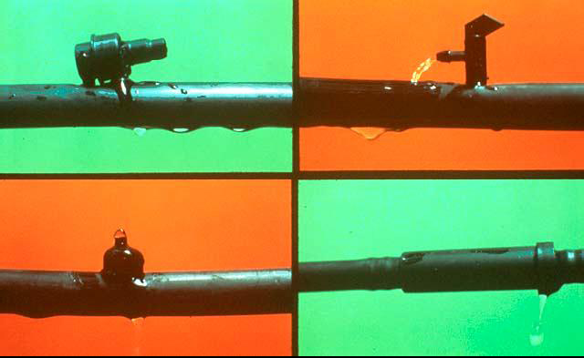
Efficient Irrigation
Drip Irrigation uses 30% to 50% less water than
sprinkler irrigation
Avoids spraying
foliage so diseases
are less likely to
occur
Eliminates spray
drift
Requires watering to only 25% of the root area

Slide 51
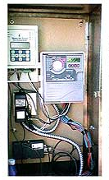
Efficient Irrigation
Weather-based systems can even adjust the irrigation schedule based on local weather
Weather
Based
Wireless
Monitor
Existing
Controller
Wireless
Modem
Hidden
Antenna

Slide 52
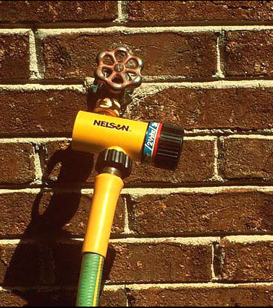
Efficient Irrigation
Special timers for soaker hoses run for 5 minutes, then off for 10 minutes allowing water to soak down into the intended area & avoiding runoff.

Slide 53
Efficient Irrigation
Target irrigation to plants that show signs of stress
    Gray/green Color
    Wilting
    Dying Branches
Use a handheld hose with water breaker
or sprinkler can to target irrigation to
plants that need water

Slide 54

Efficient Irrigation
Avoid water run-off to decrease
nutrient and/or chemical
movement, wasting H₂0 & costing $$$
Watering deeply (once established)but less
frequently encourages deep-rooting
Avoid frequent, brief, shallow watering(after
establishment); creates shallow roots &
drought intolerance. However during establishment frequent shallow watering is needed.

Slide 55
Seven Smart Yard Principles
Planning and Design
Soil Analysis
Appropriate Plant Selection
Practical Turf Areas
Efficient Irrigation
Use of Mulches
Appropriate Maintenance

Slide 56
Use of Mulches
The best mulches are organic, fine-textured & non-matting

Slide 57
Benefits of Mulches
Prevents evaporative water loss from the soil
Prevents soil borne diseases
Insulates the roots of plants from extreme heat and cold
Reduces weed competition

Slide 58
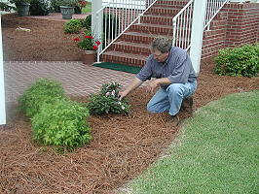
How to Mulch
9 - 3 cu. ft. bags or
13 – 2 cu. ft. bark mulch
covers ~ 100 sq. ft.
Use a 2 – 3 inch layer
Mulch as much area as possible
Don’t pile around the base of trees or shrubs
1 bale of pine straw
covers ~ 50 sq. ft.

Slide 59
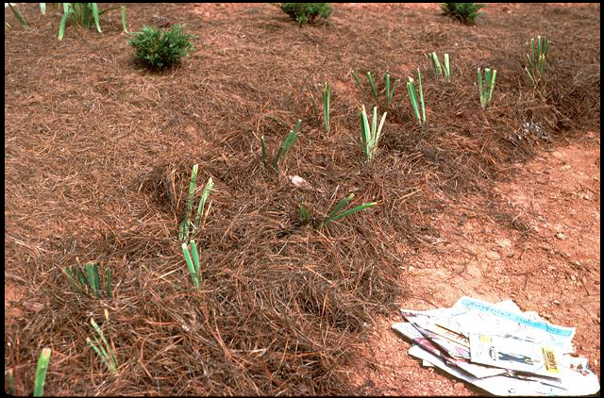
How to Mulch
Newspaper under organic mulch, 2 to 3 sheets thick, provides an extra barrier against moisture loss.
Mulching is especially important to shallow rooted ornamentals like azaleas & dogwoods

Slide 60
How to Mulch
may use landscape fabrics to help prevent weeds but be aware of potential problems

Slide 61
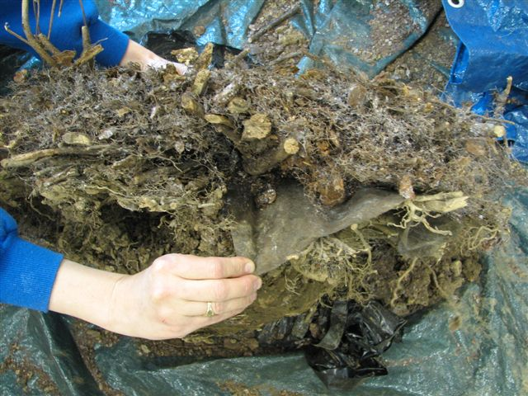
Landscape Fabric After 10 Years
Homeowner continued to add mulch year after year over the fabric – roots grew primarily in the mulch – drought of 2007 killed all of the plants

Slide 62
Seven Smart Yard Principles
Planning and Design
Soil Analysis
Appropriate Plant Selection
Practical Turf Areas
Efficient Irrigation
Use of Mulches
Appropriate Maintenance

Slide 63
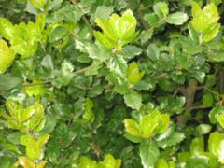
Appropriate Maintenance
Avoid Frequent Flushes of
Vegetative Growth Brought on by:
ExcessFertilization
Improper Pruning
Excess Irrigation

Slide 64
Appropriate Maintenance
Target fertilization to plants that need it.
Established trees and shrubs may not need
to be fertilized annually.
Use slow release forms of nitrogen (Ureaformaldehyde, IBDU, Sulfurcoated urea)
Use low rates of fertilizer
Limit fertilization during dry periods

Slide 65
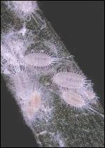
Appropriate Maintenance
Too much nitrogen from overfertilizing
Increases pest problems
Increases top growth
Reduces root growth
Increases pruning requirements
Increases runoff into groundwater

Slide 66
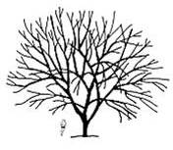
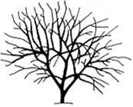
Appropriate Maintenance
Before pruning
After pruning
Prune by selective thinning instead of shearing or topping/heading

Slide 67
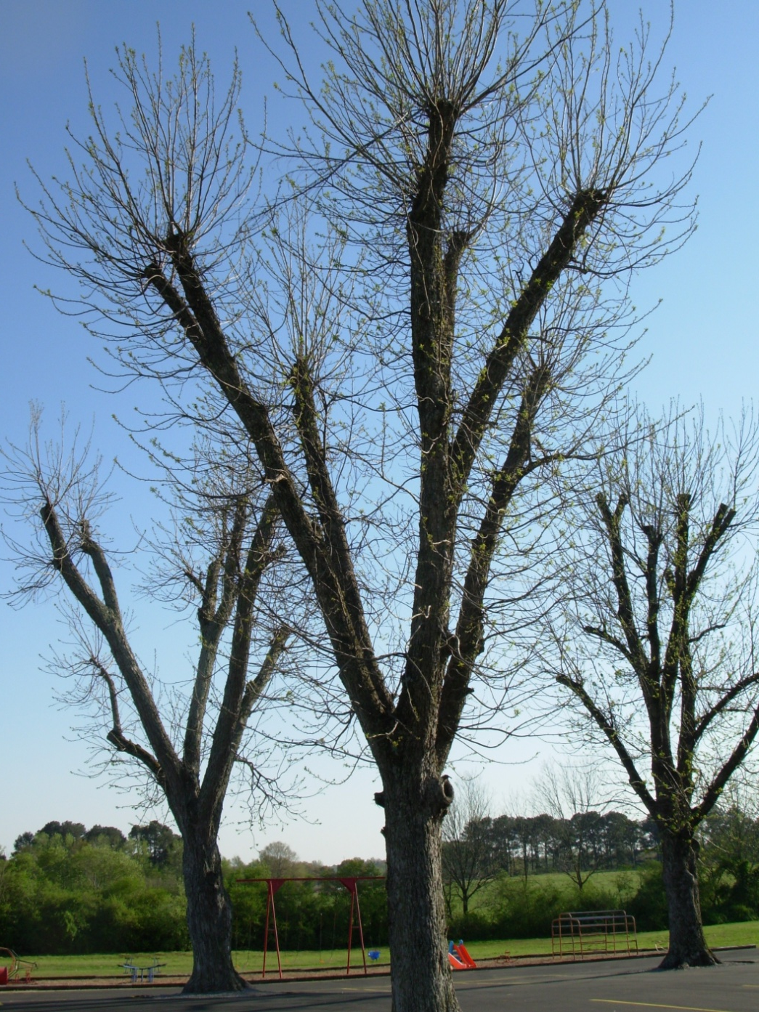
Topping trees
This is always a bad and harmful practice not to mention that it destroys the appearance

Slide 68
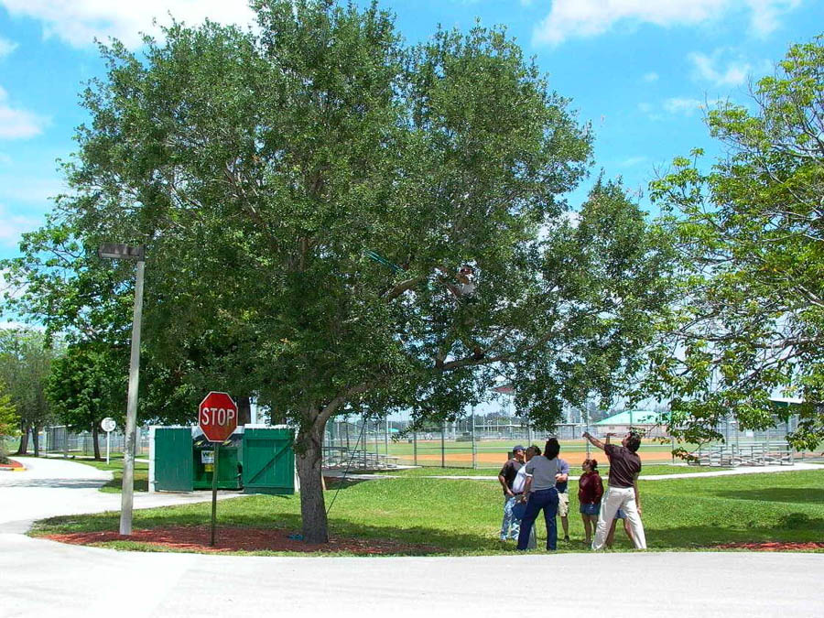
Notes:
This group of arborists are deciding how much to prune on this live oak.

Slide 69
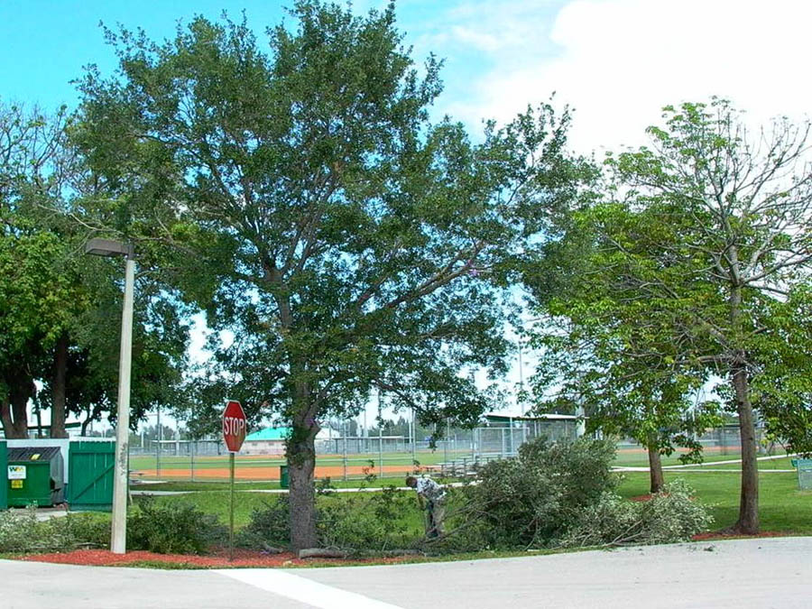
Notes:
They decided to remove about 25% of the foliage from throughout the tree. Notice that following pruning the main trunk is clearly visible (arrow), This is a good example of structural pruning which we will cover in detail later in this slide show. Trees pruned in this manner fair better in storms than trees that are lions-tailed, or those that are not pruned at all.

Slide 70
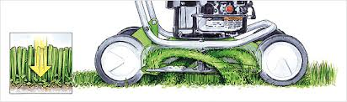
Appropriate Maintenance
Grass clippings…
hold moisture
&
recycle nitrogen back into the soil
Grass clippings do not cause thatch!!
So, let the clips fall
where they may
By using a
mulching mower!

Slide 71
Review: Seven Steps of a Smart Yard Landscape
Planning and Design
Soil Analysis
Appropriate Plant Selection
Practical Turf Areas
Efficient Irrigation
Use of Mulches
Appropriate Maintenance

Slide 72
Remember…
Plants Don’t Save Water… People Do

Slide 73

Questions

